Slide 1
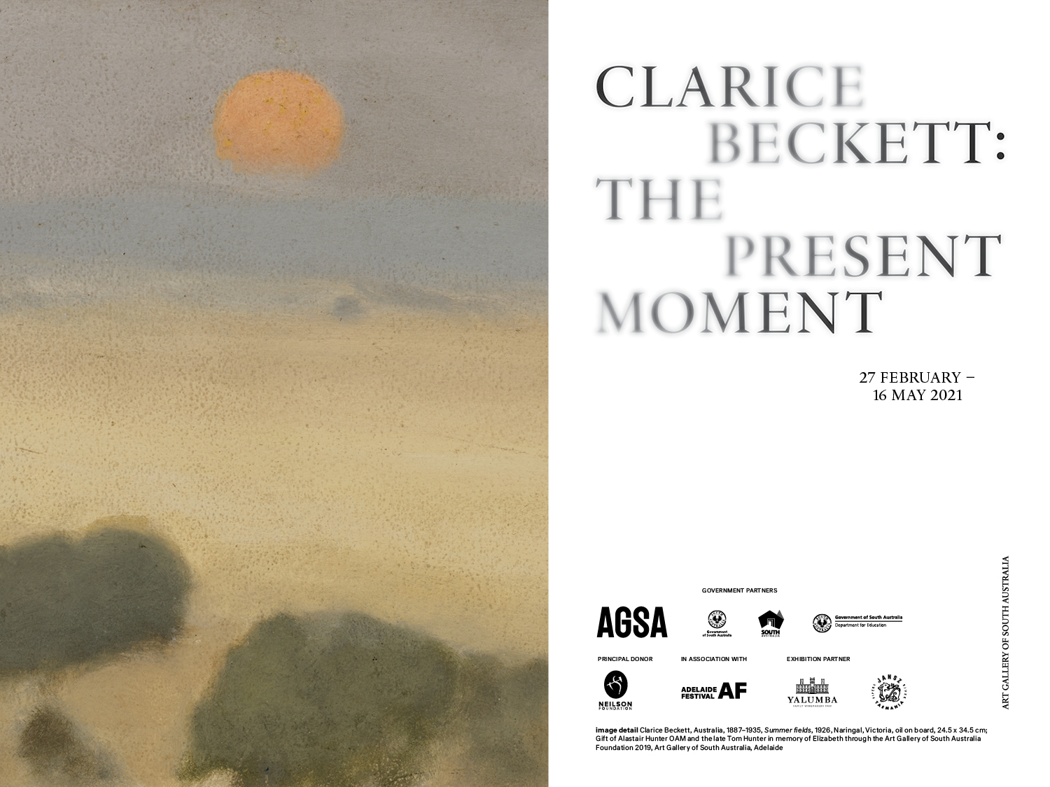

Slide 2
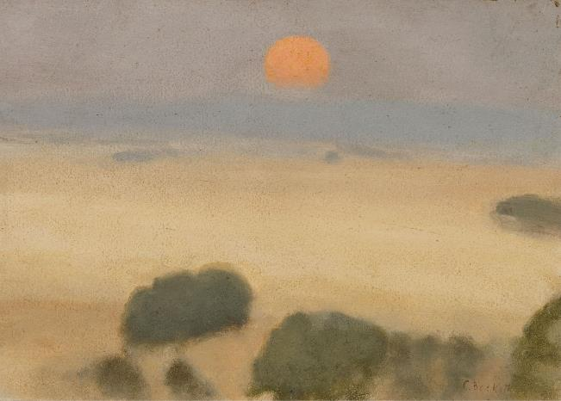
Explore the sensory impressions of Beckett's everyday world
This education resource introduces you to the work of Clarice Beckett. It can be used as a starting point in the classroom for students to learn about Modernism, the sensory experience of art, the role of the curator and the mechanics of building a picture. It is also the ideal companion to your Gallery visit.
The 130 paintings in The present moment are thematically displayed around shifts in time that chart one single day. The exhibition will take you and your students on a sensory journey from the first breath of sunrise, through to the hush of sunset and finally, a return into the enveloping mists of nightfall.
The making and responding suggestions in this resource are linked to the overarching themes within Beckett's work and provide ideas that relate to the world of your students whilst they learn about Australian art history. Through this, students are invited to explore, discuss and compare Beckett's work with other artists they encounter in the Gallery's collection.
Clarice Beckett, Australia, 1887 - 1935, Summer fields, 1926, Naringal, Victoria, oil on board, 24.5 x 34.5 cm; Gift of Alastair Hunter OAM and the late Tom Hunter in memory of Elizabeth through the Art Gallery of South Australia Foundation 2019, Art Gallery of South Australia, Adelaide, photo: Saul Steed.

Slide 3
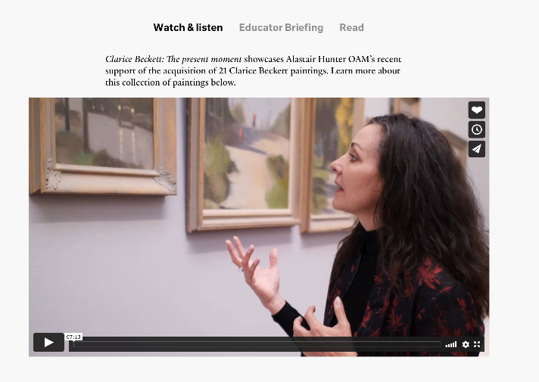
Resources
Visit the website for the following resources:
Recorded teacher briefing (available from 3 March 2021)
Curator talk by Tracey Lock
‘Race to find missing pieces of artistic jigsaw’, The Australian
The Gallery’s Learning programs are supported by the Department for Education.
Art Gallery of South Australia staff Tracey Lock, Kylie Neagle, Thomas Readett and Dr. Lisa Slade contributed to the development of this resource.
AGSA Kaurna yartangka yuwanthi.
AGSA stands on Kaurna land.

Slide 4
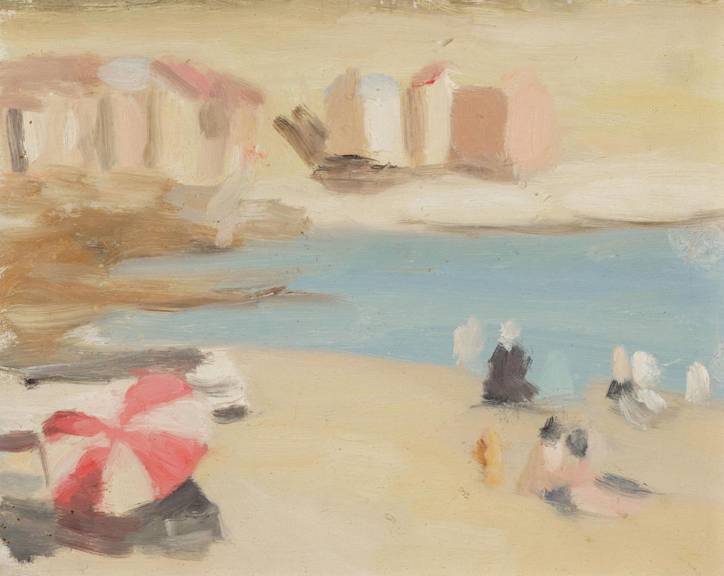
Introduction to Clarice Beckett
Learn more about one of Australia’s most important painters of the interwar period

Slide 5
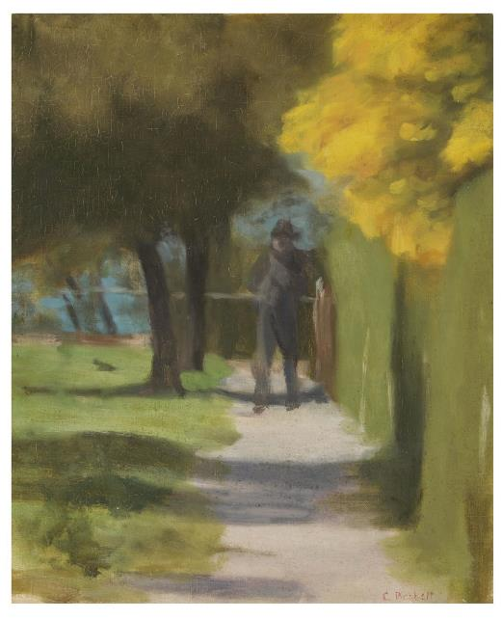
Introduction to Clarice Beckett
Learn more about one of Australia’s most important painters of the interwar period
Clarice Beckett was born in 1887 in Casterton in regional Victoria. Today she is recognised as one of Australia’s most important painters of the interwar period, yet her contribution was almost completely lost to art history. Many of Beckett’s paintings were either destroyed or damaged after her premature death in 1935 from pneumonia which she contracted while painting in the rain near her seaside home at Beaumaris, Melbourne.
In 1914 Beckett enrolled at the National Gallery School in Melbourne where she studied drawing for three years under the tuition of Australian artist Frederick McCubbin. Beckett declined a fourth year of study in oils under Bernard Hall and instead joined controversial tonalist painter and teacher Max Meldrum in his newly opened private art school. In 1919 she moved from Bendigo with her parents to Beaumaris which is located in Bayside Melbourne, where she lived and painted for the rest of her life. She enjoyed painting at all times of the day, however towards the end of her life, as she cared for her elderly mother, she predominantly painted in the early mornings and evenings. Beckett also developed a strong interest in music and literature.
Clarice Beckett, Australia, 1887 - 1935, October morning, c.1927, Melbourne, oil on canvas on board, 54.7 x 44.4 cm; Gift of Alastair Hunter OAM and the late Tom Hunter in memory of Elizabeth through the Art Gallery of South Australia Foundation 2019, Art Gallery of South Australia, Adelaide, photo: Saul Steed.

Slide 6

Introduction to Clarice Beckett
Learn more about one of Australia’s most important painters of the interwar period
Beckett depicted everyday views of her local environment including transient subjects such as moving cars, trams, lone figures, waves and shadows. Her misty paintings of modern Melbourne in the 1920s and 1930s captured the outdoors, including sea and beachscapes, and suburban street scenes, that often recorded the shifting effects of light– either in the quiet, early morning or in the stillness of the evening.
Her paintings of the local environment possess a sense of timelessness. No prior knowledge is required to appreciate Beckett’s paintings. Anyone who has engaged with the outside world can relate to and experience a connection to these subtle and silent paintings of nature.
Clarice Beckett, Australia, 1887 - 1935, Bathing boxes, Brighton, 1933, Brighton, Melbourne, oil on board, 17.5 x 22.0 cm; Gift of Alastair Hunter OAM and the late Tom Hunter in memory of Elizabeth through the Art Gallery of South Australia Foundation 2019, Art Gallery of South Australia, Adelaide, photo: Saul Steed.

Slide 7
‘To give a sincere and truthful representation of a portion of the beauty of Nature, and to show the charm of light and shade, which I try to give forth in correct tones so as to give as nearly as possible an exact illusion of reality’
Clarice Beckett

Slide 8
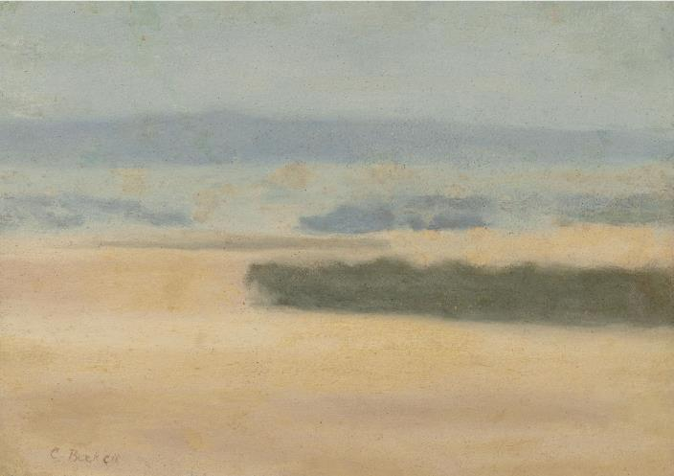
Introduction to Clarice Beckett
Learn more about one of Australia’s most important painters of the interwar period
Beckett exhibited her work for sixteen years, including in solo exhibitions every year between 1923 and 1933 at the Athenaeum Gallery in Melbourne. She also exhibited in group shows and was invited to join the Twenty Melbourne Painters, a group of break-away artists who were supporters or students of Meldrum. Her perceived alignment with the polarising figure of Meldrum saw her publicly ridiculed, and this, together with the modest and less heroic nature of her landscapes, resulted in limited critical attention during her lifetime. The critic Bruce James observed, her paintings, ‘are little evocations that build like musical phrases towards a greater and more compelling whole. That’s why groups of Becketts can be so thunderous’ - ‘Universal vision in dull suburbia’, The Age, 22 March, 1955
Clarice Beckett, Australia, 1887 - 1935, The plains, 1926, Naringal, Victoria, oil on board, 25.8 x 35.3 cm; Gift of Alastair Hunter OAM and the late Tom Hunter in memory of Elizabeth through the Art Gallery of South Australia Foundation 2019, Art Gallery of South Australia, Adelaide, photo: Saul Steed.

Slide 9
What is tonalism?
Tonalism is a painting system without any preliminary drawing of a subject where artists record tonal impressions quickly onto a canvas with oil paints. This is done in the order that the impressions met the eye, often reducing a scene to large areas of light and dark. This is based on Max Meldrum’s theory that the mind can be trained to receive visual impressions in varying orders of importance, with the most significant being the majority tonal value. This is the first value that should be directly painted onto the canvas. The painting is then built up through recording these initial impressions.
The aim of tonalism is to create an illusion of nature, one that responds to the environment in an immediate way. It is an objective study of nature, with artists using a radically reduced colour palette and feathering brushwork. The method requires artists to use only five tones which are applied with a round brush and a generous amount of paint to ensure the transition between tones is seamless.
The systematic nature of Australian school of tonalism means that an identifiable soft impressionist style was created by Meldrum and his followers. At times this made it difficult to distinguish the work of different artists. Beckett’s work stands apart from other Meldrum Group artists (Meldrumites), who applied Meldrum’s Tonalism. Beckett’s work captured extraordinary spatial recession and smooth, velvet painted surfaces and were almost much brighter in colour. She was the finest colourist of the Meldrum Group and the first to develop signature motifs, such as the telegraph pole, roof tops and the motor car.

Slide 10
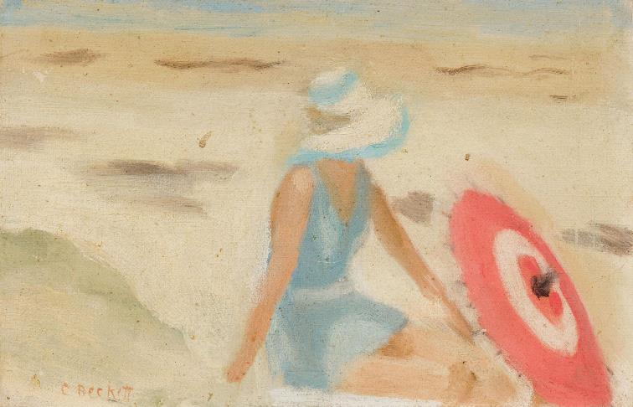
Getting started
Who was Clarice Beckett? Write a short biography describing Beckett. Use her paintings to build her profile.
What is distinctive about Beckett’s paintings? Consider subject matter, style and technique. Identify three characteristics that define Beckett’s work. Share your findings with the class.
What do you find to be strange about Beckett’s paintings and what do you find familiar?
Select two works of art which were painted at different times of the day. What visual qualities suggest the time of day?
Beckett’s paintings are quiet and capture a sense of stillness. How do you think she has achieved this? Examine the painting’s surface for clues.
Select a work of art that reminds you of a fond memory. What was it about Beckett’s painting that reminds you of this time? Share your response with the class in the form of a poem about this recollection.
Clarice Beckett, Australia, 1887 - 1935, The red sunshade, 1932, Port Phillip Bay, Melbourne, oil on board, 14.2 x 22.0 cm; Gift of Alastair Hunter OAM and the late Tom Hunter in memory of Elizabeth through the Art Gallery of South Australia Foundation 2019, Art Gallery of South Australia, Adelaide, photo: Saul Steed.

Slide 11
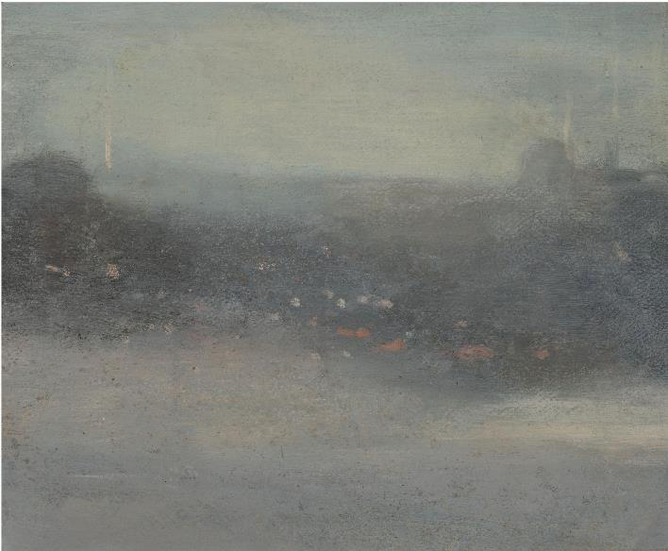
Slow down
Artist and art critic Percy Leason advised when viewing Beckett’s exhibition in 1931:
“View[ing] ... from six or eight paces is important; this is the distance at which the artist weighed up the value of every brush stroke ... roll up your catalogue and view each picture through it. This might cause amusement to other visitors, but what matter? You will be rewarded with a wonderful suggestion of air and light and sufficient detail, and finish” - P. Leason, ’Current art shows’, Table Talk, 5 December 1931
Try viewing Beckett’s work as Leason suggests - roll up a sheet of paper and view each work of art through it. What do you think is the optimal distance to view Beckett’s work? How do her paintings change as your get closer or further away?
Clarice Beckett, Australia, 1887 - 1935, Evening, after Whistler, c.1931, Melbourne, oil on board, 29.0 x 33.5 cm; Gift of Alastair Hunter OAM and the late Tom Hunter in memory of Elizabeth through the Art Gallery of South Australia Foundation 2019, Art Gallery of South Australia, Adelaide, photo: Saul Steed.

Slide 12
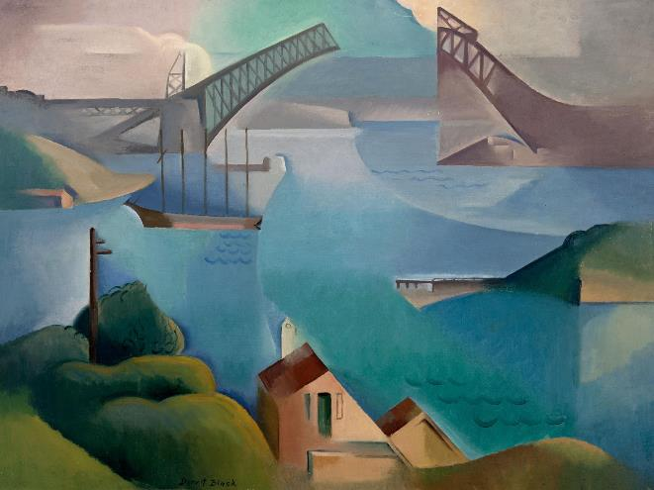
Present your pitch
Beckett’s paintings depict her everyday local suburban environment. Do you think these are typically Australian images? What is an iconic Australian image?
Select one work of art by Beckett and one by another artist in AGSA’s collection that captures the essence of Australia and could be used for a marketing campaign to promote tourism in Australia to an international audience. For example, when we imagine Australian icons, the Sydney Harbour Bridge often comes to mind, perhaps The Bridge by Dorrit Black will be included as one of your selections.
Present your pitch to the class where you will all vote on which works of art will be used for this marketing campaign for Australia.
Dorrit Black, Australia, 1891 - 1951, The Bridge, 1930, Sydney, oil on canvas on board, 60.0 x 81.0 cm; Bequest of the artist 1951, Art Gallery of South Australia, Adelaide.

Slide 13
Recording the Present and Remembering the Past
Who was Clarice Beckett – the person? We know quite a lot about Beckett’s life as an artist but very little information exists about her actual life. The novel Night Street by Kristel Thornell, which won the Vogel Literary Award in 2009 draws inspiration from Beckett’s life, revealing a story about her life as young painter who defies conventions and art critics alike.
- What sources do we rely on today to inform us about a person’s history?
- How reliable are these sources?
Document the life of someone in your family. You might like to make a short film or written text.
- What important stories of this person’s life need to be told?
- Are there photographs, videos, journal entries, letters, maybe even your own observations, or perhaps their social media accounts that could be used to piece together their life? How reliable are these sources?
- What is the legacy they will leave behind? Perhaps it is something they made or a garden they cared for or perhaps this person had an impact in other ways?

Slide 14
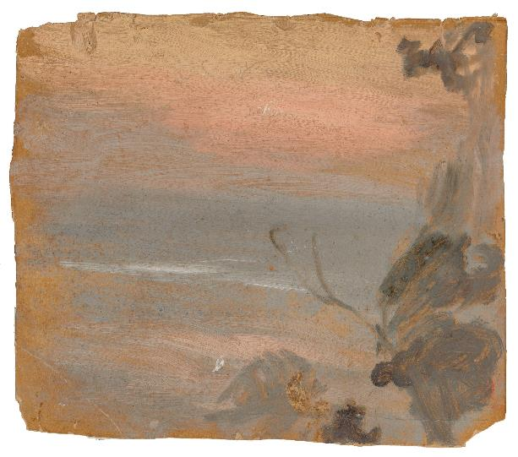
Making
Explore your local environment and make a series of sketches from different viewpoints. Back in the classroom create three works of art of the same scene using layered tones of chalk pastel on different textured papers. Which surface did you prefer using and why?
Generally, Beckett preferred adverse weather conditions – rain and overcast grey days – because it was easier to record tonal impressions. Find a work of art by Beckett that you think was painted in winter and one that was painted in summer. What are the winter and summer colour palettes where you live? Visit a paint store and select paint swatches that best represent two opposing seasons where you live. Using these colours create a work of art of that captures the essence of your favourite season.
Clarice Beckett, Australia, 1887 - 1935, Sunset, n.d., Melbourne, oil on card, 29.5 x 32.5 cm; Gift of Alastair Hunter OAM and the late Tom Hunter in memory of Elizabeth through the Art Gallery of South Australia Foundation 2019, Art Gallery of South Australia, Adelaide, photo: Saul Steed.

Slide 15
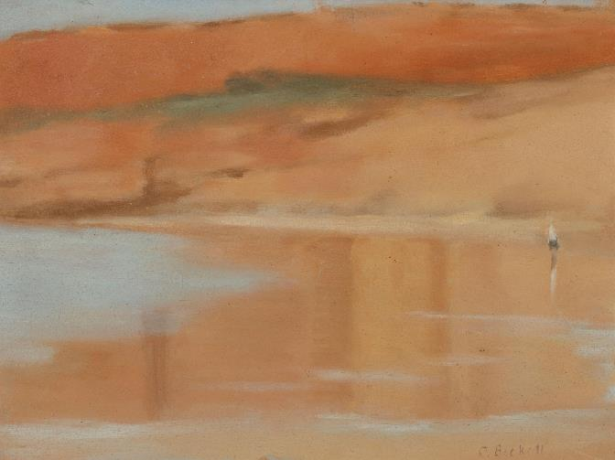
Space and Blur
Clarice Beckett had an extraordinary ability to convey a sense of distance in her paintings and surround her subjects in atmosphere. With this she depicted the presence of space and air which resulted in smoky or blurred representations. This quality was often misunderstood and referred to as fog.
Beckett’s dissolving of form creates a feeling of recessive space and distance. In this way she followed the ideas of Meldrum, who said that when standing ‘before a good picture the spectator should feel the ability to take a deep breath. There must be a feeling of depth and air’. The illusionary sensation of a breathy atmospheric moment was a well- known practice of the impressionists and of American painter James Abbott McNeil Whistler, who advised: ‘Paint should not be applied thick. It should be like breath on the surface of a pane of glass’. Beckett made a tribute painting to Whistler titled Evening after Whistler, c. 1931.
Clarice Beckett, Australia, 1887 - 1935, Wet sand, Anglesea, 1929, Anglesea, Victoria, oil on board, 29.3 x 39.0 cm (sight); Gift of Alastair Hunter OAM and the late Tom Hunter in memory of Elizabeth through the Art Gallery of South Australia Foundation 2019, Art Gallery of South Australia, Adelaide, photo: Saul Steed.

Slide 16
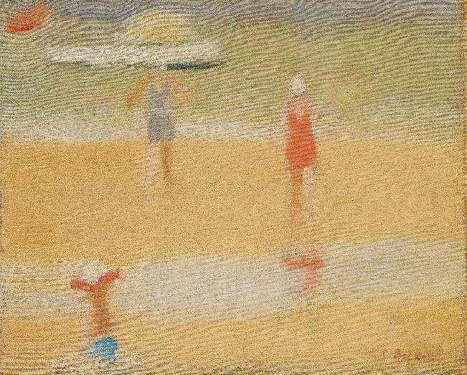
Making and Responding
Beckett’s painting approach was rapid and involved no preliminary sketching. She looked at her subject with her eyes blurred or semi closed and painted what she saw, without any interpretation or modification, to create an illusory ‘real’ effect. Squint while looking at a scene outside the classroom. What do you notice about what you see?
Working in all types of weather, Beckett was interested in capturing the ethereal effects of mist, rain, haze and smoke. Some of these phenomena can alter your vision.
Try to distort your view by creating interventions when painting an outdoors scene:
- Create an A4 viewfinder which has an inbuilt screen of baking or tracing paper.
- Using an old pair of eye-glasses cover the lenses with Vaseline and wear these while painting.
- Take a blurry photo, un-focus your lens, use Photoshop to manipulate (blur or pixelate) your image or move your device while taking a photograph. Use this image as your reference image to paint from.
Clarice Beckett, Australia, 1887 - 1935, Beach scene, c.1932, Beaumaris, Victoria, oil on canvas on board, 24.2 x 29.5 cm (sight); Gift of Douglas and Barbara Mullins 2003, Art Gallery of South Australia, Adelaide.

Slide 17
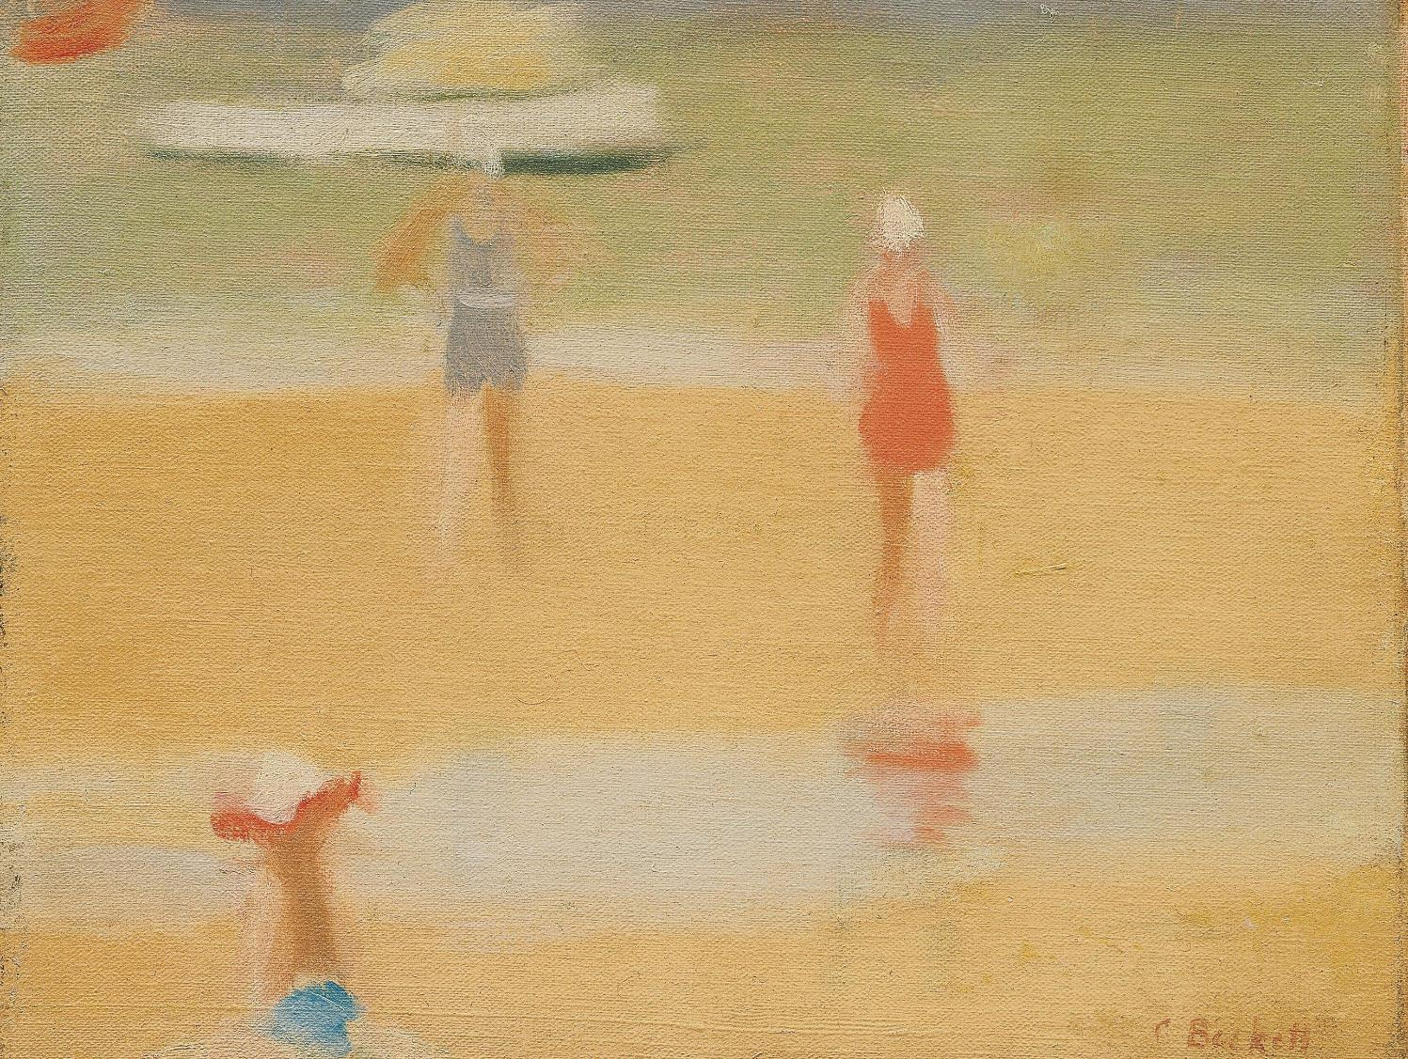
A Modern Woman
Learn about Beckett as a pioneering modernist

Slide 18
A Modern Woman
Learn about Beckett as a pioneering modernist
Beckett never subscribed to any art movement but closely identified with Max Meldrum’s unusual teaching methods, which transformed her painting practice. These methods using a limited colour palette and applying tones in broad areas directly onto the canvas surface without any under drawing. Beckett extended these methods by applying them en plein air (in the open air or outside). This approach to painting had been common place for Impressionist painters from the mid nineteenth century. Impressionists were interested in capturing colour and light to paint form. Beckett however was interested in capturing space and distance using light to dissolve form. By painting outside Beckett rapidly captured in oil paint the shifting effects of light, from early morning and into twilight and dusk, which translated into an atmospheric form of painterly abstraction.
As curator of The present moment, Tracey Lock says ‘the art of Beckett allows us to see the world anew’. Becektt’s preoccupation with conveying shifts in light and shade is evident in her everyday views of her local environment which are painted at different times of the day and in different weather conditions. This, combined with Beckett’s compositional techniques, we see the common place as though through fresh eyes.
Modernist artists in the late nineteenth and early twentieth centuries rejected traditional styles and realistic depictions of subject matter. Instead, modernist artists deviated from large labour intensive realist studio paintings and experimented with materials and techniques, resulting in works of art that were finished very quickly and that played with form and colour. These artists were sometimes inspired to paint modern industry. Beckett’s interest in to capturing the changes she discovered in her surrounding world such as trams, cars, telegraph and electric light poles and bitumen roads places her within this broad definition of modernism.

Slide 19
What is modernism?
Modernism is the cultural response to the rapid changes of the Industrial Revolution. Beginning in the mid-nineteenth century, modernism reflected the dramatic shifts in society that took place in Europe, North America and eventually the world, including Australia. Manufacturing, new modes of transportation, such as the steam engine, the car and the aeroplane, as well as the invention of electricity and telecommunications along with the rise of capitalism transformed formerly agrarian societies into urbanised cities and towns. Modernism is the artistic response to this rapid social and technological change.
In terms of its visual expression, modern art was markedly different from its preceding movements. The previous centuries of Western art had long been occupied with mythological, biblical and historic subjects. Art was understood as an illustrative tool, used on behalf of the church or by those in power. Modern art, however, revolutionised this understanding as it sought to find new expression in response to the changes of the modern world. Over the nineteenth and twentieth centuries, the parameters of art and the role of the artist were deeply questioned. Artists began to value art as a form of personal expression and for holding value intrinsic to itself. Art loosened its grip on being illustrative or illusionistic, making a long grand arc towards abstraction in the middle of twentieth century.

Slide 20
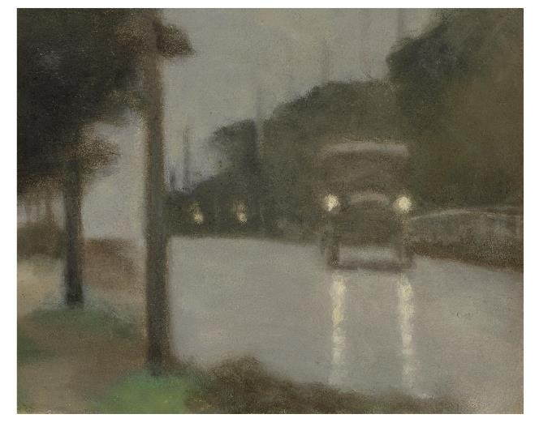
Curator’s Insight – Motor Lights
Motor lights presents a radical break from the traditional subject matter of the time, depicting an everyday and unremarkable road scene. Here, Beckett paints the first images in Australian art in which an everyday bitumen road is elevated to a high-art subject. Using the light source of the car’s headlights, Beckett transforms the area of road surface from an unremarkable flat grey into a vibrating field of atmospheric space, reflected light and liquid colour.
By Tracey Lock, Curator of Australian painting and sculpture at AGSA, The Present Moment - the art of Clarice Beckett, 2021.
Clarice Beckett, Australia, 1887 - 1935, Motor lights, 1929, Melbourne, oil on board, 28.3 x 35.2 cm; Gift of Alastair Hunter OAM and the late Tom Hunter in memory of Elizabeth through the Art Gallery of South Australia Foundation 2019, Art Gallery of South Australia, Adelaide, photo: Saul Steed.
Making
Beckett’s paintings reveal a changing modern Australian life, often featuring cars, trams and buses – all synonymous with the modern world. When talking about the work Motor Lights by Beckett, the Australian painter, Sir William Dargie stated ‘it was painted without the fear of depicting things most people would regard as ugly’. Create a painting that captures something people today would consider ugly; how will you use light and tone to present this subject in a new way?
Create a work of art that celebrates the contemporary world that you live in today. What medium will you use and why?

Slide 21
Think & Discuss
In 1979, the AGSA’s then curator, Ian North purchased Morning shadows from the milestone Clarice Beckett retrospective exhibition, held that same year. Today the artist and writer, North suggests that concepts of modernism remain fluid. With regard to Beckett, ‘what seems modernist in one context, seems conservative in another’. In this way, Beckett’s art is difficult to define as belonging to a single definitive art movement. As Tracey Lock, curator of the exhibition notes ‘on one hand Beckett’s paintings looks like realism, yet on the other they appear blurred and abstract’.
Explain how Beckett’s work fits within the definition of modernism in terms of style, technique and subject matter.
Considering the time and place in which Beckett created her work, how might one deem her work to be conservative?
Investigate works of art made prior to modernism. How were these works of art different to work made by Beckett and other modern artists generally? Consider the size of the work and who the works were made for.
Look at examples of works of art made by other Australian artists who were painting at the same time as Beckett. How is her work different from theirs? How might Beckett have been influenced by other artists? What is unique about her work? Tip: Perhaps begin with Grace Crowley, Bessie Davidson, Sydney Long, Max Meldrum, Hilda Rix, and Grace Cossington Smith.
Beckett was interested in transient motifs, which became recurring themes in her work. Look at the work Passing trams, do you get a sense the trams are moving? How does she convey movement and yet capture a sense of stillness? What other impressions do you deduce from Beckett’s use of light and tone? Is it a warm, cold, loud or quiet street scene?

Slide 22
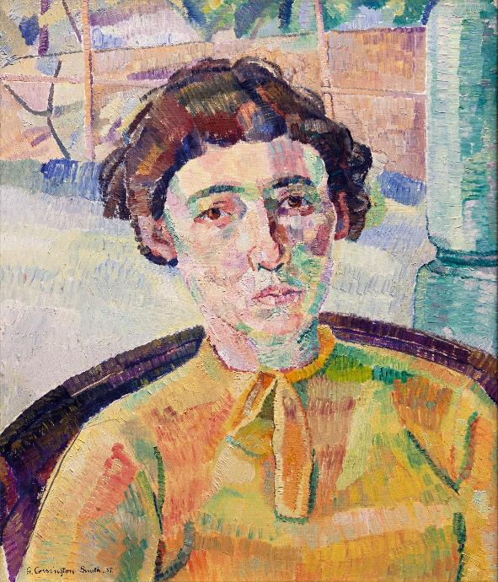
The Modern Traveller
In the late nineteenth century and early twentieth century many Australian artists travelled to London and Paris to study at innovative art schools with like-minded artists. Here they were introduced to modern movements such as impressionism, post-impressionism, cubism and abstraction.
Australian art critic Patrick McCaughey was among the first, in 1971, to identify Beckett as a modernist and place Beckett alongside Grace Cossington Smith and Margaret Preston as a major artist of the period. McCaughey stated that Preston and Cossington Smith were conscious modernists having travelled extensively, while Beckett had never left Victoria and struggled to pursue her career as an artist. However, Beckett was very well read, so much so that Gino Nibbi (1896-1969), author, art critic and owner of the Leonardo Bookshop in Little Collins Street, proclaimed her as ‘the best-read woman in Melbourne’. Beckett may not have travelled like other Australian modernist painters of her time, but she was reading the same literature as European artists and aware of scientific advances that were being made. In this way she was exposed to the same modern ideas and concepts.
Grace Cossington Smith, Australia, 1892 - 1984, The artist's sister, 1936, Sydney, oil on paperboard, 49.5 x 41.5 cm; South Australian Government Grant and d'Auvergne Boxall Bequest Fund 1989, Art Gallery of South Australia, Adelaide, © Estate of Grace Cossington Smith.

Slide 23
Responding
Research Preston, Beckett and Cossington Smith and their development as artists during the modern era. Write one sentence for each artist that summarises their influence on Australian art.
Poetry and Music
Beckett was influenced by literature and music including Chopin and Debussy. These composers were inspired by the impressionists, but also by sunrises, sunsets and the sense of the temporal. In around 1903 composer Frederick Delius’s wrote a piece Sea Drift. It takes its name from Walt Whitman's compilation of poems Leaves of Grass, and the piece itself includes text from Whitman’s poem Out of the Cradle Endlessly Rocking. The title of Beckett’s painting Sea Drift may suggest that she was inspired by both Delius and Whitman when creating this work of art.
Getting started:
- Listen to Sea Drift
- Listen to musical scores by Chopin and Debussy.
- Read Whitman’s poem Out of the Cradle Endlessly Rocking.
What connections can you make between these pieces and Sea Drift by Beckett?
Your turn
Create a work of art that is inspired by a piece of music or poetry. You may like to read some of Whtiman’s poems in Leaves of grass which contain several poems about the sea or the shore to help you visualise a scene from writing alone.

Slide 24
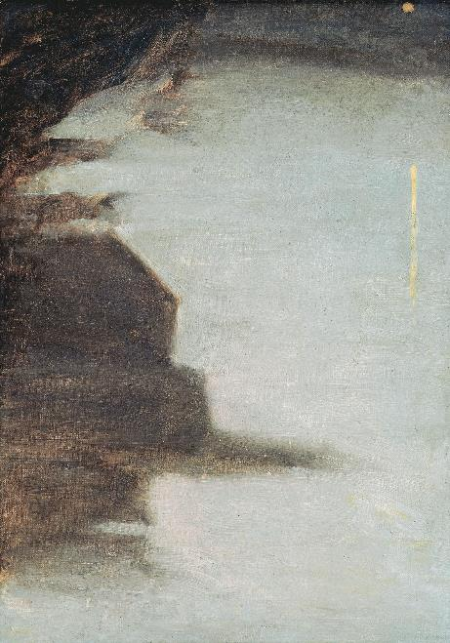
Abstraction and Spirituality
Abstract art, which emerged in the early twentieth century, is often described as non-representational. This means that rather than depicting identifiable subject matter artists respond to things you can’t necessarily see such as emotions, sounds and spirituality. This sometimes results in pure abstract works of art that consist of geometric shapes, colours and gestural marks. For example, Swedish painter Hilma af Klimt (1862 -1944) was interested in depicting invisible forces such as electromagnetic fields and infra-red light, while Russian painter and art theorist Wassily Kandinsky (1866-1944) believed sounds manifested themselves as colours and shapes.
Kandinsky developed a new way of representing the world of the early twentieth century – the age of the machine and scientific advances. He moved away from depicting the real world and instead believed that colour had a powerful and spiritual impact, associating the sounds of musical compositions with colour, tones, shapes and lines. As Kandinsky stated “colour is a power which directly influences the soul. Colour is the keyboard, the eyes are the hammer, the soul is the strings. The artist is the hand that plays, touching one key to another, to cause the vibrations in the soul”.
Like Kandinsky, Beckett’s approach to painting was deeply spiritual and culminated in the creation of an optically indefinite blurred quality. This was a way of perceiving and subtly recording the world. Whether deliberate or accidental, Beckett conjured the feeling of eternal space by unifying fields of vibrating colour.
Clarice Beckett, Australia, 1887 - 1935, Nocturne, c.1931, Melbourne, oil on canvas board, 63.4 x 48.3 x 7.5 cm (frame), 50.4 x 35.4 cm (sight); d'Auvergne Boxall Bequest Fund 2000, Art Gallery of South Australia, Adelaide.

Slide 25
Discuss & Debate Examine
Tracey Lock, the curator of Clarice Beckett: The present moment, describes Beckett’s work as an atmospheric form of painterly abstraction. Select five works of art by Beckett. Arrange these works from least to most abstract. Discuss your choices with the class. Remember: Abstract art is any work of art that is non- representational; it makes little or no visual reference to the physical world.
Conduct a class debate with one side arguing that Beckett’s paintings are realistic while the other argues they are abstract. Provide examples to support each side of the argument. Where in the continuum of ‘realistic to abstract’ is Beckett’s work situated?
Innovation in Australian art has often occurred through landscape painting, including the breakthroughs made with Australian tonalist landscapes. This later paved the way for artists such as Fred Williams in 1962 with his abstraction of the Australian landscape. Williams would comment on Clarice Beckett’s practice stating ‘she really was ahead of her time’. What do you think he meant by this? Examine the works of Fred William in comparison to Beckett. How are they similar and how are they different?

Slide 26
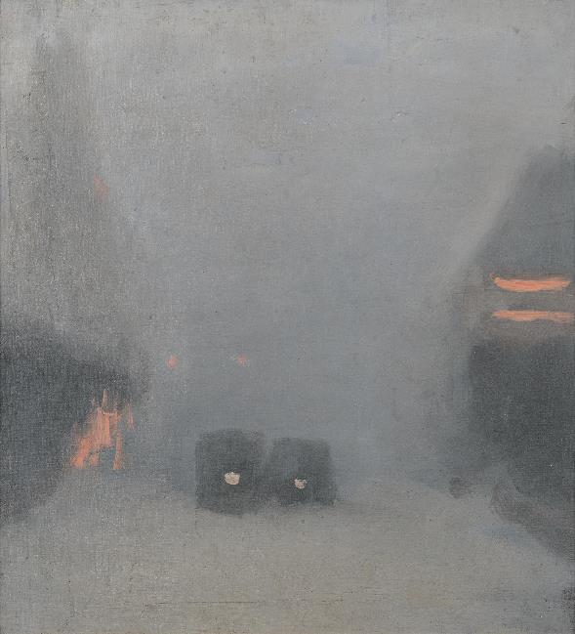
Slowing down
Beckett’s paintings are intimate engagements that more closely resembled quiet personal meditations between the self and nature. Practise being mindful. As a class, brainstorm all the things you admire about the natural world? Spend some time outside observing tree formations, leaves or the way animals interact with each other or their environment. Be still. After 5 minutes of being still, write a reflection of the thing that you found the most interesting.
On one side of a blank postcard template, draw your favourite painting by Beckett using only three lines. On the other side of your postcard describe the atmospheric feeling of this painting to someone who has never seen this work before. Send your postcard to this person.
Look closely at the work Passing trams, c. 1931. Imagine you have stepped inside this work of art. What is it like here? What can you feel, smell, see and hear? What would you be wearing and who might be with you?
Clarice Beckett, Australia, 1887 - 1935, Passing trams, c.1931, Melbourne, oil on board, 62.8 x 58.7 x 7.0 cm (frame), 48.6 x 44.2 cm (sight); Edna Berniece Harrison Bequest Fund through the Friends of the Art Gallery of South Australia 2001, Art Gallery of South Australia, Adelaide.

Slide 27
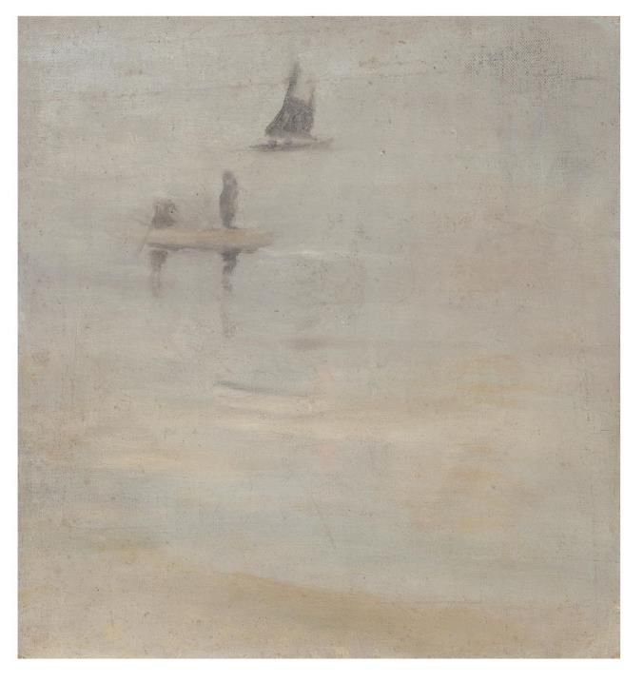
Soundscapes
Visit your favourite place, it might be a place in nature, your home or suburban area. Record the sounds of this place. Swap your recordings with other people in your class. Create a work of art based solely on the sounds you hear.
Beckett paints just enough information for our brains to fill in the gaps or details, which creates a sense of a certain place. Create a pastel drawing or watercolour painting that captures the essence of a busy scene. Which elements are most important, which will you leave up to the viewer to imagine?
Clarice Beckett, Australia, 1887 - 1935, Sea Drift, c.1930, Melbourne, oil on canvas on board, 34.0 x 32.0 cm; Gift of Alastair Hunter OAM and the late Tom Hunter in memory of Elizabeth through the Art Gallery of South Australia Foundation 2019, Art Gallery of South Australia, Adelaide, photo: Saul Steed.

Slide 28
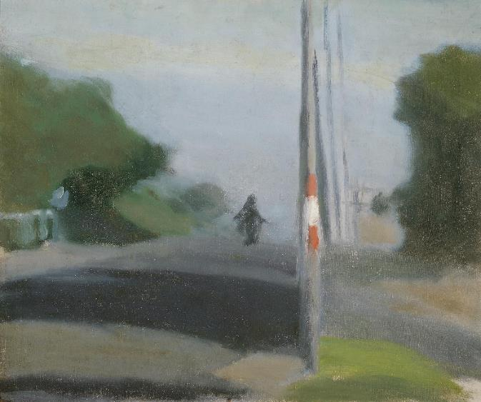
Beckett and Photography
Frozen in time
The invention of photography during the Industrial Revolution, followed by the release of the first commercial camera (the Kodak Brownie) in 1900, altered the role of artists forever. Painting had to redefine itself. The depiction of realistic representations of objects, people and places was no longer an artists’ main pursuit, as these depictions could now be easily acheived with a photograph.
Beckett’s gentle, atmospheric form of painterly abstraction had a parallel association with the advances in photography where a soft aesthetic was being explored. For example, her work coincided with the height of soft- focus pictorial photography, led by the Adelaide-born photographer John Kauffmann (1864-1942). Pictorial photographers used the camera like a paintbrush, manipulating their image to highlight the beauty of their subject rather than simply capturing or recording reality. At times their atmospheric photographs were mistaken for paintings.
Clarice Beckett, Australia, 1887 - 1935, Morning shadows, c.1932, Beaumaris, Melbourne, oil on canvas board, 49.5 x 60.0 cm (sight); South Australian Government Grant 1980, Art Gallery of South Australia, Adelaide, photo: Saul Steed.

Slide 29
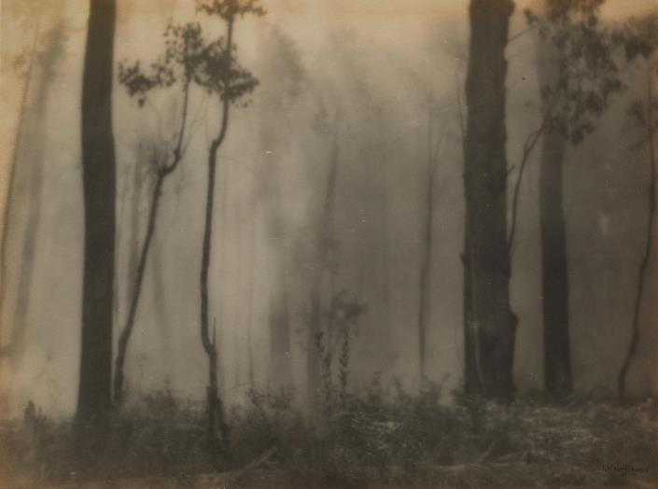
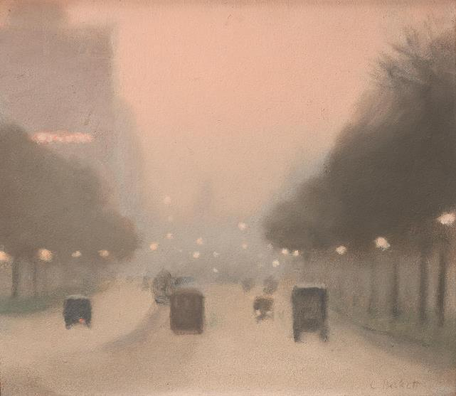
John Kauffmann, Australia, 1864 - 1942, Bush fire, c.1910-1930, Victoria, gelatin-silver photograph, 22.1 x 29.36 cm (image & sheet); J.C. Earl Bequest Fund 2018, Art Gallery of South Australia, Adelaide.
Clarice Beckett, Australia, 1887 - 1935, Evening, St Kilda Road, c1930, Melbourne, oil on board, 33.8 x 39.5 cm (sight); Purchased with funds provided by the Australian Collection Benefactors' Program 2013 Art Gallery of New South Wales, Sydney, photo: Felicity Jenkins.

Slide 30
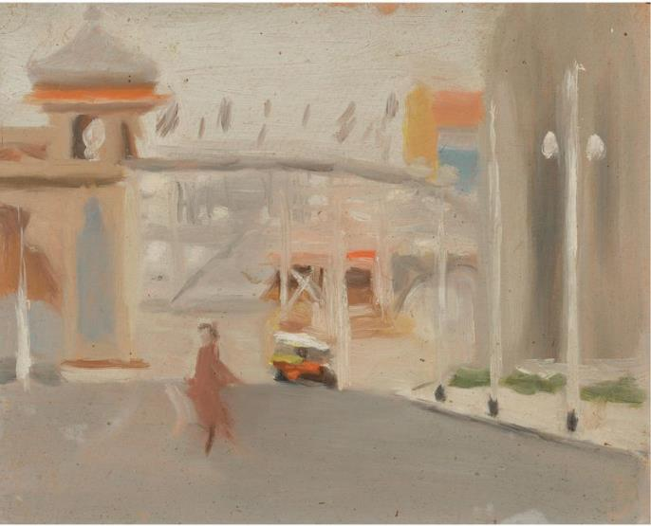
Beckett and Photography
Frozen in time
Beckett’s work also gives the impression of a photograph. She explores an interest in motion, composing and painting as though her subjects have been captured spontaneously in a split moment in time, resulting in a candid or ‘shoot from the hip’ quality. In Morning shadows, c.1932, she depicts a motorbike in freeze frame, a split second before it escapes from vision over the hill. In A good blow, like a snapshot, the painting marks the moment of arrival of a surging wave and its dematerialisation into formless matter. In these candid-like paintings, Beckett creates tension between the seemingly fragmented imagery of something in motion and the representation of stillness.
Clarice Beckett, Australia, 1887 - 1935, Luna Park, 1919, St Kilda, Melbourne, oil on board, 18.0 x 20.0 cm; Gift of Alastair Hunter OAM and the late Tom Hunter in memory of Elizabeth through the Art Gallery of South Australia Foundation 2019, Art Gallery of South Australia, Adelaide, photo: Saul Steed.

Slide 31
Responding
The invention and increased use of photography in the modern era encouraged artists to explore and experiment, as they were no longer needed to depict notable people, places or events with incredible accuracy. If photographic depictions surpassed the need for artists, what is the role of the artist in painting the Australian landscape in the modern era, and also today? Tip: Look at the Wynne Prize or the Hadley's Art Prize
Compare Beckett’s work to soft- focus pictorial photography of 1900s. Begin by looking at the work of John Kauffmann. List all the things which these two artists’ works have in common.
Making
Beckett often captured social gatherings at the beach as if suspended in time. Randomly grouped figures (often in pairs) are shown in motion, with arms raised, or bending over and absorbed in what they are doing. Look at the work Warm summer evening. Describe what the figures are doing. Imagine the next frame of this scene - draw what the figures will do next?
Beckett adopts an apparent random or chance ‘incidental’ approach to framing her landscape views, an approach with links to a photographic awareness. Take a series of candid photographs of an everyday street. Experiment with different techniques and angles including ‘shooting from the hip’.

Slide 32
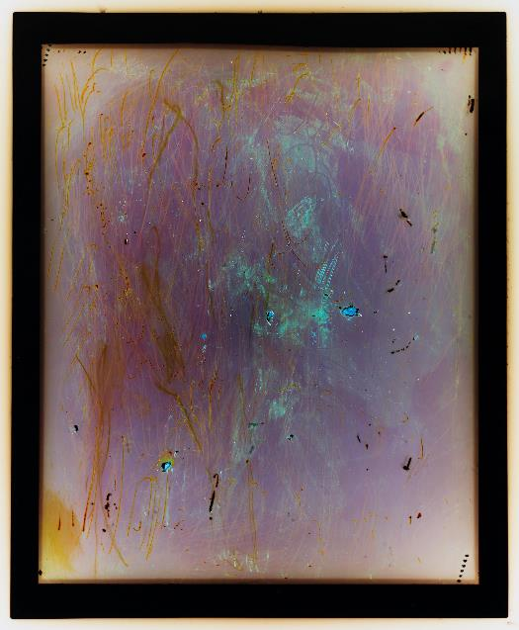
Learn more
In recent years, with the invention of digital cameras and the camera phone, photography has experienced its own resurgence, with artists returning to the handmade print or experimental process of art making. Investigate the work of artists who use camera-less techniques for their photographic work such as Sonja Carmichael, Elisa Carmichael and Justine Varga.
Justine Varga, Australia, born 1984, Infection, from the series Memoire, 2016, Sydney, type C photograph, 144.0 x 119.0 cm (image), 147.5 x 123.0 cm (frame); Gift of Susan Armitage through the Art Gallery of South Australia Foundation 2016, Art Gallery of South Australia, Adelaide, Courtesy the artist and Hugo Michell Gallery, photo: Stephen Oxenbury.

Slide 33
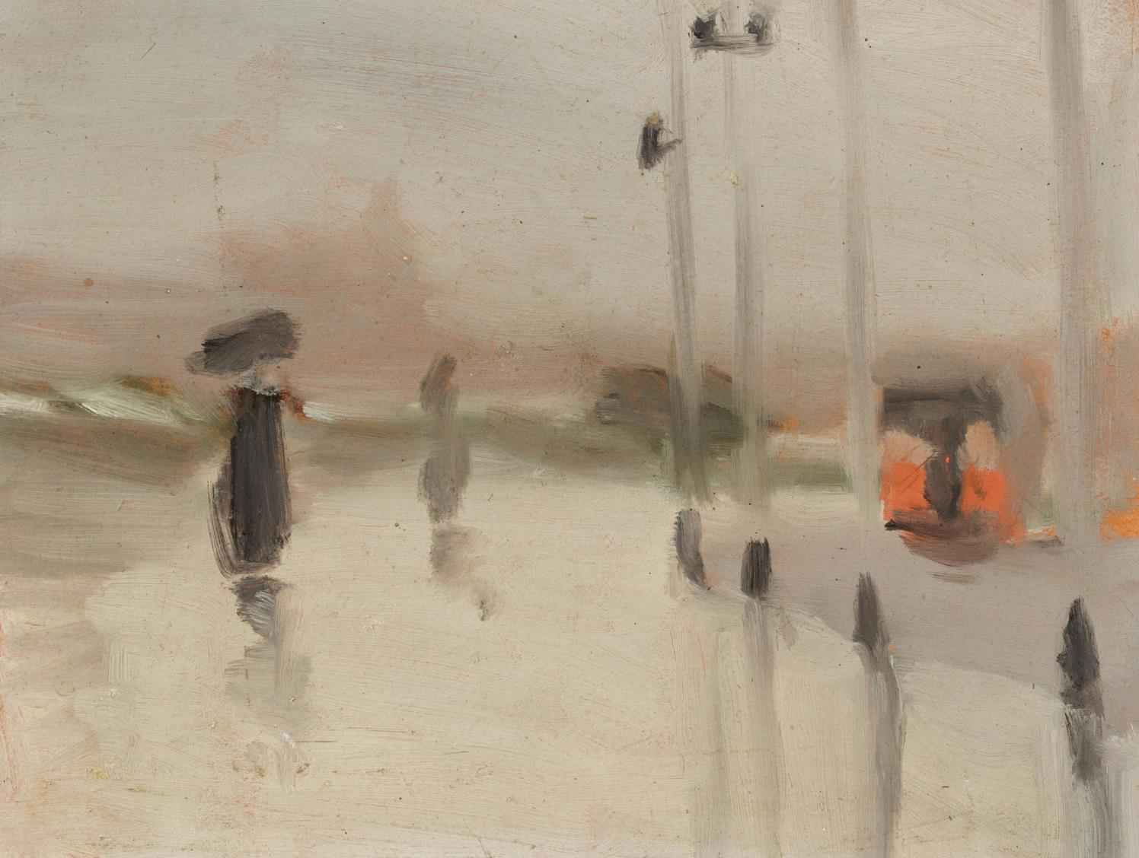
Mechanics of building a picture
Discover Beckett's compositional techniques

Slide 34
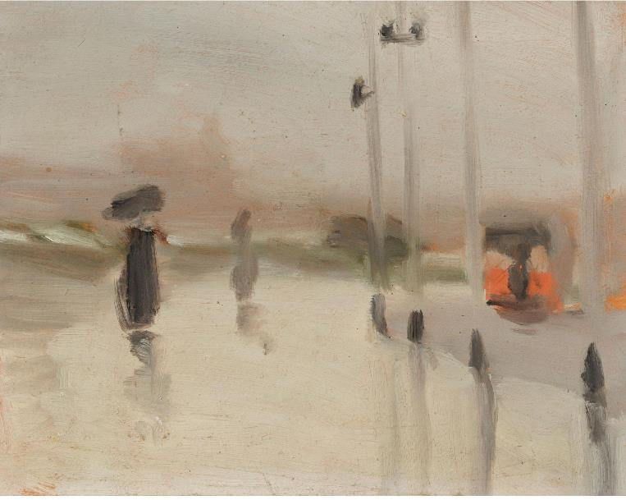
Mechanics of building a picture
Discover Beckett’s compositional techniques
Beckett’s approach to creating a painting is subtle. She includes recurring themes or subject matter combined with clear structural devices such as the use of horizontal and vertical lines. Beckett also plays with light and the illusion of distance (recessive space). She abandoned pre-existing compositional rules such as the grid of the Golden Mean, which had been used by artists for centuries to create a work of art that was pleasing to the eye using a mathematic principle. Instead, Beckett adopted an apparent random approach to frame her landscape views. This seemingly spontaneous and unstructured painting method includes the use of overlapping planes to create a fragmented quality, and inadvertently propels her work into a modernist space.
Clarice Beckett, Australia, 1887 - 1935, Wet day, Brighton, c.1928, Melbourne, oil on board, 17.4 x 22.2 cm; Gift of Alastair Hunter OAM and the late Tom Hunter in memory of Elizabeth through the Art Gallery of South Australia Foundation 2019, Art Gallery of South Australia, Adelaide, photo: Saul Steed.

Slide 35
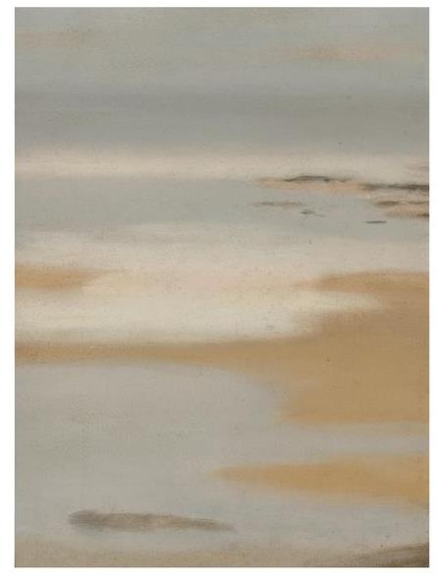
Light
Beckett uses filtered light as a way to dissolve overall form rather than to build up individual elements within the composition. Her use of diffused light creates a close tonal range, which dissolves the boundaries between the areas of light and shade and, thereby, cliff, tree and water. The soft melting edges of her forms are barely perceptible, and planes appear to shift from one into the other to create an extraordinary breath-like dreamy harmony, as Max Meldrum famously stated ‘there are no lines in nature’.
Beckett made use of refracted light to convey the phenomena of nature in terms of light and colour. In Wet sand, Anglesea, 1929, and Tranquility, 1933, her glimmering and shimmering painted effects take the viewer to the edge of spatial orientation. The sun is gone, yet strips of beach and the ochre cliffs dissolve into a unified shifting field of luminous, fluid colour. Here, Beckett edges the rendering of nature almost into cosmic abstraction.
Clarice Beckett, Australia, 1887 - 1935, Tranquility, c.1933, Melbourne, oil on board, 38.8 x 28.8 cm; Gift of Alastair Hunter OAM and the late Tom Hunter in memory of Elizabeth through the Art Gallery of South Australia Foundation 2019, Art Gallery of South Australia, Adelaide, photo: Saul Steed.

Slide 36
Responding & Making
The worship of sunlight is a recurring subject with some of the greatest statements in Australian art history. Find other examples in AGSA’s Australian art collection where this is evident. Compare these with Beckett’s use of diffused light.
Look at paintings by Beckett where the sea and the sky appear to merge into one plane. What types of light conditions create this sense of the horizon line collapsing?
Visit a place which has a body of water, it might be the ocean or a waterfall or your local pool. Observe how light reflects off the water’s surface. Create a series of photographs at different times of the day which captures these shimmering natural phenomena. Remake in chalk or oil pastel and blend your colours.

Slide 37

The Horizontal and Vertical
A feature of many of Beckett’s compositions is the use of extreme horizontal and vertical lines. She regularly broke the rules of composition by placing a strong vertical in the centre of her images, as is evident in The last flush, c. 1928. As curator Tracey Lock describes ‘here she counterbalances the scene with a shadowy form on the left; filled with reminders of twilight, the dominant vertical seems to connect the physical world to a timeless higher reality’. Beckett reverses this approach in Wet night, Brighton, 1930, where the centre is a void of air above the suggestion of a road leading into the limitless sea. This flooded scene is framed by four posts, which optically work as two vertical bands running across from top to bottom of the picture plane.
Beckett also often framed her views from elevated viewpoints or through foreground structures like trees – as though she had arrived at the spot by chance – to depict a spontaneous glimpse of the natural world.
Clarice Beckett, Australia, 1887 - 1935, Morning shadows, c.1932, Beaumaris, Melbourne, oil on canvas board, 49.5 x 60.0 cm (sight); South Australian Government Grant 1980, Art Gallery of South Australia, Adelaide, photo: Saul Steed.

Slide 38
Experiment
Look & Analyse
Investigate different composition techniques used by artists including those informed by geometry such as the Golden Mean and the rule of thirds. Find examples of these in works of art in AGSA's collection. What other types of composition techniques did you discover? Draw multiple thumbnail sketches of what you can see out of your classroom or bedroom window using different compositional techniques including Golden Mean, rule of thirds and strong horizontal and vertical lines like Beckett.
A painting sometimes consists of a foreground, middle ground and background. What do you think is the function of these planes? Draw over photocopies of Beckett’s paintings to identify the foreground, middle ground and background. Repeat this for a few of Beckett’s paintings with different subject matter. Was the composition constructed the same each time? Where does she place her subject matter? What is consistent about her compositions?
Beckett presents a spontaneous glimpse of the world as we move through nature in Early morning (The fisherman), as if we are a silent witness having stumbled upon this scene by chance. Can you find another work of art by Beckett where this may be the case?

Slide 39
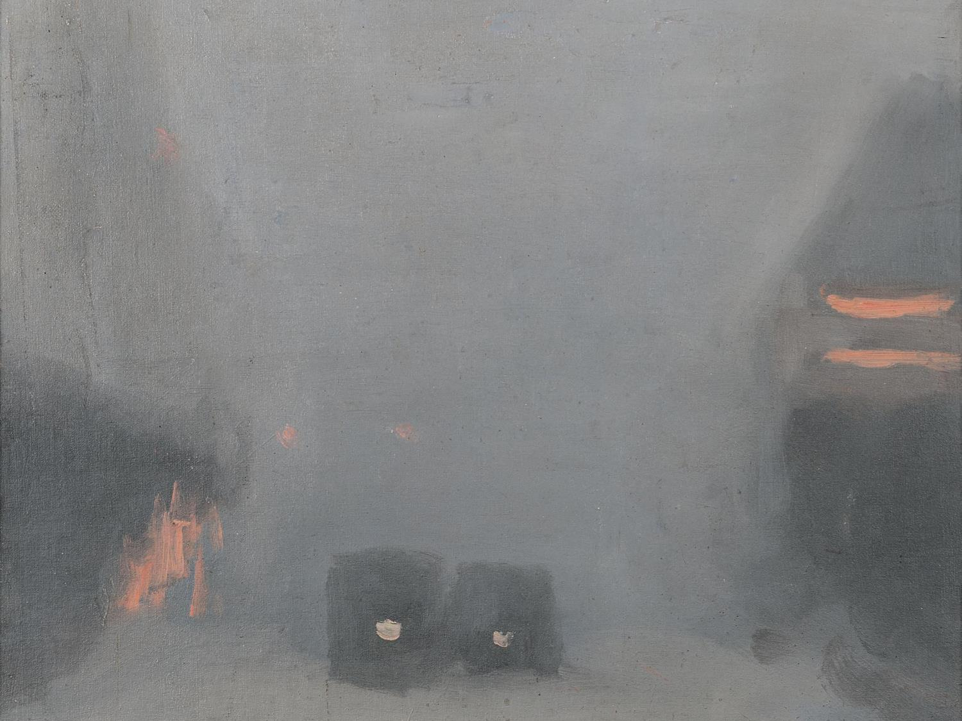
Painting your world
Explore Beckett's everyday world

Slide 40
Painting your world
Explore Beckett’s everyday world
Beckett depicted views of her local environment including transient subjects such as moving cars, trams, lone figures, waves and shadows, reminding us of the beauty in the everyday. Her misty paintings of modern Melbourne in the 1920s and 1930s captured the outdoors, including sea and beachscapes, and suburban street scenes, that often recorded the shifting effects of light– either in the quiet, early morning or in the stillness of the evening.
Curator’s Insight – Walking home c.1931
The gentle and seemingly insignificant nature of Beckett’s subjects, for instance, Walking home, were misunderstood by the small and narrow-minded Melbourne art world. This everyday scene possibly depicts the artist’s sister Hilda walking ahead of her daughter, Patricia, who was dragging her feet in the shadows on the road near Port Phillip Bay. The human figures are merged with the natural world. The work captures an incidental moment of suburban life and was the opposite of the more commonly revered hard realism found in the elevated themes and heroic landscapes of the interwar period. Rather than depicting a famous location or important moment in history Beckett's work captures an incidental event in suburban life.
By Tracey Lock, Curator of Australian painting and sculpture at AGSA. This text first appeared in The Present Moment - the art of Clarice Beckett, 2021.

Slide 41
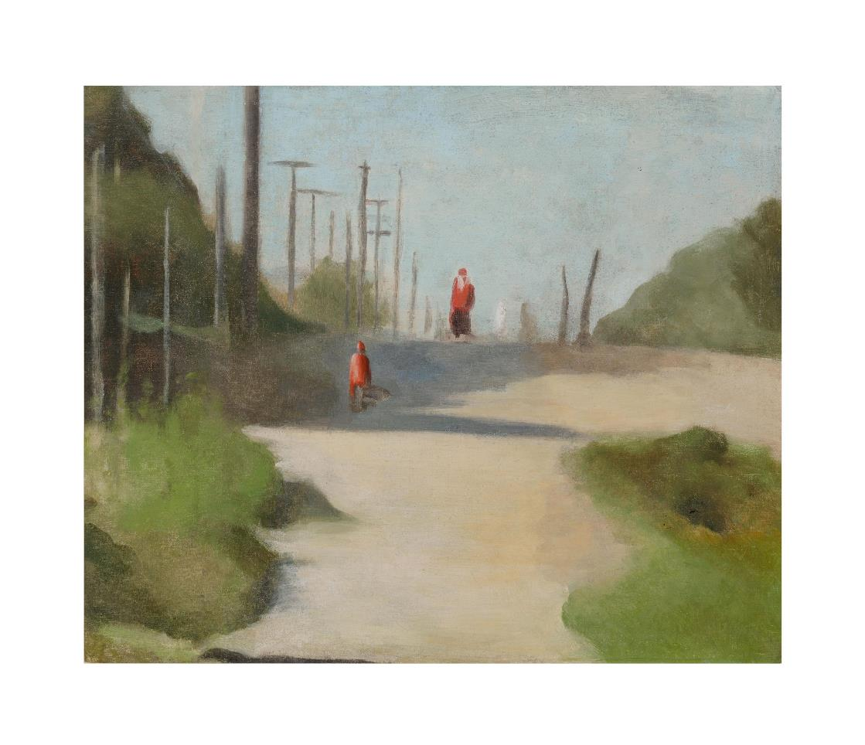
Clarice Beckett, Australia, 1887 - 1935, Walking home, c.1931, Melbourne, oil on canvas on board, 49.2 x 59.5 cm; Gift of Alastair Hunter OAM and the late Tom Hunter in memory of Elizabeth through the Art Gallery of South Australia Foundation 2019, Art Gallery of South Australia, Adelaide.

Slide 42
Explore the outdoors
Beckett painted her surrounding environment with the majority of scenes depicted were in walking distance from her home. What does the Australian landscape look like where you live?
During a lunch time at your school complete an en plein air painting or pastel drawing of students playing and interacting with each other. How will you capture the figures being merged with their environment and the atmosphere or energy of this moment?
What is your favourite time of day and why? Create a work of art that captures your favourite time of day and give your work a title that reflects that time of day.
Beckett was interested in the profound wonder of experiencing nature. Take a nature walk with your class. Look closely at your surroundings and focus on the small details, such as the colour of the plants and trees or the details in the bark or leaves, or the shadows created on the ground. Draw these observations in your sketchbook.
Take a series of photographs of the same scene at 4-6 different times during one particular day. Which time of the day did you prefer? What subtle lighting changes did you notice at different intervals throughout the day? Compare your images with other members of your class.
Minimal marks are used in Beckett’s paintings to give an impression of a place. Look at an outside scene. What are the three most dominant elements? Quickly paint or block in these elements with watercolour paint.
Create three pastel drawings of your favourite place in nature that when joined together creates a panoramic view. Join these canvases together in a ‘U’ shape so that the viewer can step inside the world you see.

Slide 43
Invent & experiment
Beckett made use of whatever materials were readily accessible and was known to paint on the reverse of found materials like Cornflakes boxes (Sunset) – and paper bags – (Bathing boxes), c.1932 (p. 94). Collect a range of surfaces from the recycling bin and create a series of paintings or pastel drawings using these materials as the surface of your works of art.
Whether by choice or necessity, Beckett was not a studio painter. She used a portable painting box and a mobile trolley to paint both colour notes and finished impressions outdoors. She painted in direct natural light, mostly on small board supports, approaching her subjects spontaneously and recording her visual responses with minimal materials. Design your own portable painting box or bag which you could take with you when you paint outdoors. What items will you need? Will you need to carry it or will it be fitted to your bike? Remember, you have to carry it so it must be easy to transport.

Slide 44
Recording routines
Beckett did not travel abroad like some of her peers. Although she was criticised for limiting her subject matter this ended up being a strength of her practice as she became familiar with the place in which she lived and was confident in capturing the spirit of that place.
Over the course of a term, spend time observing a simply routine you regularly perform in your life. Record this routine in some way either by taking a photograph, sketching, making a sound recording or making quick tonal recordings in pastel or watercolour. Create an animation using the recordings, drawings and paintings you collected that captures this routine.

Slide 45

Role of the curator
Piecing together the life of one of Australia's finest painters of the twentieth century

Slide 46
Curatorial premise
Retrospective and survey exhibitions assess a large body of work by a single artist. These are also called monographic exhibitions. They usually follow a chronology to demonstrate the shifts and developments that evolve across an artist’s body of work. Sometimes the curator may give greater emphasis to a particular period in the artist’s career or highlight certain processes, ideas or media. In some instances different genres may also be included, such as still life, portraiture or landscape. The curator may choose to include drawings, photographs, prints and oil paintings, along with other interpretative material including music, video etc.
Spanning sixteen years, Clarice Beckett’s active professional career was relatively brief for a major artist. Across this period, she created only oil paintings and the changes in her painting approach and subject matter are very subtle. Beckett never dated her paintings and this has made the dating of her work very difficult for art historians and curators. For example, it is often hard to know if a painting is from 1922 or 1935.
That she never dated her work was not unusual, but it does indicate that ‘clock or date’ time was a secondary concern for the artist. Her paintings suggest that she was more preoccupied with diurnal time (the course of the day) and the shifting effects of light throughout the day. The precise locations of her landscape subjects are also difficult to identify. In this way, her paintings appear to have universal qualities, being both timeless and placeless.
In consideration of these qualities, I chose to structure the exhibition around the chronology of a single day in order to emphasise Clarice Beckett’s interest in broader, universal themes such as the cosmos, and the eternal and the ephemeral. This curatorial approach also points to how Clarice Beckett was interested in a range of mystical and spiritual concepts that emerged from Buddhism, Christianity, theosophy and anthroposophy. Rather than limiting the presentation of Clarice Beckett as an Australian modern woman artist, it was important to indicate to audiences that her art explored spiritual dimensions. This helps to reposition her in the broader context of international modernism.
By Tracey Lock, Curator of Australian Art at the Art Gallery of South Australia
What is a curator?

Slide 47
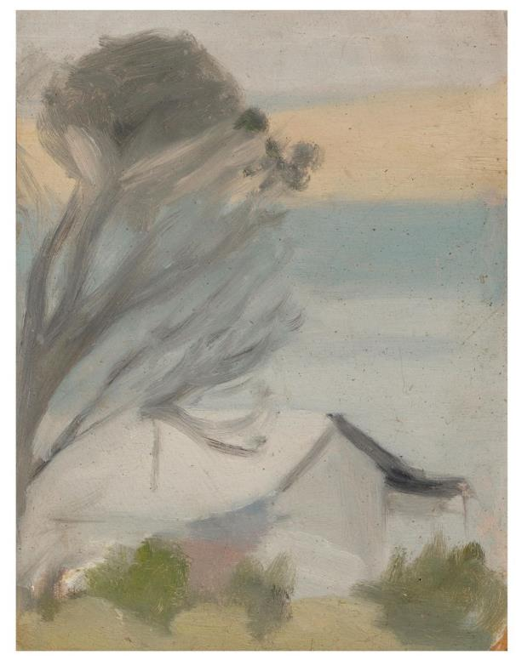
Beckett Rediscovered
After Clarice Beckett died in 1935 at the age of 48, she was forgotten. A chance encounter in the early 1970s led to the art of Clarice Beckett being rediscovered by curator Rosalind Hollinrake. Her rediscovery of Beckett led to fifty years of dedicated research and promotion that has seen Beckett recognised as a major Australian twentieth century artist.
In the 1970s, Hollinrake championed the work of Beckett and other little-known and overlooked artists in her small commercial gallery in Melbourne. While Beckett’s importance has now been acknowledged, today Rosalind Hollinrake’s role as a pioneer Australian woman curator is finally receiving appreciation.
Clarice Beckett, Australia, 1887 - 1935, The cottage San Remo, c.1931, San Remo, Victoria, oil on board, 22.0 x 17.6 cm; Gift of Alastair Hunter OAM and the late Tom Hunter in memory of Elizabeth through the Art Gallery of South Australia Foundation 2019, Art Gallery of South Australia, Adelaide, photo: Saul Steed.

Slide 48
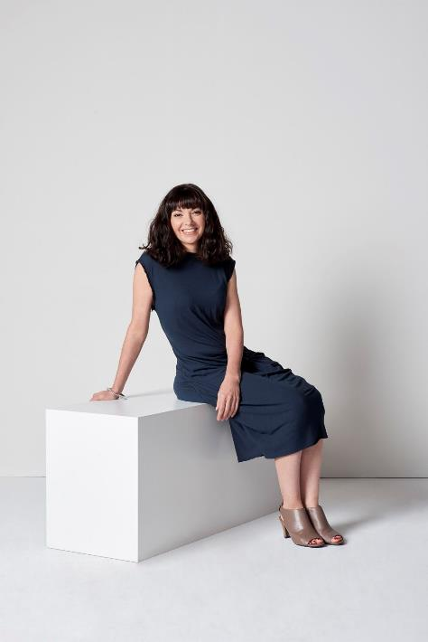
The Curator
Tracey Lock is Curator of Australian Art at the Art Gallery of South Australia. She has written six books on Australian art, including the defining monograph on Dorrit Black (2014) and most recently, Clarice Beckett (2021). Most recently, she curated Clarice Beckett: The Present Moment and in 2019 she curated Adelaide Cool: The abstract art of David and John Dallwitz. In 2018 she led an experimental rehang of the Gallery’s permanent Australian art collection (700 works of art) that tested new curatorial methodologies, encompassing Australia’s engagement with Asiatic, Islamic and Oceanic cultures. She has been responsible for key additions to the Australian art collection, including works by Fred Williams, Sidney Nolan, Anna Platten, Dorrit Black and a major collection of 21 paintings by Clarice Beckett. Tracey Lock has been the recipient of the Churchill Fellowship (2012) and the Cité Internationale des Arts Residency Fellowship, Paris (2017).
Photo: Sven Kovac.
Fun Fact
This exhibition also inspired the writing of an award-winning fictional book about Clarice Beckett called Night Street written by Kristel Thornell.

Slide 49
Making and Responding
When displaying her work for exhibition, Beckett grouped her works in themes, which was quite different from the usual way artists hung their work. The present moment has been thematically displayed around the shifts in time that chart the chronology of one single day. What are some other thematic ways the works of art in this exhibition could have been displayed?
Imagine The present moment was to tour regionally throughout Australia. However, only 5 works of art can go on the road. Which 5 works would you select and why?
Write a new wall label for your favourite work of art by Beckett.
Curator Tracey Lock has paired Beaumaris seascape by Beckett with a tonal score, Song of Summer by Delius. This piece was created around 1919 and describes the sea:
"I want you to imagine we are sitting on the cliffs of heather and looking out over the sea. The sustained chords in the high strings suggest the clear sky and stillness and calm of the scene...You must remember that figure that comes in the violins when the music becomes more animated. I'm introducing it there to suggest the gentle rise and fall of the waves. The flutes suggest a seagull gliding by." – Frederick Delius
How do the sound and visual effects in the exhibition enhance the works you see on the walls? Select a work of art by Beckett and pair a contemporary and historical piece of music to accompany it. Why did you make your selections?
Research a single Australian artist of your choosing and create a hypothetical exhibition of that artist’s work. Create a tableaux or mood board that illustrates the works of art you selected for the exhibition as well as any additional audio or visual components.

