Slide 1
Erin Coates & Anna Nazzari Interpretive Resource
Biology | Environment

Slide 2
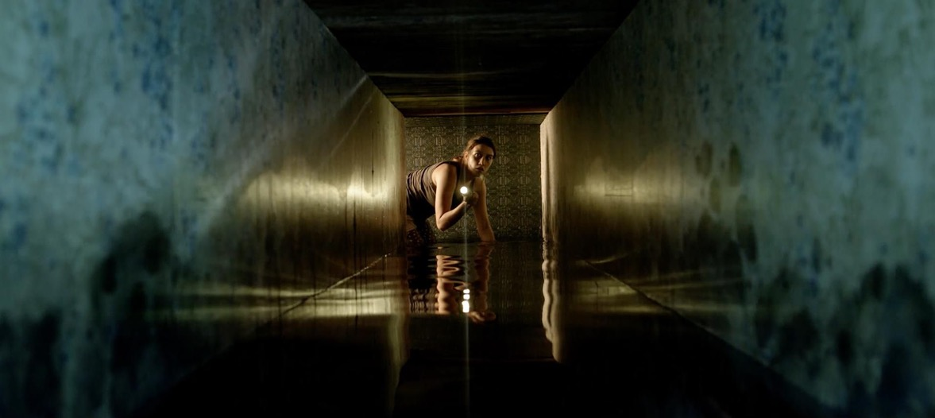
Erin Coates & Anna Nazzari
Biology | Environment
Erin Coates and Anna Nazzari are both Perth-based artists who frequently collaborate. Together they have produced films and sculptural installations, they also regularly exhibit their individual practices alongside each other. Coates and Nazzari work across a variety of shared mediums including drawing, sculpture and installation. Their artistic interests overlap too; both artists are concerned with the body, ideas of gender, absurdity and morality. Most recently, their shared focus has been the subject of Ocean Gothic.
still: Erin Coates, Australia, born 1977, Anna Nazzari, Australia, born 1976, Dark Water, 2019, Perth, 2K video with stereo sound, 15 mins; © Erin Coates/Anna Nazzari

Slide 3
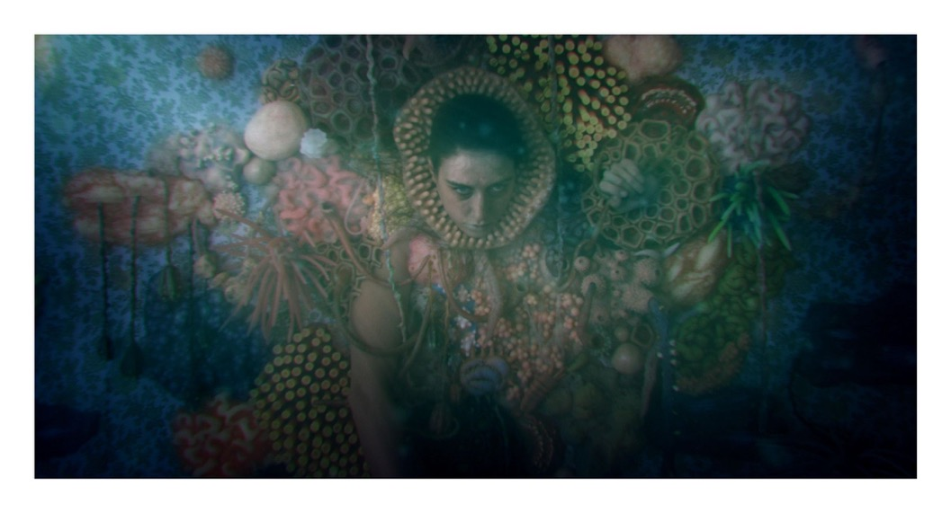
Ocean Gothic
Ocean Gothic is not to be confused with an art historical movement or sub-genre of contemporary art. Rather, it describes a philosophical relationship we have with the ocean. This relationship is centred on concepts of scale, power and beauty, and encompasses emotions like awe and sometimes even terror. The fact that the ocean is so deep and such a powerful force of nature, and also remains largely underexplored compared to other environments like the desert or outer space, means we fill the depths of what we don’t know with figments of our imagination. In Western art history and philosophy, there is a name for this special combination of beauty, reverence and fear of nature – the sublime. The term encompasses both our physical experience of natural environments as well as our feelings when we observe reproductions of awe-inspiring landscapes through painting, photography, film and even literature.
Coates and Nazzari explore ideas of Ocean Gothic in their works on paper, carvings and ceramics. They combine the mysterious and bewitching qualities of the ocean with the human body as a means to explore human fragility, as well as our attitudes towards the landscapes we live amongst.
Editing: still: Erin Coates, Australia, born 1977 and Anna Nazzari, Australia, born 1976, Dark Water, 2019, Perth, 2K video, sound, 15 mins; © Erin Coates/Anna Nazzari.

Slide 4
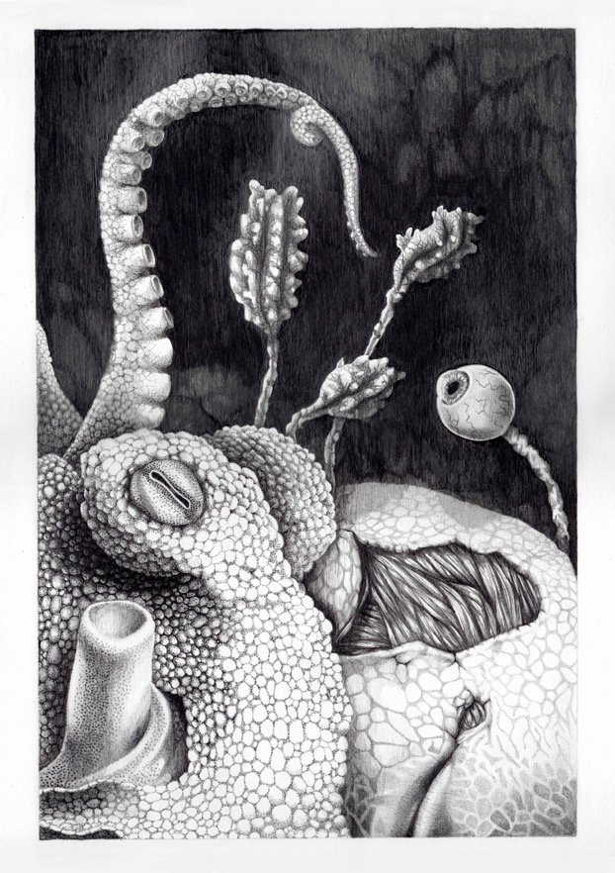
The Ocular Superiority of Cephalopods (2019) and Echinoderm Dentata (2019)
Erin Coates was born and raised in Albany, a coastal city on the southern tip of Western Australia. Her fascination with the ocean is partly inherited as her father was a professional shell diver; she grew up in a house full of shells, marine curios and relics from shipwrecks. An avid snorkeler and free-diver herself, the variety of marine life in her graphite drawings comes from first-hand observation. Across the series we see a menagerie of molluscs, sponges, weeds and corals in combination with parts of the human body.
The Ocular Superiority of Cephalopods (2019) sees octopus and human quite literally meet eye-to-eye. The two figures appear to be wrestling for space on the page but also in quiet observation of each other. Echinoderm Dentata (2019) describes a similar hybrid, where animal meets human.
The Ocular Superiority of Cephalopods, graphite on paper, 64 x 50cm, 2019

Slide 5
The Ocular Superiority of Cephalopods (2019) and Echinoderm Dentata (2019)
The title gives us a clue as to the combination. An echinoderm is a species of marine invertebrates, such as the starfish or sea cucumber, and the Latin term dentata means “toothed”. As you scan the fleshy forms populating the drawing you encounter sets of human teeth. Coates draws parallels between metaphors of the ocean and metaphors of the self. Having spent much of her time exploring the ocean, she shares an endless fascination and empathy for marine species. As she describes, “My fear is not of what is in the ocean, but the effect humans are having on it.”
Erin Coates in Erin Coates & Anna Nazzari: Dark Water, exhibition catalogue, Linden New Art, 4 March – 23 June 2019, p8. https://issuu.com/lindennewart/docs/dark_water_ecatalogue
The Ocular Superiority of Cephalopods, graphite on paper, 64 x 50cm, 2019

Slide 6
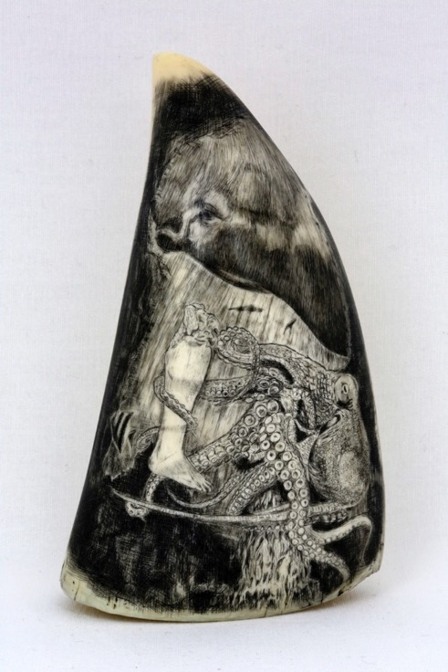
The Séance (2015), The Phantom Leg (2015) and The Burial Grounds (2015)
In 2015, Anna Nazzari produced a series of carvings using the late-eighteenth century technique of scrimshaw. The hand-skill involves engraving the surface of whales teeth and bones. As a relic of the whaling industry, the teeth are frequently dominated by heroic imagery chronicling dangerous sea journeys; coastlines and landscapes recorded from sea; and feature portraits of boats, sailors or important naval figures. A scrimshander, the title given to a person who produces scrimshaw, would often rub the carving with soot to make visible the etched surface.
With increasing demand for conservation, whaling in Australian waters permanently ceased in 1979. As a result, scrimshaw is rarely practised and contemporary scrimshanders only use whales teeth already in circulation. Nazzari sourced the teeth for her scrimshaw series through estates and antique auctions in Albany, one of the last operational whaling stations in Australia and where she learnt the craft.
Anna Nazzari, The Séance, 2015

Slide 7
The Séance (2015), The Phantom Leg (2015) and The Burial Grounds (2015)
Under Nazzari’s hands the whales teeth are powerful talismans. They are the physical evidence of an animal that once lived. Nazzari builds a relationship between your body and the imagined body of the whale; in observing the teeth, you and the spectre of the whale now occupy the same room. The imagery of The Séance (2015) doubles down on this idea. In their attempt to communicate with spirits, three men are seen to sit around a table conjuring a phantom whale. The Burial Grounds (2015) also describes a supernatural occurrence. A man levitates above the ribs of a beached whale. His hands and feet appear energetically charged, the background farm house places us out of time, and a brooding sky altogether evoke an eerie sense of spiritual power. Nazzari’s images of the whales, as well as the teeth themselves, embody tales of radical environmental change, loss and resurrection.
Anna Nazzari, The Séance, 2015

Slide 8
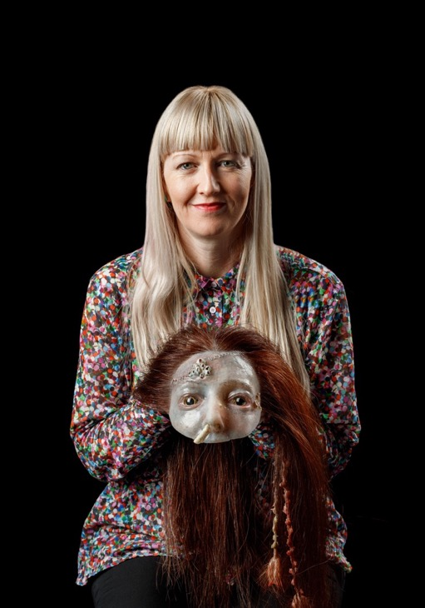
Early Years and Primary
Biology | Environment
Responding
Describe Coates and Nazzari’s Internal Interior sculpture in three words. As a class collate these words on a large sheet of paper. Using these words as a starting point what might the artists be communicating?
Coates has spent much of her time exploring the ocean and shares an endless fascination and empathy for marine species. “My fear is not of what is in the ocean, but the effect humans are having on it.” Investigate the effects humans are having on the ocean. What are some things we can do to minimise our impact on the ocean?
Research an unusual sea creature such as the flamingo tongue snail, clown frog fish, dumbo octopus or the eastern fiddler ray. Write a story about your unusual sea creature that includes interesting information about what it looks like, where it lives, what it eats and who its predators are.
Photo: Saul Steed

Slide 9
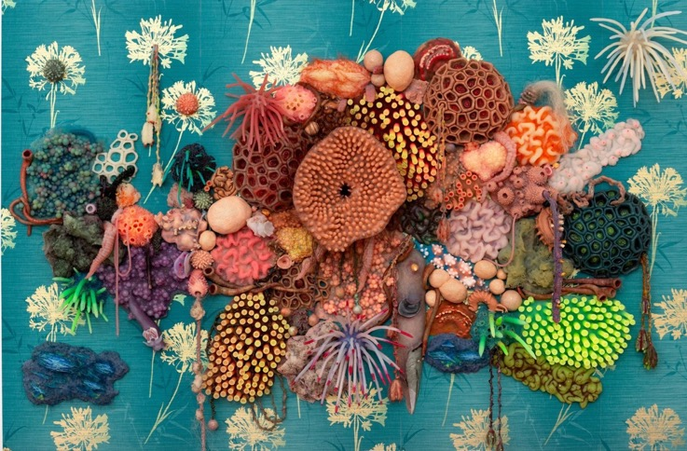
Early Years and Primary
Biology | Environment
Making
The whales’ teeth are powerful talismans. A talisman is an object that is said to have magic powers or may bring good luck. Do you have an object that brings you good luck? Make your own talisman - what special powers will it hold?
Using a variety of images of sea creatures, plants and animals, create an exquisite collage. Transform your collage into a 3D version of your monstrous creation using clay or plasticine. Name your unique marine creature.
What is your favourite memory of the ocean or time spent near a waterway? Create a simple line drawing or drypoint print that depicts an element of this memory.
detail: Erin Coates, Australia, born 1977, Anna Nazzari, Australia born 1976, Internal Interior, 2019, Perth, silicon, ceramic, hair, sperm whale tooth, wood, paper, 120.0 x 180.0 x 15.0 cm; © Erin Coates/Anna Nazzari

Slide 10
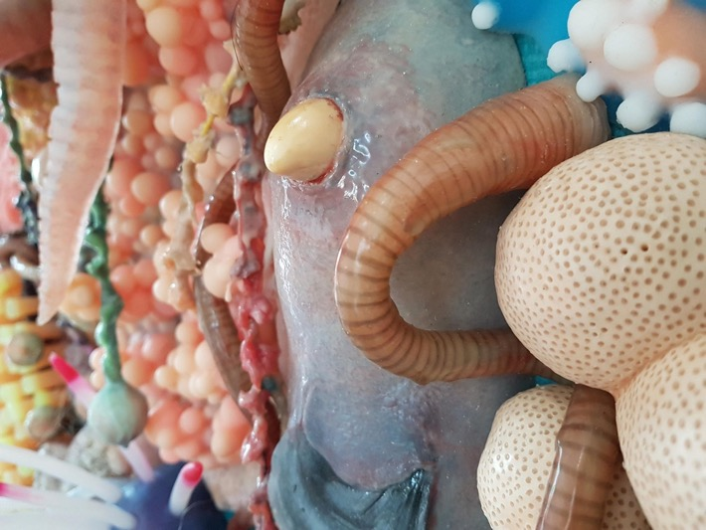
Secondary
Biology | Environment
Responding
The sublime is a massive category that can be expanded upon – questions about how seeing large, powerful scenes of nature make you feel.
Older students might watch the youtube link below on Edmund Burke’s “The Sublime”. – poetry o fthe sublime
Create a work of art about a supersition, unusal event – research a superstition – origins etc
Research habitat loss – work of art in resonse
Collaborate – create a video – animate drawings
Responding
How does seeing large powerful images of nature make you feel?
Investigate marine habitat loss in Australia. What are the causes of this loss? Write a letter to your local environment minister about your findings and concerns.
Research the history of the sublime. Begin by watching the videos about Edmund Burke and the Sublime. Why might we describe Coates’ and Nazzari’s work as sublime? Locate other works of art that you consider sublime, either in the Gallery or online. Write a poem in response to a sublime work of art.
detail: Erin Coates, Australia, born 1977, Anna Nazzari, Australia born 1976, Internal Interior, 2019, Perth, silicon, ceramic, hair, sperm whale tooth, wood, paper, 120.0 x 180.0 x 15.0 cm; © Erin Coates/Anna Nazzari

Slide 11
Secondary
Biology | Environment
Making
Collect images of coral and marine life and complete a series of drawings. Experiment by combining two or three of your drawings to create a new species. Make a clay or paper sculpture of your morphed species and create a collaborative reef installation with your classmates.
Research superstitions or an unusual event or story. Create a work of art that responds to this story. You might like to create a video or animation.
Investigate what radical environmental changes have occurred in Australia in the last 20 years. Recently artists have been making climate badges to send to their local politician in response to the inaction regarding climate change. Create your own climate badge.
Erin Coates, Australia, born 1977 and Anna Nazzari, Australia, born 1976, Internal Interior, 2019, Perth, silicon, ceramic, hair, sperm whale tooth, wood, paper; © Erin Coates/Anna Nazzari

Slide 12
Erin Coates & Anna Nazzari
Resources
Websites
Erin Coates, artist website http://www.erincoates.net/
Anna Nazzari, artist website https://annanazzari.com.au/
Open Water: The Offering, First Draft, 3 – 25 May 2018, Sydney. https://firstdraft.org.au/new-events/may-2017-ope-water-the-offering
“Whaling”, Australian Government: Department of the Environment and Energy, accessed 27 January 2020, https://www.environment.gov.au/marine/marine-species/cetaceans/whaling
Videos
“10 mins of video by Erin Coates and Anna Nazzari”, Vimeo, published 2017, https://vimeo.com/254065018
“Edmund Burke on the Sublime”, YouTube, published by BBC Radio 4, 7 November 2014, https://www.youtube.com/watch?v=t0fHjIPpR-Q
Edmund Burke – the Sublime, YouTube, published by School of Life, 22 January 2016,
https://www.youtube.com/watch?v=BvzG_p_sdOQ
Podcasts
“Curator Blair French on Erin Coates ‘The Last Climber Alive Must Keep Herself Fit and Ready’”, Soundcloud, published in association with The National: New Australian Art, Museum of Contemporary Art, 23 June 2017, https://soundcloud.com/thenationalau/erin-coates
Articles & Books
Bell, J., ‘Contemporary Art and the Sublime’, in Nigel Llewellyn and Christine Riding (eds.), The Art of the Sublime, Tate Research Publication, January 2013, https://www.tate.org.uk/art/research-publications/the-sublime/julian-bell-contemporary-art-and-the-sublime-r1108499
Coleman, S. “Erin Coates / George Egerton-Warburton”. Artlink, Vol. 34, No. 4, Dec 2014: 74-75.
Edited by Wilson, L., Catts, O., Viola, E. Unhallowed Arts, The University of Western Australia Publishing: Perth, 2018. Excerpt pages 62-63, hosted by Erin Coates’ website, https://static1.squarespace.com/static/57ad4b4237c58174719955a6/t/5cf4ff69598e060001234986/1559560095265/HyperBook.jpg
Erin Coates & Anna Nazzari: Dark Water, exhibition catalogue, Linden New Art, 4 March – 23 June 2019. https://issuu.com/lindennewart/docs/dark_water_ecatalogue
This resource has been written and developed by Belinda Howden, Dr. Lisa Slade, Assistant Director, Artistic Programs and Kylie Neagle, Education Officer.
Education programs at AGSA are supported by the Government of South Australia through the Department for Education.

