Slide 1
Dušan and Voitre Marek: Surrealists at sea
AGSA Kaurna yartangka yuwanthi. AGSA stands on Kaurna land.
The Gallery’s Learning programs are supported by the Department for Education.
Art Gallery of South Australia staff Elle Freak, Kylie Neagle and Dr. Lisa Slade contributed to the development of this resource.

Slide 2
Introduction to resource
This education resource introduces you to the work of Czech-Australian brothers Dušan and Voitre Marek. It can be used as a starting point in the classroom for students to learn about Surrealism, the experience of immigrating to Australia, the impact of war and the role of the curator. It is also the ideal companion to your Gallery visit.
Dušan and Voitre Marek: Surrealists at sea is the first major survey of the art of Dušan and Voitre Marek. From their arrival in Adelaide in 1948, Dušan and Voitre set into motion a surge of new ideas and controversies that challenged the conventions of Australian art.
Set against the sound of ticking clocks and a music box, this exhibition presents the breadth of their investigations. Highlights include the artists’ voyage paintings created during their long sea journey from Europe to Australia and Dušan’s pioneering surrealist films.
There are over 45 making and responding suggestions in this resource that are linked to the overarching themes within the Marek brothers' work and provide ideas that relate to the world of your students whilst they learn about Australian art history. Through this, students are invited to explore, discuss and compare their work with other artists they encounter in the Gallery's collection.

Slide 3
Dušan and Voitre Marek shared an unwavering commitment to their art. Although they were singular in their interpretations, they were united by their exploration of their own deeply personal and philosophical questioning about the world and their place within it.
Elle Freak, Associate Curator of Australian Paintings and Sculpture

Slide 4
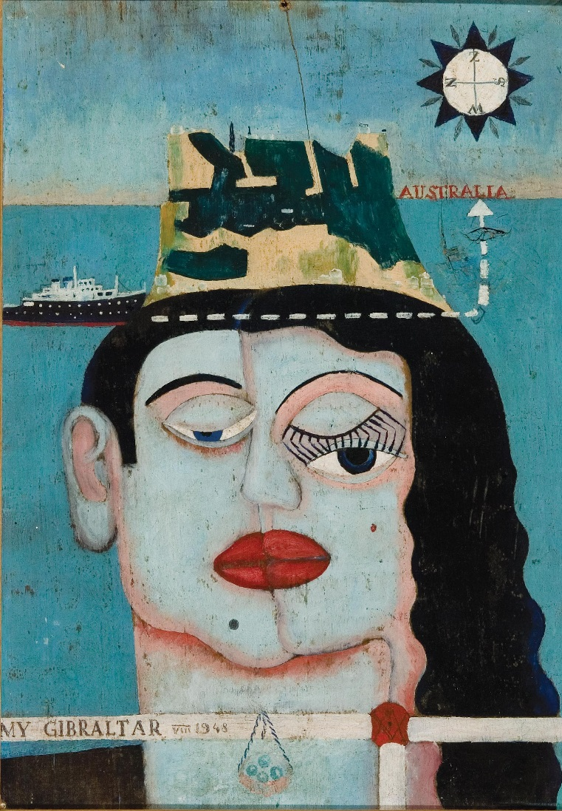
Introducing the Marek Brothers
Dušan Marek (1926-1993) and Voitre Marek (1919-1999) were born in Czechoslovakia. The brothers shared a nurturing, adventurous and creative childhood. As children, they developed artistic interests including a love of music and literature particularly concerning philosophy and world religions. Their grandmother was also interested in the arts and wrote poetry and their father encouraged them to pursue their own spiritual paths or faith.
After becoming a qualified jeweller and engraver in metal in 1938, Voitre moved to Prague to study sculpture and the history of art at the Academy of Arts, Architecture and Design. While there he perfected his technical skills and upon graduating in 1944, Voitre became a full-time sculptor and exhibited frequently.
Voitre Marek, Australia, 1919 - 1999, My Gibraltar, 1948, on board the SS Charlton Sovereign, oil on board, 29.0 x 20.5 cm; d'Auvergne Boxall Bequest Fund 1996, Art Gallery of South Australia, Adelaide, © Estate of Voitre Marek.

Slide 5
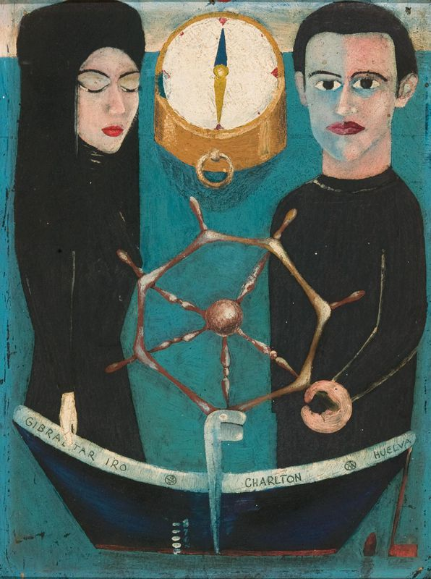
Introducing the Marek Brothers (continued)
At the age of thirteen Dušan declared himself a surrealist after he held his first solo exhibition. He was committed to surrealism throughout his career, interested in objet trouvé (found objects) and had a preference for painting on scrap materials. Encouraged by Voitre, Dušan studied painting at the Academy of Arts, Architecture and Design in Prague from 1946-48, where he was influenced by works of Surrealists such as Max Ernst.
In 1948 Marek and Voitre decided to flee Czechoslovakia as they feared for their safety and loss of creative freedoms under the Soviets (a communist regime of the late Russian Empire) who had taken control of their country. Dušan and Voitre Marek spent five months in a German refugee camp and arrived in Australia (Sydney and later Adelaide) in October. 1948.
Voitre Marek, Australia, 1919 - 1999, Gibraltar IRO, 1948, on board the SS Charlton Sovereign, oil on board, 29.0 x 20.5 cm; d'Auvergne Boxall Bequest Fund 1996, Art Gallery of South Australia, Adelaide, © Estate of Voitre Marek.

Slide 6
‘I do not care. I shall paint things as I see them. I abandoned realism when I was fourteen’
Dušan Marek

Slide 7
Getting started
Using a map of the world plot the Marek brother’s journey from Czechoslovakia, to Dillenburg in Germany and then to Australia. How far did they travel?
Do you have siblings? What things do you have in common with your siblings – what things are different? If you don’t have any siblings, what other family member are you most like or share similar interests with.
Examine works of art created by Dušan and Voitre Marek. What do you notice that is similar and/or different about their work?

Slide 8
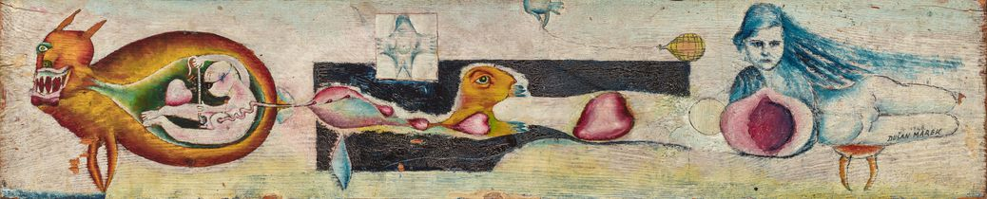
Experiences of war
The Czechoslovakian Communist Party seized full power in a coup d’état (or coup) in February of 1948. This resulted in immediate repression of Czechoslovakia and was the beginning of four decades of communist rule in the country. During this time, thousands of Czechoslovakians faced political persecution for a variety of freedoms - freedoms which today are considered basic human rights. It was illegal to emigrate across the political boundary which divided Europe, essentially those controlled by the Soviet Union and non-Soviet controlled areas, this is known as the Iron Curtain.
What is a coup d’état?
A coup is the seizure of a government and its powers by another political group or dictator. Coups are usually considered an illegal move. Although coups still do happen today, due to the increase of democracy around the world, they occur less often. Investigate coups (successful or not) which have happened in recent times.
Dušan Marek, Australia, 1926 - 1993, Birth of Love, 1948, Dillenburg, oil on wood, 14.7 x 72.0 cm; Gift of the artist 1988, Art Gallery of South Australia, Adelaide, © Art Gallery of South Australia.

Slide 9
Experiences of war
Prior to the Communist coup Czech artists created a variety of works from figurative to abstract as they were connected with the West and aware of such movements as Cubism and Surrealism. However, the Soviet influence on fine art was overwhelming. Travel and communication between the art worlds ceased and artists were forced to adapt to the new political climate, creating works that adhered to socialist ideals only. In essence, these works of art were considered propaganda; biased or misleading and used for political persuasion.
After the coup, artists who challenged this new order by creating works of art that could make people politically aware were considered enemies, as they defied the Communist regime. Fearing the loss of their creative and personal freedoms, Dušan and Voitre Marek along with Vera Podpěrová (Voitre’s fiancé) decided to flee Czechoslovakia. They were helped across the border by two guides and the Marek’s paternal cousin Milena Koliašová. Milena worked for the Czech Resistance and helped hundreds of people flee before an informer reported her actions to the Communist Party. She received a sentence of twenty-two years, of which she served ten, her husband was sentenced to a year of heavy labour for not reporting his wife to authorities and their children were denied a tertiary education.

Slide 10
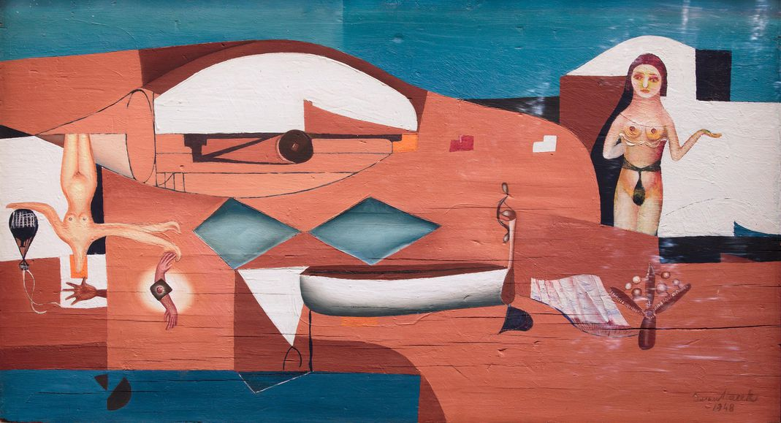
Experiences of war
In March 1948, Dušan, Voitre and Vera reached the assembly point for those seeking political asylum in Allied Occupied Germany and were taken to the Dillenburg displaced persons’ camp where they remained until July. Birth of Love and The Voyage by Dušan were created during his time in the camp and were painted on wooden slats that were removed from the base of their beds. These works survived, as did a series of drawings in a sketchbook by Voitre. These portraits captured the people he encountered in the camp and were accompanied by fragments of text in Czech.
On 4 August 1948, the Marek brothers sailed from Bremerhaven, Germany aboard SS Charlton Sovereign, arriving in Sydney on 29 October, while Vera travelled to Australia on the SS Wooster Victory from Genoa.
Dušan Marek, Australia, 1926 - 1993, Gibraltar, 1948, SS Charlton Sovereign, oil, synthetic polymer paint, pen & ink on board, 28.5 x 51.5 cm (image); Purchased with the assistance of James Agapitos OAM and Ray Wilson OAM 2007, National Gallery of Australia, Art Gall.

Slide 11
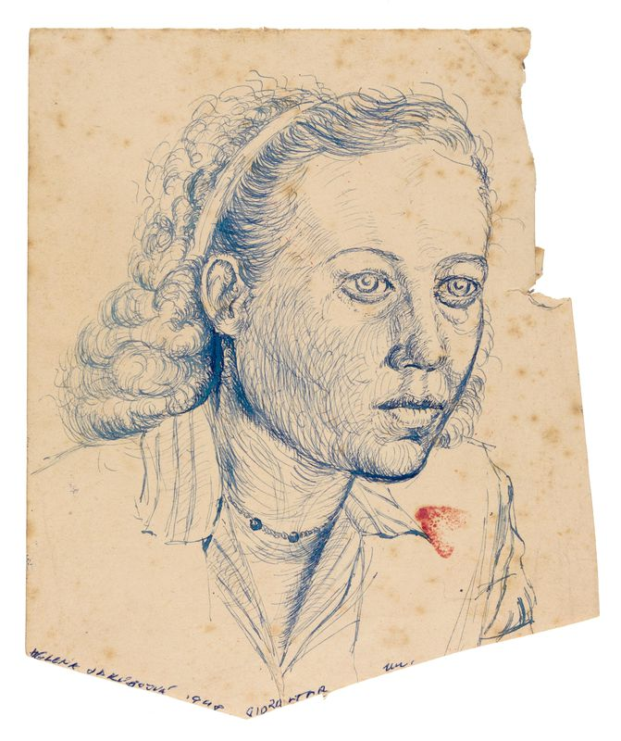
Responding
Look at the work by Josef Manes, Mikolis Ales and Josef Vaclav Myslbek who were considered good examples of progressive art, that drew inspiration from Czech folk culture. Compare these works to those created by the Marek brothers during this time. How were they different?
Why do you think art movements such as Impressionism, Cubism and Surrealism were forbidden under a Communist regime?
Discuss the following statement: ‘Art is a powerful tool to awaken society to political issues’. Find an example where an artist or a work of art has instigated change or brought about awareness of a political or social issue.
The portraits Voitre drew while in Dillenburg include inscriptions in Czech, which read like fragments of random thoughts or overheard conversations. Over the course of a week, be mindful and listen to conversations you hear as you are going about your day. Take notes of these fragmented pieces of dialogue. Use these words and sentences to create a surreal poem.
Voitre Marek, Australia, 1919 - 1999, Helena Jakubová, 1948, on board the SS Charlton Sovereign, pen & blue ink, pencil on paper, 18.1 x 15.5 cm (sheet, irreg.); Gift of the Marek and Sankey families through the Art Gallery of South Australia Foundation 2020, Art Gallery of South Australia, Art Gallery of South Australia, Adelaide, © Estate of Voitre Marek.

Slide 12
History in focus – 1939 Elle Freak, Elle Freak, Associate Curator of Australian Paintings and Sculpture
On 15 March Hitler’s forces invaded and occupied Czech lands before the Second World War had been officially declared, on 1 September 1939. Voitre was twenty years old and Dušan had just celebrated his thirteenth birthday. All members of the Marek family were affected by the Second World War.
In 1943, the brothers’ uncle, Antonín Marek, who was the father of their close cousin Milena (Miloslava) Koliašová (née Marková, 1915–2010), died of starvation in a concentration camp. According to Milena’s son Miroslav Kolias, Antonín was working as part of an entertainment troupe that staged puppet shows when he was reported to authorities for discussing the dangers of Nazism. The entire family was arrested. After pleading with authorities, Milena, her two sisters, Jara and Bozena, and her mother were sent to a ‘slave labour’ camp, while Antonín was sent to the Auschwitz concentration camp.

Slide 13
Drama, Art and English
Responding
Explore the history of puppetry throughout the world including traditional Czech puppetry, European marionettes in the 17th century, Indonesian shadow puppetry and compare these to more western or contemporary examples such as Punch & Judy, Sooty and Sweep or the Muppets. What do these puppets and the show they are part of all have in common?
Making
Dušan’s knowledge of puppetry would later be applied in his animations, while Voitre held puppet shows for the children on Kangaroo Island, where he worked as a lighthouse keeper from 1956 to 1958. Read more about the life of the Marek brothers in this resource, their early years in Czechoslovakia, their journey to and life in Australia. As a class, create a story board which captures significant moments in their lives. Assign different moments of the story to smaller groups. In your smaller group, create a series of puppets and perform a stage show that tells the life of Dušan and Voitre Marek.

Slide 14
Drama, Art and English
Making
Until 1938 Prague had around 1500 active puppet theatres, most of which were destroyed during the German Occupation, the Nazis being suspicious of the use of satire. Satire is the use of humour or exaggeration to highlight or criticize politics or topical issues. Satirical puppets often mock the physical appearance or behaviour of public figures. Explore the use of satire in Australian media platforms. Analyse and compare the use of language, literary and visual techniques between a contemporary and historical satire example.
Tip: Look at examples such as The Shovel, Sammy J or The Chaser. Select a current issue in Australian politics and create a satirical puppet show, comic or newspaper article.

Slide 15
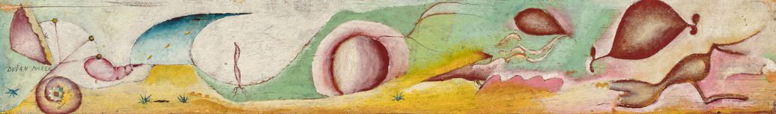
The voyage: immigration to Australia
Stormy weather and mechanical issues extended the length of Dušan and Voitre’s voyage aboard the SS Charlton Sovereign to Australia. During their long sea voyage, Dušan and Voitre created a small number of works, drawing on paper and painting on wooden panels from discarded crates and furniture.
The brothers also kept voyage journals, written mostly in Czech. Their writing during the journey is personal and full of observational details, as well as distant memories, thoughts and dreams. Dušan also wrote to his family explaining his intentions to one day return to home stating ‘the world may be large but it is also round’, while Voitre expressed his feelings of love and fear in his journal entries.
Dušan Marek, Australia, 7 /03/1926 - 1993, The Voyage, 1948, Dillenberg, Germany, oil on wood panel, 10.7 x 71.5 cm, 12.0 x 72.9 x 3.2 cm (including frame); Gift of the artist 1988, Art Gallery of South Australia, Adelaide, © Art Gallery of South Australia.

Slide 16
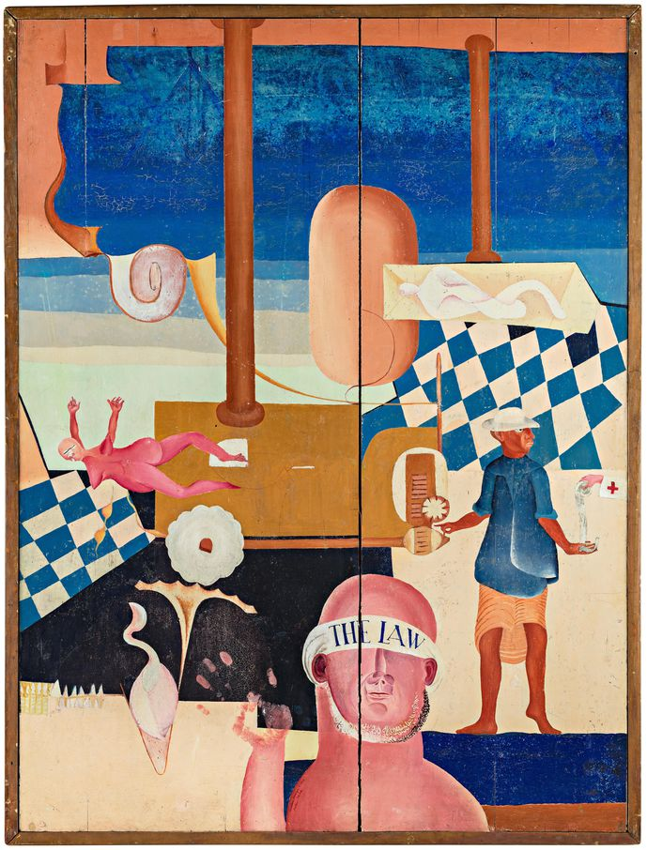
The voyage: immigration to Australia
Four paintings created by Dušan during the voyage survive including Perpetuum Mobile and Equator in AGSA’s collection which is painted on either side of the same wooden panel. This double-sided work was painted on the ship’s gaming table stripped of its felt covering. Equator depicts a surreal image where the distinctions between flesh and machinery are unclear, and figures and motifs float in space. The work may be displayed with either (or both) sides visible. It describes a universe where dual relationships and spatial dimensions are confused – even the painting itself doesn’t have a correct ‘front’ or ‘back’.
Dušan and Voitre arrived in Sydney on 29 October 1948 and travelled to the Bathurst Migrant Camp where Voitre was reunited with Vera. They stayed in Bathurst until December, long enough for the brothers to regain their health after being at sea for a long period of time, before they travelled by train to Adelaide.
Dušan Marek, Australia, 7 /03/1926 - 1993, Perpetuum mobile, 1948, SS Charlton Sovereign, oil on board, 121.7 x 91.2 cm; South Australian Government Grant 1972, Art Gallery of South Australia, Adelaide, © Art Gallery of South Australia.

Slide 17
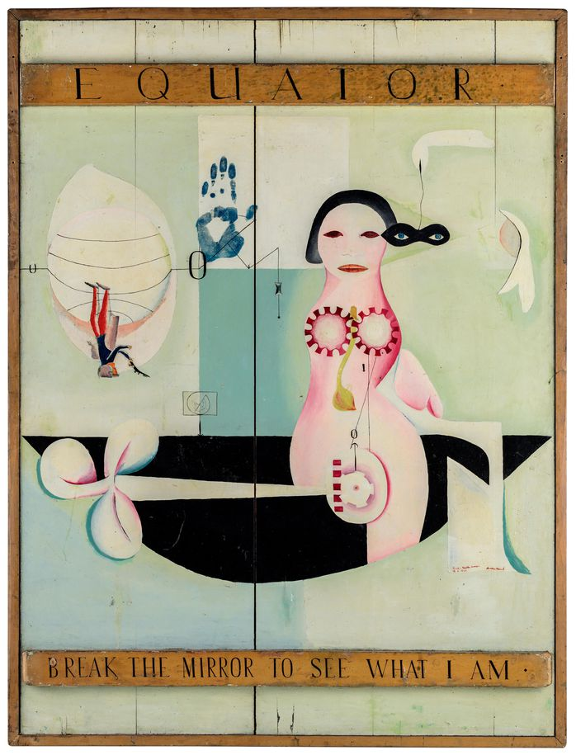
Take a closer look
What familiar symbols do you recognise in Equator and Perpetuum Mobile?
Janus is the God of beginnings, gates, transitions, time, duality and doorways and is usually depicted as having two faces, looking forward and looking back. Is the double-sided Equator and Perpetuum Mobile looking forward and back?
Sculptures are often viewed in the round, so that all sides are shown. Equator and Perpetuum Mobile is displayed so that both sides are shown. Would you consider this work of art a painting or a sculpture, or is it both?
A diptych is often a pair of paintings which are usually hinged together and displayed side by side. If Equator and Perpetuum Mobile were two separate paintings displayed next to each other how would this alter your perspective?
Dušan Marek, Australia, 7 /03/1926 - 1993, Equator, 1948, Gibraltar, SS Charlton Sovereign, oil on board, 121.7 x 91.2 cm, 126.5 x 96.0 x 5.5 cm (frame size); South Australian Government Grant 1972, Art Gallery of South Australia, Adelaide, © Art Gallery of South Australia.

Slide 18
Critical reception Elle Freak, Elle Freak, Associate Curator of Australian Paintings and Sculpture
Dušan’s double-sided voyage paintings, Perpetuum Mobile and Equator, 1948, were at the centre of early controversy. The immediacy of their imagery and materiality – inspired by and created in the context of world conflict – generated extreme responses. The paintings were rejected from display in the Seventh Annual Exhibition of the Contemporary Art Society, in Adelaide South Australia of July 1949. It was Dušan’s first exhibition in Australia and Voitre’s second. The circumstances surrounding the incident are not entirely clear, and the paintings were among eight works by Dušan and seven works by Voitre listed in the exhibition catalogue. According to Helena (Dušan’s wife), it could have been Lisette Kohlhagen, artist, CAS foundation member and secretary of the Royal South Australian Society of Arts (RSASA), who removed the works from display during the hanging of the exhibition: she had ‘complained that they had no proper frame and were obscene’. In his review of the exhibition, artist Ivor Francis acknowledged: ‘it is a great pity the selection committee was unable to find a place for some of the modern works rejected, particularly those of the surrealist painter Dušan Marek, our new arrival from abroad’.

Slide 19
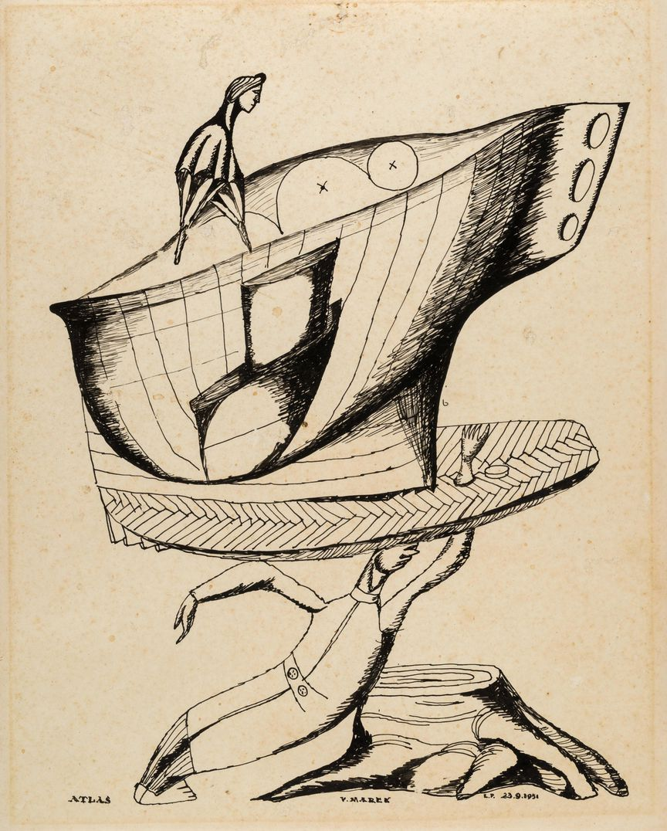
Responding
Dušan and Voitre spent time in a refugee camp and later decided to immigrate to Australia. What is the difference between a refugee and an immigrant?
Discuss some reasons people travel. What are some things you gain through the experience of travelling to a new place, particularly one which has a different culture to your own? What place would you like to travel to and why?
List some reasons people migrated to Australia in the 1940s and 50s. Why do you think people migrate today?
Voitre Marek, Australia, 1919 - 1999, Atlas, 1951, Adelaide, pen & ink on photographic paper, 25.2 x 20.1 cm (sheet); d'Auvergne Boxall Bequest Fund 1999, Art Gallery of South Australia, Adelaide, © Art Gallery of South Australia.

Slide 20
Making
Make a double-sided work of art. How might this work be displayed so that both sides can be viewed?
Both Dušan and Voitre created a small number of works, drawing on paper and painting on wood panels from discarded furniture. Create a work of art on an item which is destined for landfill.
Dušan and Voitre kept journals on their voyage to Australia. Create a work of art while on a journey somewhere. It might be while you travel to a place far away in a car or simply to school on a bus, train or tram or even while you walk to your destination.
Recall a time where you travelled somewhere for the first time. Write a letter to someone about that journey. How did you feel, what did you see? What did you like most about this new place?
Equator was to mark the occasion of crossing the equator. Think of an important event that has happened to you. Create a painting celebrating this event.
Speak to someone in your community who has immigrated to Australia. Document their story and create a work of art which captures the essence of their experience with migration. With their permission you may like to record their story and use their voice as an audio component in your work that tells their story first hand.

Slide 21
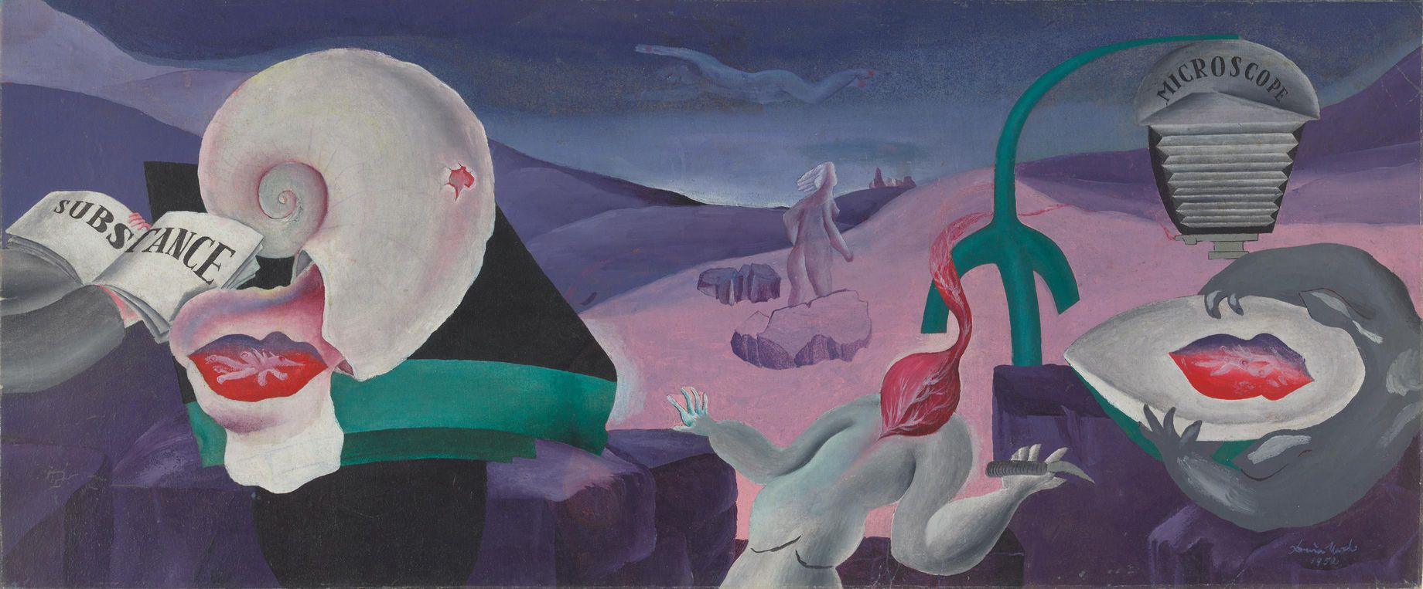
Life in Australia: Surrealism, dreams, travel and the ocean
Under a Commonwealth Employment Scheme for migrants, Dušan and Voitre were first employed by the South Australian Railways at Islington located a short distance north of the city of Adelaide, while Vera and Helena (Dušan’s future wife who he met onboard the SS Charlton Sovereign) worked at the Royal Adelaide Hospital. The brothers soon found new employment at Sheppards Jewellers where they could both utilise their skills in engraving and stone setting which they had learnt in Prague, later starting their own jewellery business ‘Marko’ in Kent Town, South Australia.
The brothers quickly took part in group exhibitions in Adelaide, stirring a wave of discussion and controversy. The early paintings, sculpture and drawings by Dušan and Voitre were incomprehensible to many. Their first exhibitions in Australia were not well received, and at times even censored. In one instance in 1949, Dušan’s double sided painting Equator and Perpetuum mobile was rejected on the grounds that it was obscene. For some, Dušan and Voitre’s disregard of formal conventions was frustrating and confusing, and their subject matter offensive and repulsive.
Dušan Marek, Australia, 1926 - 1993, Analysis of substance, 1952, Kings Cross, Sydney, oil on canvas, 36.5 x 88.2 cm; Purchased with the assistance of James Agapitos OAM and Ray Wilson OAM 2007 National Gallery of Australia, Art Gallery of South Australia, Adelaide.

Slide 22
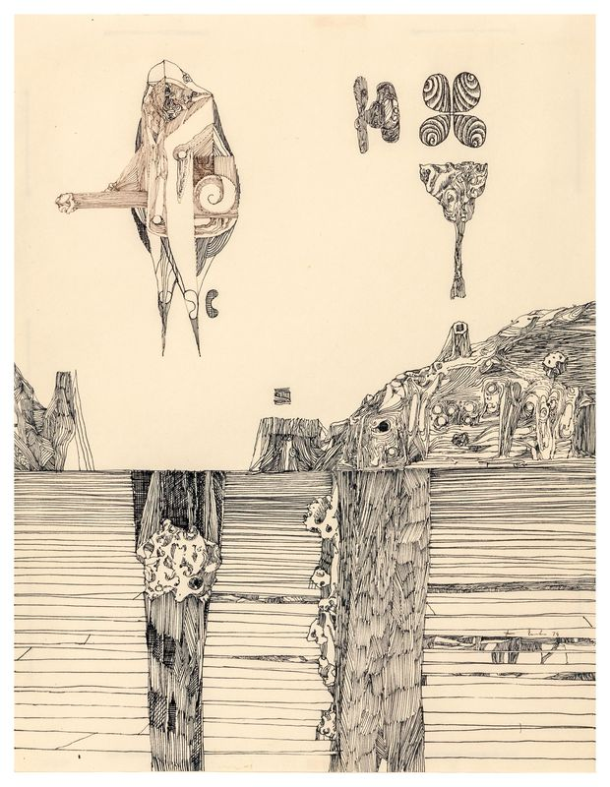
Dušan Marek
Frustrated by the rejection and prejudice of his work, Dušan and his wide Helena moved to Tasmania for a short period in 1951 and then to Sydney. In 1953 Dušan held his first solo exhibition in Australia at the Mack Gallery in Sydney, featuring fifty works of art. It was a show that engaged all the senses, with visitors surrounded in an immersive surrealist environment, with six ticking clocks, a tinkling music box, velvet bejewelled flowers, web-like drapes and burning incense. The responses to his work in this exhibition were varied. In an article titled ‘Beware of reality’ published in the Mercury, it stated Sydney viewers have described the work as obscene, fascinating, repulsive and powerful.
Dušan Marek, Australia, 7 /03/1926 - 1993, Untitled (Surreal landscape), 1974, Hobart, pen & ink on paper, 29.8 x 23.0 cm (sheet); Gift of Helena Marek 1996, Art Gallery of South Australia, Adelaide, © Art Gallery of New South Wales.

Slide 23
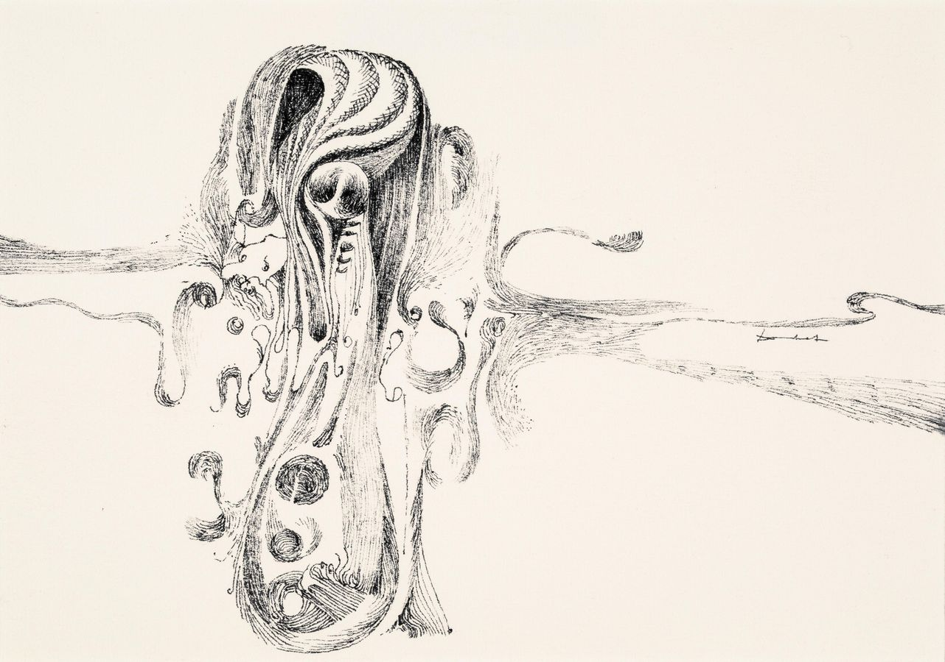
Dušan Marek
While in Sydney Dušan purchased a 16mm camera and produced two films, Light of the Darkness and Fisherman’s Holiday. He continued to produce drawings and paintings that referenced his voyage experience and personal philosophy. In 1954 Dušan and Helena moved to New Guinea where Dušan was employed as a photographer, later working on plantations in Rabaul before accepting a role as an engineer on boats that transported copra (dried or roasted coconut). While in New Guinea Dušan produced paintings and several films in addition to making film recordings of the local environment and people. Dušan also created several pen-and ink drawings and a series of lino blocks, which he printed on a textile and used to illustrate his unfinished book of poems Jelajou.
Dušan Marek, Australia, 7 /03/1926 - 1993, Untitled (abstract composition with swirling forms), 1960s-80s, Adelaide, Sydney, Hobart or Canberra, pen & ink on paper, 12.5 x 17.7 cm (sight); Gift of John Phillips through the Art Gallery of South Australia Foundation 2019, Art Gallery of South Australia, Adelaide, © Art Gallery of New South Wales, photo: Stewart Adams.

Slide 24
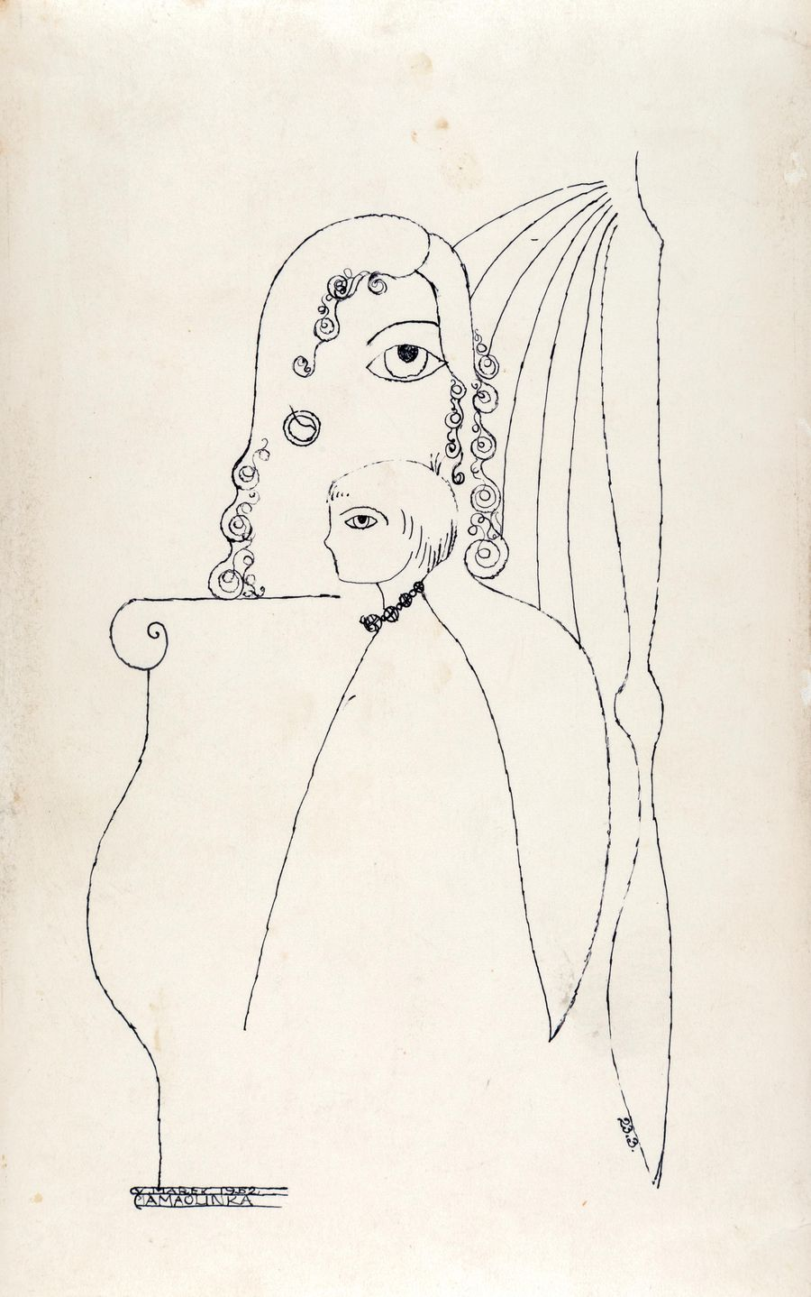
Voitre Marek
Voitre and Vera continued to live in Adelaide until 1956 when they joined the South Australian Lighthouse service and moved to Kangaroo Island with their two young children. They were stationed at three different lighthouse locations in South Australia: Cape du Couedic on Kangaroo Island; Troubridge Island, near Edithburgh on the Yorke Peninsula; and Cape Willoughby, Kangaroo Island. Both Voitre and Vera had dreamt of living as lighthouse keepers since they were in Prague and according to Vera in her unpublished memoir About my Husband: ‘For Voitre being a lighthouse keeper meant a true bonding with Australian nature’.
Voitre Marek, Australia, 1919 - 1999, My little Olga (A má olinka), 1952, Adelaide, pen and ink on photographic paper, 20.1 x 12.5 cm; Gift of the Marek and Sankey families through the Art Gallery of South Australia Foundation 2020, Art Gallery of South Australia, Art Gallery of South Australia, Adelaide, © Estate of Voitre Marek.

Slide 25
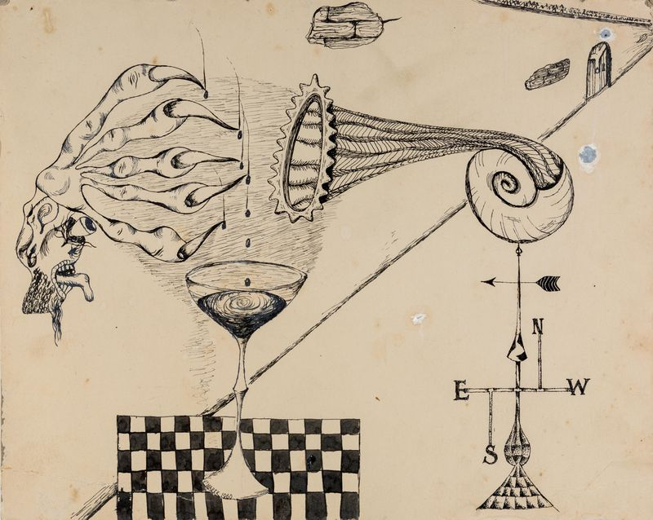
Voitre Marek
While a lighthouse keeper, Voitre continued to produce pen-and-ink drawings in a surrealist style with references to his growing faith, as well as creating busts of family and friends. Together Voitre and Vera also produced a puppet theatre and marionettes. Believing that their children may benefit from living in more conventional surroundings, Voitre and Vera decided to return to Adelaide in 1958. From the early 1960s Voitre decided to concentrate solely on his sculpture where he made works on commission for private individuals, churches and schools across Australia.
Voitre Marek, Australia, 1919 - 1999, Untitled, 1960, Adelaide, pen and ink on card, 25.0 x 31.5 cm (sheet); Gift of the Marek and Sankey families through the Art Gallery of South Australia Foundation 2020, Art Gallery of South Australia, Art Gallery of South Australia, Adelaide, © Estate of Voitre Marek.

Slide 26
Curator’s insight Elle Freak, Elle Freak, Associate Curator of Australian Paintings and Sculpture
On the beach, 1949, one of the first paintings Dušan created in Australia, summons multiple subconscious and poetic associations. He presents a series of organic shapes – suggestive of clouds, shells, human limbs and muscular tissue – freely occupying open space and even inhabiting the surface of the outer frame. When considering the words of curator Daniel Thomas, who observed how, during Dušan’s first Australian summer, he loved floating, not swimming, during long hours in the sea, On the beach perhaps conveys the disorientating sensation of sitting on hot white sand and then floating in cold rippling water. There is no sense of linear time or a clear passage of developing forms. The only fixed identity is the delicately described face of Dušan’s future wife Helena Jakubová. Here, in this painting, she inhabits an alluring position within a fertile activity of organic life, placed below a blue rain cloud and above fleshy coral-pink limbs. She is hovering somewhere between reality and dream.

Slide 27
Responding
Locate Czechoslovakia on a map. Notice how Czechoslovakia is land-locked, meaning that it is cut off from the ocean. When Marek arrived in Australia he was impressed by Adelaide’s beaches and the Coorong and would spend lots of time simply floating in the water. What are some special places you have been to? What was unique about this place?
Marek was impressed by Australia’s vastness and in particular the bright colour and hard clean light in South Australia. Research artists who have emigrated to Australia. How did their works capture their experience of a new place? Tip Yosl Berger, Khai Liew, Inge King, Wolfgang Sievers and Guan Wei.
In 1949 the Contemporary Art Society in Adelaide rejected Equator for its annual exhibition, stating it was too obscene. In 1987 the same painting was acquired by the Art Gallery of South Australia and in 1993 it was included in the exhibition Surrealism: revolution by night at the National Gallery of Australia alongside other surrealists such as René Magritte. How else did Marek challenge the mainstream with Equator and Perpetuum Mobile? Investigate incidents in Australian art history where contemporary works of art have caused controversy or debate.

Slide 28
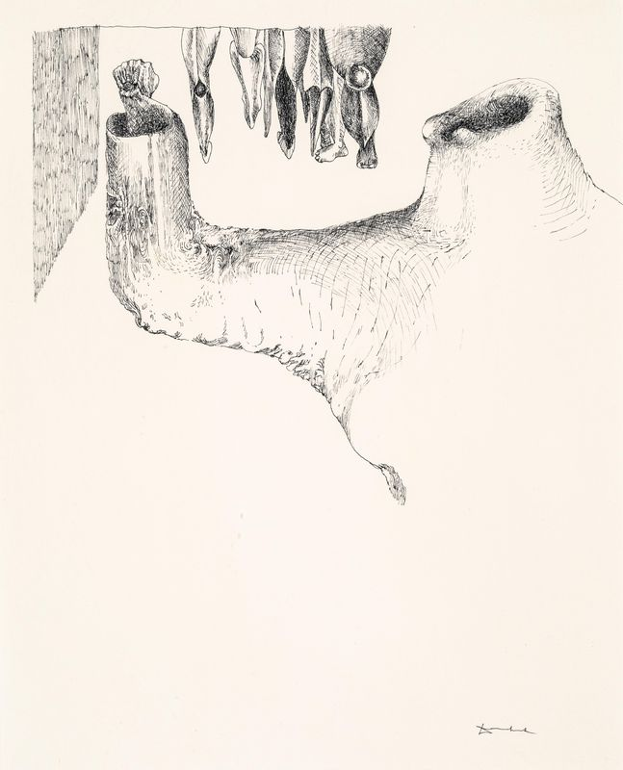
Responding
Ambiguity of form, intention and presentation puzzled many of the brothers’ early critics. Their first exhibitions inspired a range of responses, including the headlines, ‘Surrealist art show compelling’ and ‘Weird art display by two Czechs’. Using one of these two headlines, create your own exhibition review using works of art to support your claim.
On 11 November, 1950 Dušan purchased advertising space in The Advertiser, Adelaide, and stated: ‘Art cannot speak through nice social forms. It must not fear to speak plainly. Man is not privacy. Break the mirror which changes your sides. Empty yourself to see what you are. Dušan Marek’. Unpack each sentence, what do you think he meant by this? Do you agree with his statement? Consider this statement in relation to contemporary art today, is it still relevant?
Sydney viewers described Dušan’s work of art in his solo exhibition as obscene, fascinating, repulsive and powerful. Find examples which you think best suit these descriptions and explain why.
Dušan Marek, Australia, 7 /03/1926 - 1993, Untitled (surrealist composition with limb), 1960s-80s, Adelaide, Sydney, Hobart or Canberra, pen & ink on paper, 22.0 x 17.7 cm (sight); Gift of John Phillips through the Art Gallery of South Australia Foundation 2019, Art Gallery of South Australia, Adelaide, © Art Gallery of New South Wales, photo: Stewart Adams.

Slide 29
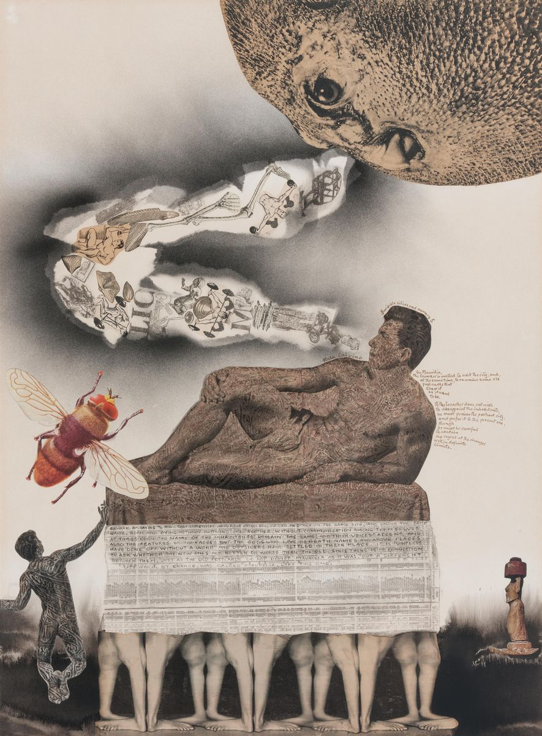
The Marek brothers and Surrealism
Surrealism was an artistic and literary movement which began in the 20th century and explored the unconscious mind as a way to unlock the imagination. Artists were inspired by dreams and included imagery which defied logic and suggested a new reality.
Investigate other Surrealist artists such as James Cant, Leonora Carrington, Ivor Francis, James Gleeson, René Magritte, Joan Miró, Meret Oppenheim, Dorothea Tanning and Remedios Varo. How do these artists compare to Marek’s approach to surrealism?
James Gleeson, Australia, 1915 - 2008, Invisible cities and memory 5, 1976, Sydney, collage of book and magazine, illustrations, some overprinted with linocut, airbrush & ink, stamp & ink, fibre-tipped pen on paper, 75.5 x 56.0 cm (image & sheet); Gift of Ray Wilson OAM through the Art Gallery of South Australia Foundation 2014. Donated through the Australian Government's Cultural Gifts Program, Art Gallery of South Australia, Adelaide.

Slide 30
The Marek brothers and nature
Dušan was disappointed by his first sight of the sea in Germany. However upon seeing rocks of Rode in South Australia, the glare and the whiteness of the sun and sand and the primal ocean surge, were characteristics that more attune to what he had visualised. When visiting the Coorong Dušan spent long hours in the sea floating, not swimming. Similarly, nature was an important element for Voitre, his time on Kangaroo Island, surrounded by sea, as described by Vera meant a true bonding with Australian nature.
The seashore as a place of transformation is a frequent theme in Surrealist art. Round the twist is an Australian children’s comedy series based on a collection of stories by author Paul Jennings. The stories follow the supernatural and at times unreal adventures of the Twist family who live in a lighthouse on the Southwestern Victorian coast. What do you think it would be like to live in lighthouse? Read a short story by Paul Jennings or watch an episode of Round the Twist. What elements of Jennings stories adhere to surreal ideas? Create your own surreal or unreal story centred around the ocean.
Dušan took eagerly to the strange Australian realities. James Gleeson (1915-2008) was a prominent surrealist artist whose work explore human nature through flesh-like and mechanical landscape forms. Look at the works by both artists. What do you notice that is similar and different between these two artists’ surreal works.

Slide 31
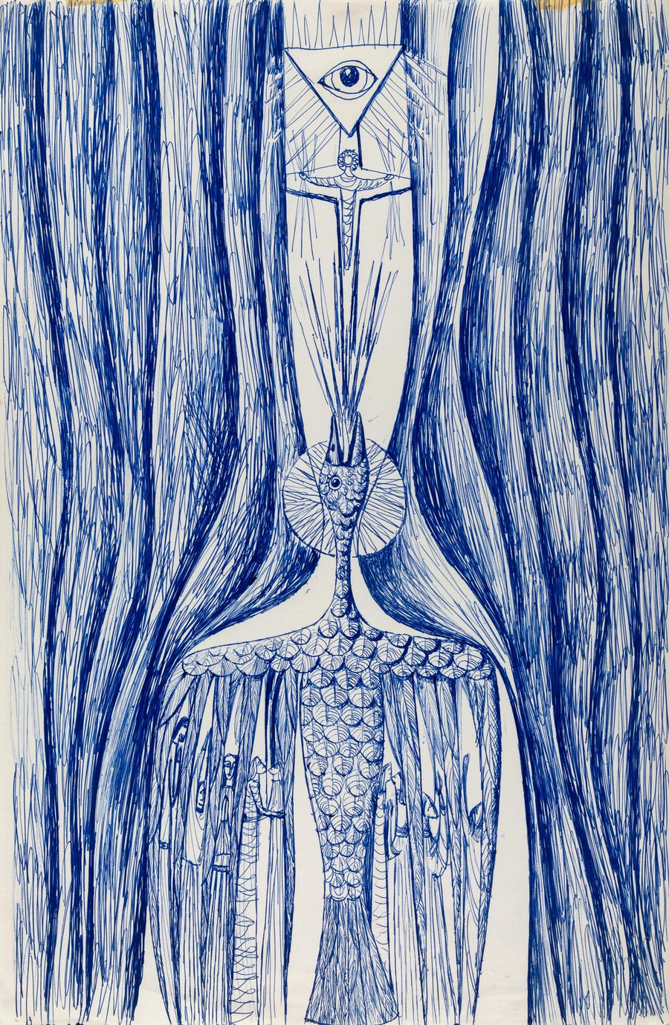
Making
Surrealist artists sometimes used Automatism (automatic writing) as a way of encouraging spontaneity and stimulating image-making. Artists would write as fast as they could without thinking, nothing is corrected or re-written. Practice automatic writing. Use your writing as inspiration for a work of art using either objet trouvé (found objects) or a salvaged surface. You may like to start by choosing words at random. These could then be illustrated on your salvaged surface or you could locate found objects that connect or respond to your automatic writing in some way.
List some things you find scary. Create a nightmarish scene using only biro and a single continuous line that incorporates some of these things.
Voitre Marek, Australia, 1919 - 1999, Untitled, 1960s, Adelaide, pen and blue ink on paper, 40.6 x 26.4 cm (sheet); Gift of the Marek and Sankey families through the Art Gallery of South Australia Foundation 2020, Art Gallery of South Australia, Art Gallery of South Australia, Adelaide, © Estate of Voitre Marek.

Slide 32
Making
Voitre and Dušan returned to drawing throughout their practice, using the medium for varied purposes including caricature, observational studies and animation. Dušan’s animated work was informed by the lively tradition of Czech animation, which began in the 1920s with advertising films. Dušan’s surreal animations Light of the Darkness, Fisherman’s Holiday and Nightmare are all silent three-dimensional puppet or plasticine works, with some carved wooden puppet heads in Nightmare. In contrast, Dušan’s animation Adam and Eve based on the biblical story of the creation of man and woman uses only dots, circles and lines. Create an animation using one of the methods below:
Create an abstract animation based on a biblical or mythological allegory using only coloured paper cut into basic geometric shapes.
Write a collection of words on different pieces of paper. Eg. Bicycle, clock, time, winter, summer, cold, travelling etc. The more words the better. Take turns selecting a word at random until you have 10 words. Using these words as the basis for your story create a surreal animation. You may like to make paper puppet or plasticine figures to illustrate your surreal story

Slide 33
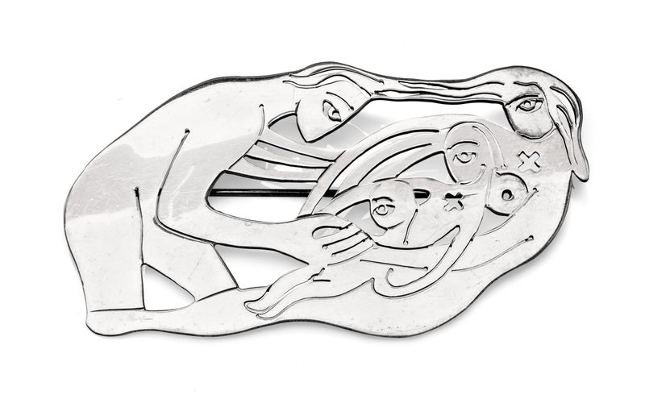
Making
Surviving examples of Voitre’s jewellery, created on impulse for friends and loved ones, have a more personal and individual tone. These include a small curvilinear brooch in the shape of a perfume bottle, adorned with marcasite (polished pieces of pyrite – crystal like in structure) which is in AGSA’s collection. Created by Voitre for Vera, the organic form could be equally recognised as a heart, or a piece of fruit, seeming to melt into and even emerge from the shapes of nature. In another example, Voitre employs a series of fluid and interconnecting lines to define an image of himself with his wife and their two young children.
Using aluminium, cardboard or recycled materials create a piece of jewellery for someone you care about that symbolises an aspect of your relationship with that person.
Dušan and Voitre delighted in the act of emptying fragments of their thoughts, feelings, and memories into their works, which then act as portals for the viewer’s own liberating experience. For two weeks, keep a journal of all your thoughts, feelings, dreams and memories. Use this journal as a starting point for a work of art that captures some of these ideas.
Voitre Marek, Australia, 1919 - 1999, Brooch (family group), c.1953, Adelaide, silver, 8.4 x 4.6 x 0.6 cm; Gift of Dr Jane Vernon-Roberts through the Art Gallery of South Australia Foundation 2020, Art Gallery of South Australia, Art Gallery of South Australia, Adelaide, © Estate of Voitre Marek.

Slide 34
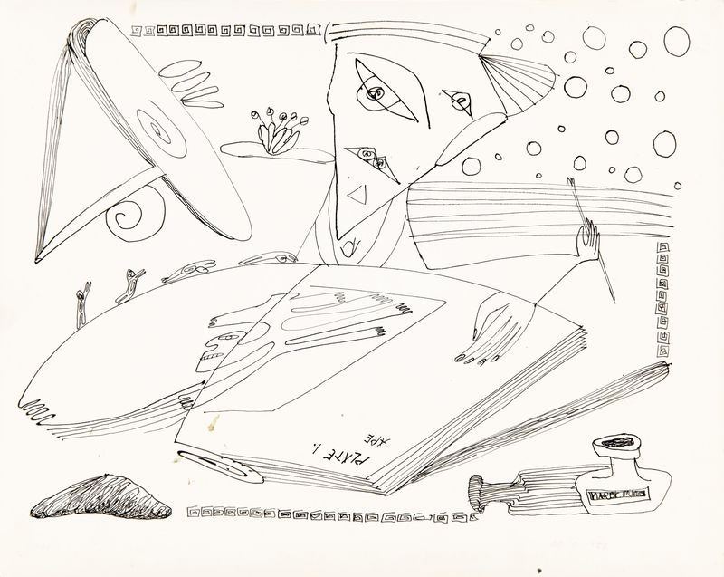
What is surrealism?
Surrealism is an art-historical, literary and intellectual movement originating in Europe during the inter-war years of the twentieth century. With a focus on freeing the subconscious mind and championing chance and irrationality, surrealists such as André Breton, Salvador Dali, Rene Magritte, Max Ernst, Meret Oppenheim and Dorothea Tanning used art as a means for uncovering the workings of the mind. These artists blurred the lines between dream and reality and explored repressed desires to expose deeper realms of the human psyche.
Surrealism adopted a number of the art-making methods established earlier by the dadaists, a generation of artists who revolted against the horrors of the First World War. These included opening up the artistic process to chance, using games to create art, and producing art in groups or collectives. They also developed a number of new artistic techniques, including automatic drawing and writing, rubbings taken from uneven surfaces (known as frottage) and decalcomania – the impression of paint onto a surface to create abstract and uncanny effects. These methods helped the surrealists to explore hidden dream worlds and unlock the mysteries of the mind.
Visit What is Surrealism to see examples of surrealist works in AGSA’s collection
Voitre Marek, Australia, 1919 - 1999, Mood, 1952, Adelaide, pen & ink on photographic paper, 20.2 x 25.2 cm (sheet); d'Auvergne Boxall Bequest Fund 1999, Art Gallery of South Australia, Adelaide, © Art Gallery of South Australia.

Slide 35
Making and responding
Investigate Investigate surrealist works of art by South Australian artists Dusan Marek, Jacqueline Hick, Ivor Francis, Peter Purves Smith and Jeffrey Smart. What makes these works surreal?
Explore After looking at a variety of surrealist works of art, brainstorm common characteristics. Write a definition for surrealism based on the works you have seen.
Create Using collage create a hyperreal scene featuring a surreal creature or figure placed in a contemporary world. Select three images – of an everyday object, an animal and a landscape. Combine these elements to make your own surreal collage.

Slide 36
Making and responding
Automatic writing or drawing
Place an interesting object in the centre of the room. Using this object as stimulus write automatically for a timed period. Relax your mind and allow your writing to flow spontaneously. Use this writing to create a short story about this object and compare your writing with that of others. Record your dreams for a week and create a work of art inspired by your dreams.
Tip: Try to use only blue biro so that you aren’t tempted to edit your work – let your imagination run free!
Decalcomania
Make a series of blobs onto paper using watercolour paint or diluted acrylic paint. Move the paint around by tilting the paper to create random shapes. Once dry, draw over or around these shapes to transform them into something else.

Slide 37
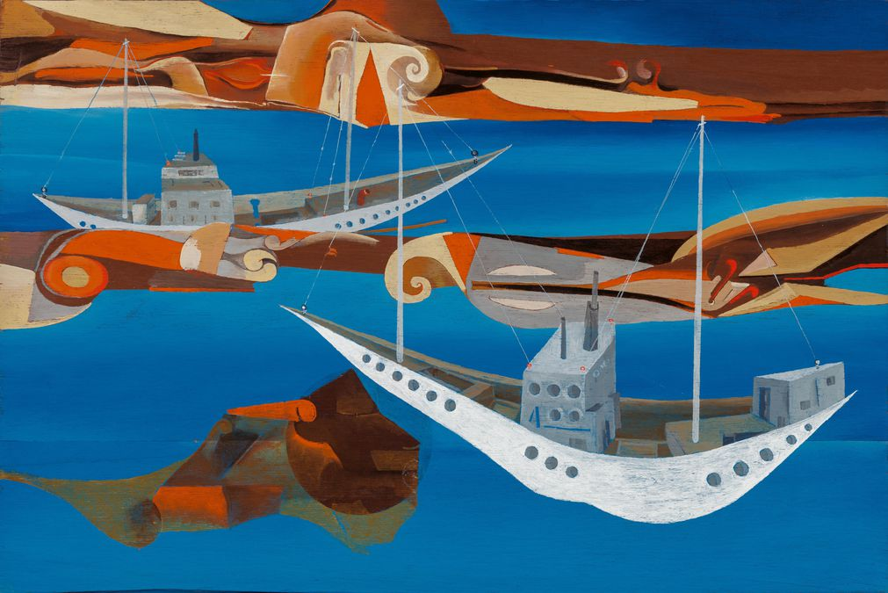
A surreal adventure in Dušan and Voitre Marek: Surrealists at sea
Attention teachers – this information is for you!
You are the captain of your class and will be in charge of exploring Dušan and Voitre Marek: Surrealists at sea.
Facilitate the following activities to engage your students with works of art while they look, imagine and draw some surreal scenes in the exhibition!
You will need a surreal school kit which includes:
Lead pencils
Sketch books
Make sure students each have a pencil and sketchbook before you enter the exhibition space.
Dušan Marek, Australia, 1926 - 1993, Karu and Kulu, 1993, Eden Hills, oil, synthetic polymer paint on plywood, 45.6 x 68.3 x 4.2 cm; Private collection, Art Gallery of South Australia, Adelaide, © Art Gallery of New South Wales.

Slide 38
Getting started
Dive into Surrealists at sea and make your way into the exhibition. Warming up the brain (5min)
Look at the work Perpetuum Mobile and Equator for one minute.
Now spend one-minute thinking/writing of some words in response to this work of art (like a word association game).
Play a round-robin with each student sharing one word from their list. Continue to share a different word, how many times can you get around the circle before you run out of words.
Idea for back in the classroom Collate the words from your round-robin game and use them as a starting point to write a short surreal story.
Early years/primary Students may simply share one word out loud
Middle/secondary
Students are encouraged to write down their responses

Slide 39
Warming up the drawing hand (5min)
These are quick exercises (1 minute each) that the captain (teacher) will direct:
Draw your favourite animal using the hand you write with
Draw your favourite animal using the hand you never write with
Draw your favourite place or food standing on one leg
Draw the work of art in front of you only using straight lines (or using circles or triangles).
Draw a continuous line drawing of another work of art without taking your pencil off the page.
Blind drawings (10min)
Draw the person in front of you without looking at your paper or taking your pencil off the page.
Halfway through drawing, instruct the students to turn their paper upside down or on its side and continue drawing.

Slide 40
Exquisite Corps (5min)
Exquisite Corps is a game surrealist artists played and one that is still popular today. Participants take turns in drawing a section of a body on paper, folding the drawing to hide their contribution, before passing it on to another person to draw the next section. Sometimes the results are funny, odd and grotesque!
Find examples in the exhibition where Dušan and Voitre Marek have applied this method to their work. Draw your favourite exquisite corps!
Using the concertina sketchbook try your hand at your own exquisite corps. You could take inspiration from some of the themes in the exhibition.
Idea for back in the classroom Try some more exquisite corps with writing, poetry or collage.
Collecting objects (10min)
As a class make a list of the objects you can see in the works of art by the Marek brothers. For example, clocks, boats, water etc.
Teacher to lead! Using the class list, call out one of the words. Students to draw this object from memory. After one minute, call out a different word. Student will stop drawing the previous object and begin drawing the new one. Continue this method, repeat word and vary the time between each prompt. Students may join their objects together in some way so that it becomes one drawing.

