Slide 1
Michael Candy Interpretive Resource
Technology | Robotics

Slide 2
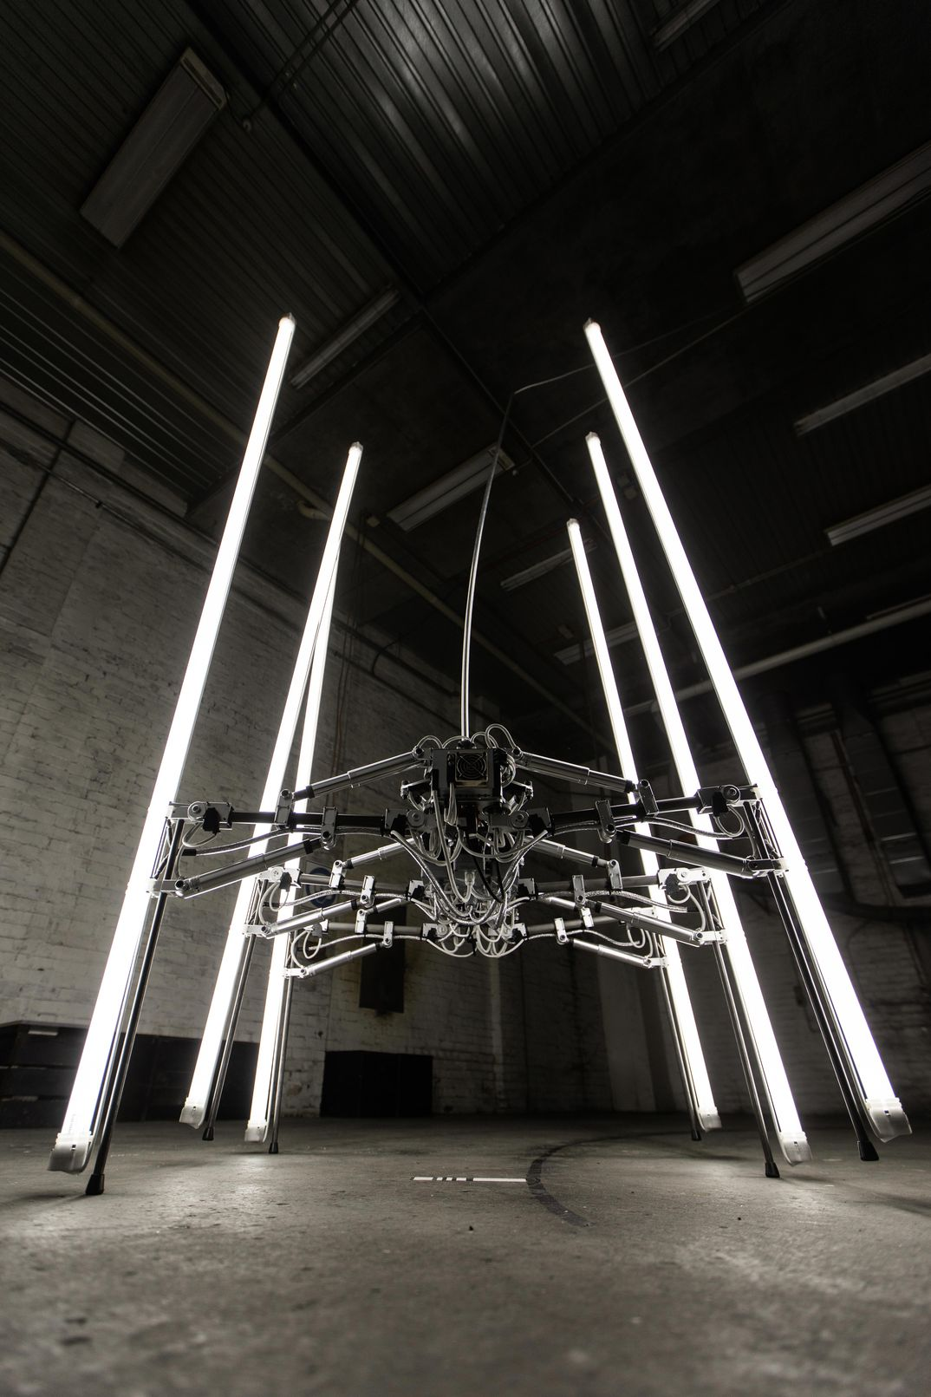
Michael Candy
Technology | Robotics
Born in Durban (South Africa) in 1990, Michael Candy currently lives and works on the Gold Coast in Queensland. Having studied fine art and industrial design, Candy breaks down everyday machines and devices to re-build them as kinetic sculpture. He describes his approach towards robotics and technology as “instinctive engineering”, an intuitive method of construction and design.
Kinetic art is a term used to describe works of art that move, have moving parts or can be perceived to be in motion. In Western art history, kinetic art traces back to the early twentieth-century. As modern modes of transport such as cars, trains and aeroplanes were invented, artists strived to reflect the changing world around them. In particular, they wanted their art to capture concepts of speed, movement and time. Candy’s sculptures echo these sentiments. His art makes use of twenty-first century technologies, software and hardware that is now essential to navigating our daily lives.
installation view: A Forest featuring Cryptid by Michael Candy, Dark Mofo, Hobart; Courtesy Dark Mofo.

Slide 3
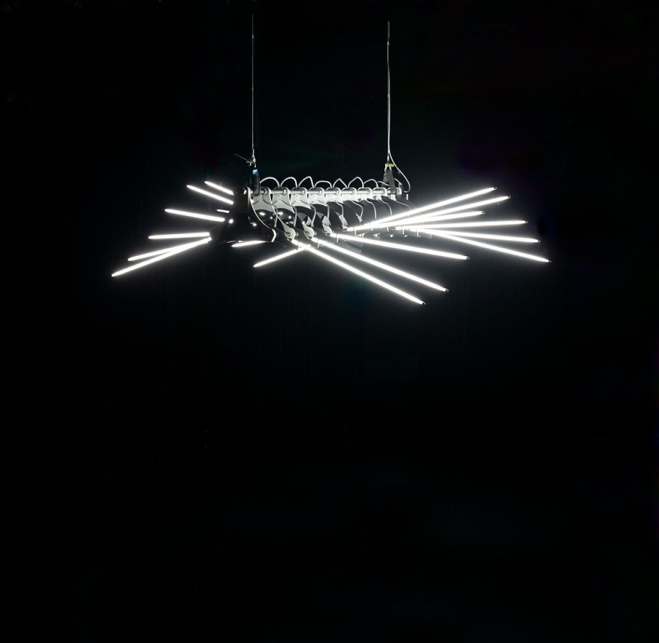
Big Dipper (2014)
Michael Candy is as fascinated by nature as he is robotics. He frequently twins the two sources of inspiration in his sculpture. The results can be described as biomimetic – an object that imitates a plant or an animal. Big Dipper (2014) features nine pairs of fluorescent arms, attached to a central metal spine. Its illuminated limbs move slowly and smoothly through the air in a wave-like pattern. All at once, the sculpture resembles an insect, an octopus or perhaps something we might find at the depths of the ocean. The title of the work, Big Dipper, refers to a star constellation of the same name. This constellation is visible from both hemispheres of the globe. This is an important feature to Candy as he is interested in the ways in which humans, flora and fauna are united through universal patterns in nature. Although Big Dipper appears familiar to us for all these reasons, Candy has actually created a new kind of creature.
installation view: A Forest featuring Big Dipper by Michael Candy, Dark Mofo, Hobart; Courtesy Dark Mofo, photo: Remi Chavvin

Slide 4
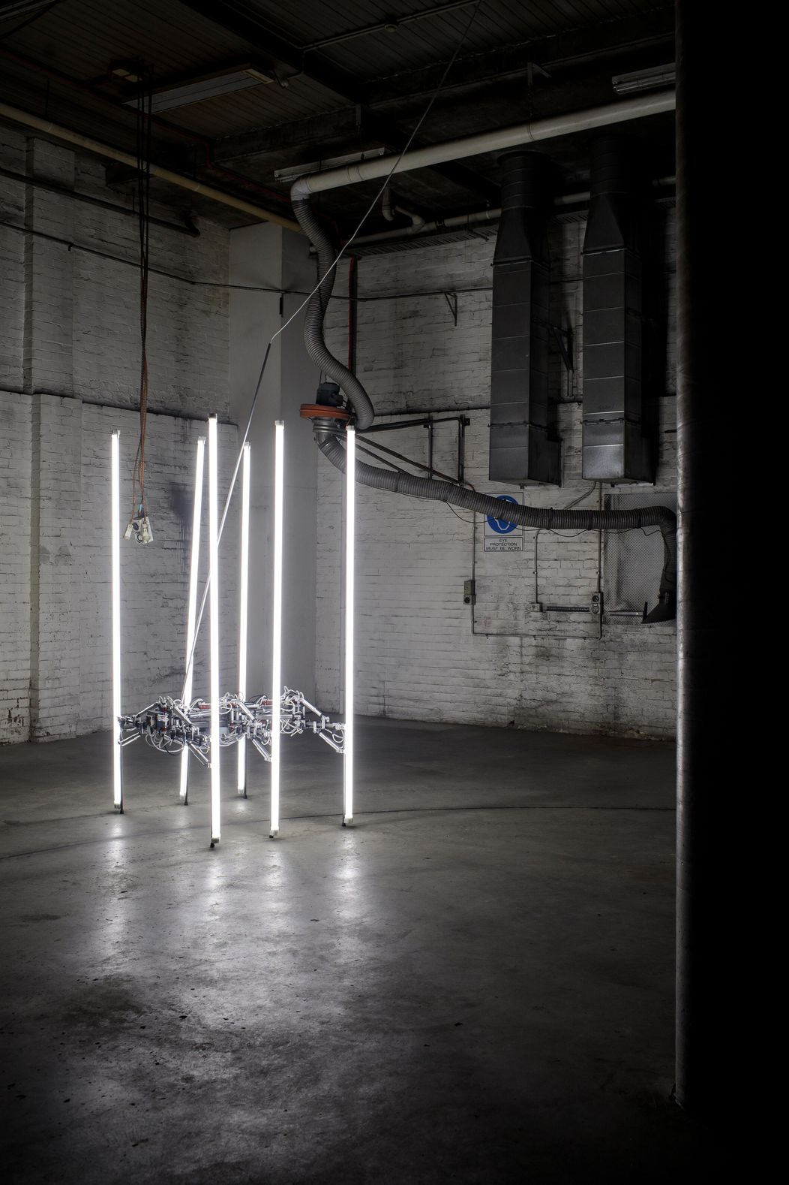
Cryptid (2019)
Cryptid (2019) is a lumbering kinetic light sculpture and another example of a biomimetic form. With six illuminated legs and an articulated body, the sculpture looks like an oversized, slow-moving insect.
The term ‘cryptid’ is used to describe creatures whose existence is unknown or purely anecdotal, rather than based on scientific evidence. Examples of cryptids include the Loch Ness Monster of Scottish folklore, the Yeti of the Himalayas or North America’s Bigfoot. These animals share an aura of elusiveness; they have managed to avoid capture and subsequently become known and studied by scientists.
Michael Candy’s Cryptid prompts us to think more deeply about technology. As our lives have become increasingly dependent on devices and machines, he asks us to consider their place and role in the world. Just as we classify insects, flowers, trees and even clouds, might we also classify robots? Candy is proposing his cryptid has autonomy – that it can think and act on its own, independent of human control. As a self-acting, independent entity, could Cryptid be a new kind of species?
Editing: installation view: Michael Candy, South Africa, born 1990, Cryptid, 2019, Gold Coast, Queensland, A Forest, Dark Mofo, Hobart; © Michael Candy/Michael Bugelli Gallery, courtesy Dark Mofo

Slide 5
Early Years and Primary
Technology | Robotics
Responding
If Candy’s Cryptid lived outside of the Gallery what might be its daily habits? Where would it live and what would it eat? What does it do all day?
We rely a lot on technology to function in the world today. From the moment we wake up technology is an important part of how we work, play and engage with others. How often do you use technology? Create a log book for a week recording the amount to times you used or engaged with technology. As a class brainstorm some the benefits and consequences of using technology excessively?
Research other contemporary artists who have used light and movement as their medium. For example Olafur Eliasson, Dan Flavin, Rafael Lozano-Hemmer, Jonathan Jones, Ross Manning, teamLab, James Turrell.
Making
Invent your own cryptid. What does it look like, how does it move, where does it live, what are its habits, what role does it have in its environment? How might you classify your cryptid? Is it a flower, animal, humanoid or machine?
Create your own kinetic work of art that explores the concept of speed, movement or time.
Big Dipper, refers to a star constellation of the same name. This constellation is visible from both hemispheres of the globe. Create a work of art that responds to something in nature you are interested in. It might be a particular constellation, or other natural phenomena such as the weather, seasons, bodies of water or earth formations.

Slide 6
Secondary
Technology | Robotics
Responding
Compare the works of Alex Calder and Jean Tingley with those of Michael Candy. What is new or different about Candy’s work compared to early kinetic art?
Our lives have become increasingly dependent on devices and machines. Create a technology audit of your life. How dependent are you on technology? Make a list of your daily activities, how many of these rely on some form of technology? What are the pros and cons of life with and without certain types of technology?
Michael Candy encourages us to consider the role of technology in the world. Artificial intelligence (AI) is progressing rapidly automating tasks that are normally performed by humans. It has been predicted that in the next 15 years, driverless cars will be in circulation and companies like Amazon will soon be able to deliver items to your door via drone as soon as an order is placed. Investigate jobs that AI will replace. For each of these examples brainstorm industries and jobs that will be impacted on the introduction of this technology. What jobs will disappear? What are some new jobs that will be created?
Making
Spend time observing Cryptid. Create a series of observational drawings of the work. Imagine you are a scientist encountering this species for the first time. Document your thoughts about the way it moves, sounds it makes and what it looks like. Annotate your drawings as if they were scientific illustrations.
Create your own kinetic work of art that explores a concept of speed, movement or time.
Deconstruct an everyday item that no longer works and would have otherwise been destined for landfill, for example a bike, computer, an old toy, radio or musical instrument etc. Create a new work of art using the pieces from your deconstructed item.
Michael Candy created a work titled Synthetic Pollinizer which was a work of art made for bees. Create a work of art for a different species.
Tip: Watch Making Art for Bees, Synthetic Pollenizer video.

Slide 7
Michael Candy
Resources
Websites
Michael Candy’s website: https://michaelcandy.com/
Atlas Obscura, Making Art for Bees, https://www.atlasobscura.com/articles/robotic-bee-restaurant
Videos
Atlas Obscura, Making Art for Bees, Synthetic Pollenizer https://vimeo.com/250782302
“Prix Cube 2016 Michael Candy | Big Dipper”, YouTube, published by Le Cube, April 20 2016
https://www.youtube.com/watch?v=VKRKCnGThhE
Michael Candy’s YouTube Channel
https://www.youtube.com/user/Michaelcandyart/featured
Michael Candy’s Vimeo Channel
https://vimeo.com/michaelcandy
Marsh, C. “Art in motion”, ABC 91.7 Gold Coast, 13 October 2011
https://www.abc.net.au/local/videos/2011/08/23/3338671.htm
Articles
Cormack, E. Artlink, “Digital: The World of Alternative Realities”, 31 March 2017, https://www.artlink.com.au/articles/4586/digital-the-world-of-alternative-realities/
Hill, P. Artlink, “Superfictions and adventurism: The art in everday life”, 1 December 2016, https://www.artlink.com.au/articles/4558/superfictions-and-adventurism-the-art-in-everyday-/
Hill, P. Artist Profile, “Michael Candy”, issue 47, 2019, https://www.artistprofile.com.au/michael-candy/
O’Brien, J. The University of Melbourne: Asialink, “Art and Robotics at the Kathmandu Triennale”, 12 April 2017
https://asialink.unimelb.edu.au/stories/art-and-robotics-at-the-kathmandu-triennale
This resource has been written and developed by Belinda Howden, Dr. Lisa Slade, Assistant Director, Artistic Programs and Kylie Neagle, Education Officer.
Education programs at AGSA are supported by the Government of South Australia through the Department for Education.

