Slide 1
Pierre Mukeba Interpretive Resource
Culture | Identity

Slide 2
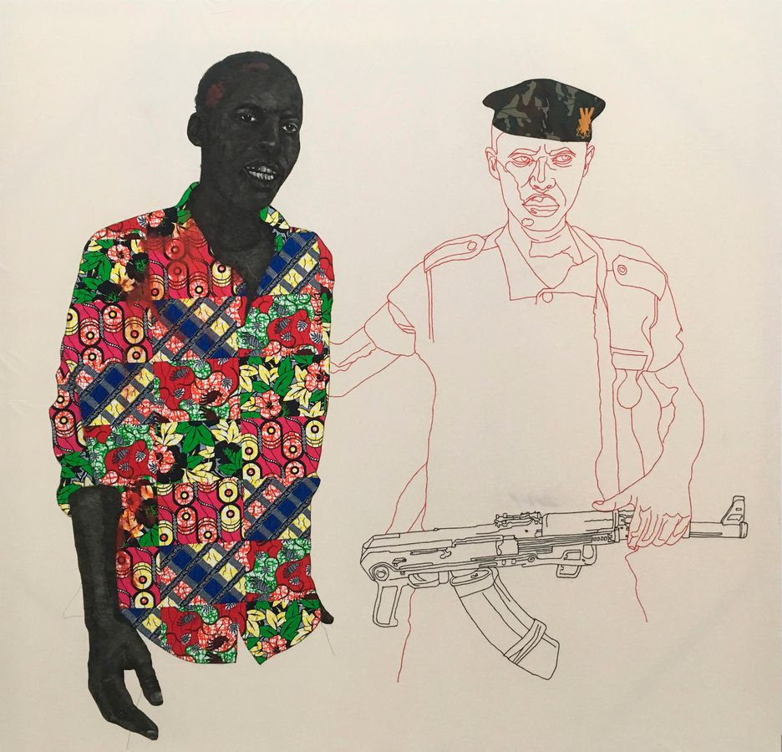
Pierre Mukeba
Culture and Identity
Born in 1995 in Bukavu, the Democratic Republic of Congo, Pierre Mukeba grew up in the shadows of civil conflict. At the age of three, Mukeba’s family sought safety in camps in Zambia and Zimbabwe as a result of the Second Congo War (1998-2003). Food was scarce and conditions were dangerous, and so his family resettled again with Mukeba’s uncle in the capital of Zimbabwe, Harare. Living with his uncle proved to be formative as Mukeba’s uncle was a sculptor who introduced him to the practice of drawing.
Early memories of his uncle’s work describe a transformative process, “I was most fascinated with the drawing, because you’d have this blank paper and after half-an-hour or so, there’d be something on it.” As changes in Zimbabwean government took hold, Mukeba’s family was unsafe once more and sought asylum in Australia. In 2006 they were granted residency in Adelaide, where Mukeba has lived and worked since.
Mukeba has channelled his observations and experiences of early life in central Africa into distinctive textile-based works. Frequently large in scale, the indelible ink and pen drawings not only reflect trauma and violence, they also celebrate the lives of his family and friends and explore contemporary portrayals of African-Australian experience.
Patrick McDonald, “Pierre Mukeba and the Fabric of Life”, The Adelaide Advertiser, 25 May 2019
Pierre Mukeba, Democratic Republic of Congo, born 1995, Barbarity, 2018, Adelaide, brush pen and fabric appliqué on cotton, 250.0 x 250.0 cm; Courtesy the artist and GAGPROJECTS | Greenaway Art Gallery.

Slide 3
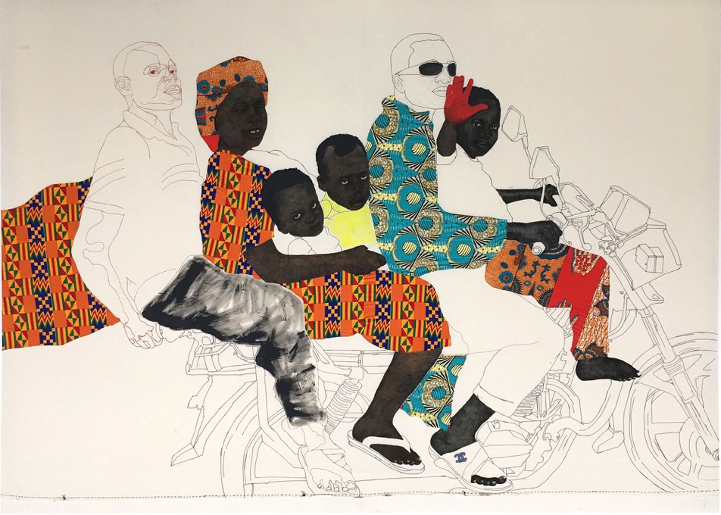
Pierre Mukeba
Culture and Identity
Despite the sheer scale of his works, the techniques behind Mukeba’s work reflect domesticity, the importance of his family and a relationship to the body. He began his practice using his own bed sheets as a drawing surface, the closest material to hand that emulated canvas. Working from his desk in his family home, he would fold up the sheets into manageable segments and rotate them to work on one section at a time; “I just fold the canvas to the exact part I want to draw on.” This process is responsible for Mukeba’s unique use of negative space – the blank canvas surrounding his subjects or incorporated into the bodies of his figures.
Eventually, Mukeba also incorporated swatches of his mother’s clothing fabrics, in particular the brightly patterned wax resist textiles famous to West Africa. Mukeba integrated this new element using appliqué – a decorative needlework technique in which small pieces of fabric are sewn onto a larger textile surface. Appliqué helps Mukeba quickly fill negative space with geometric patterns and strong colours as a shortcut to painting. The combination of these techniques sees Mukeba piece together the past and the present, where larger-than-life scenes reflect an intimate process of reconciliation.
Pierre Mukeba, born 1995, Ride to church, 2018, Adelaide, fibre-tipped pen, synthetic polymer paint and applique on canvas, 320.0 x 424.0 cm; Gift of the Art Gallery of South Australia Contemporary Collectors 2019, Art Gallery of South Australia, Adelaide, Courtesy of the artist and GAGPROJECTS Adelaide & Berlin.
.

Slide 4
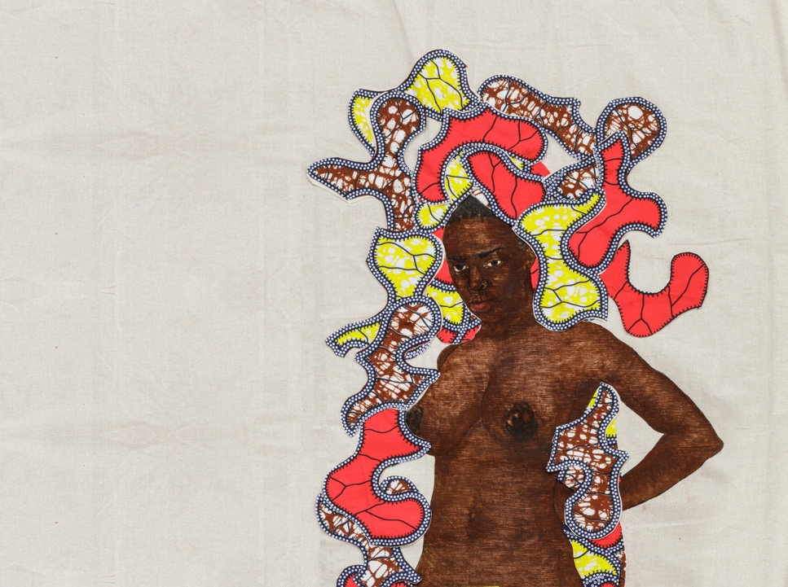
Kitenge (Part I) and Kitenge (Part II) (2020)
The word kitenge refers to the African wax resist fabrics featured in Mukeba’s double panorama. The brightly coloured, boldly patterned textiles are common to West, Central and East Africa. Kitenge is described as ‘the communicating textile’ due to the combinations of colour, pattern, symbolism, text, and the occasional political slogan that make up its striking visual language.
The textile itself embodies a complex history of cross-cultural translation. In the early 1800s the Dutch imitated the wax resist techniques of Javanese batik for a European market. Failing in popularity, the fabric was subsequently introduced to West Africa, following Dutch colonial trade routes, where it has since become deeply localised and culturally significant to the region. Mukeba’s use of kitenge is twofold. Having navigated violent political upheaval and relocation to a new country, Kitenge (Part I) and Kitenge (Part II) (2020) is a joyful assertion of his cultural heritage whilst also capturing the deeper histories of economic, racial and cultural interdependencies between Asia, Europe and Africa.
detail: Pierre Mukeba, Democratic Republic of Conga, born 1995, Kitenge, 2019–20, Adelaide, fibre-tipped pen, synthetic polymer paint and applique on canvas, two parts; © Pierre Mukeba/GAGPROJECTS/Greenaway Art Gallery, Adelaide.

Slide 5
Kitenge (Part I) and Kitenge (Part II) (2020)
Kitenge (Part I) (2020) and Kitenge (Part II) (2020) is the largest of Mukeba’s works to date. The two panels can be described as a tableau – a grouping of characters, people or objects arranged as an unfolding dramatic scene. Unlike the historic tableaux of the eighteenth and nineteenth centuries where subjects appear unaware of the viewer, Mukeba’s figures stand astride with an outward gaze that meets your own. They assert themselves in your presence. The troupe of characters reflects Mukeba’s fusion of influences. Some figures don the traditional dress of Pende tribesmen whilst others wear street fashion. There is also a reverence for classicism – an adherence to classical Greek and Roman ideas on form, proportion, balance and composition. This is evident in the contrapposto stance of Mukeba’s nude male subjects or the cheeky reference to Botticelli’s Venus, where a scallop shell is swapped out for a wristwatch and trainers.
Although Mukeba never undertook formal art training, his travels to Europe in early 2019 formed a type of self-education. Having visited some of the most famous art museums in the world, he reflects on the experience: “When I came back from Europe, it opened my whole mind on what I should be making in art, what my work should be and what I need to be showing. Most of my works have one or two, three or four figures on them… but bringing them all together one day would really be a documentation of these people’s lives.” Although classicism is typically concerned with depicting royalty, historically significant or mythological figures, Mukeba says, “it’s not about what is really happening to the normal people”. He has borrowed the visual language of classicism to elevate the lives and histories of his subjects; “I want to make art that’s as beautiful as I possibly can… where it’s not too scary to look at, but you learn something from it. You see a different view on life.”
Patrick McDonald, “Pierre Mukeba and the Fabric of Life”, The Adelaide Advertiser, 25 May 2019

Slide 6
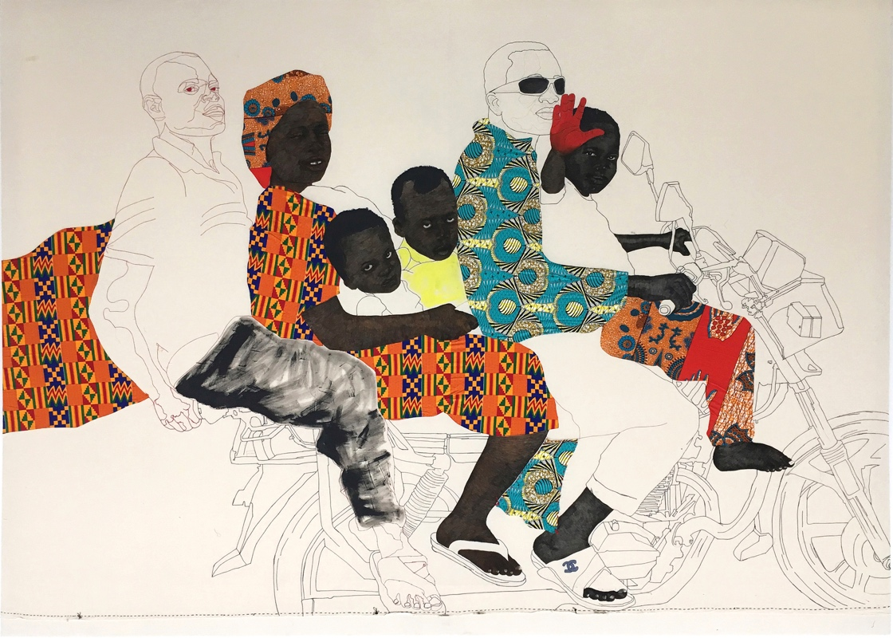
Ride to church, 2018
“I started having memories of times in Zimbabwe when my family had to jump in a car or on a bike squeezing in five to six people at a time, knowing how dangerous and unsafe it was, just to get around daily. I kept having a particular memory of all the times I was on a bike going to church with family.”
Pierre Mukeba
Quoted by Walter Marsh in; ‘Ramsay Art Prize finalist Pierre Mukeba named the people’s favourite’, The Adelaide Review, 9 August 2019, https://www.adelaidereview.com.au/arts/visual-arts/ramsay-art-prize-peoples-choice-pierre-mukeba/
Pierre Mukeba was the winner of the Ramsay Art Prize 2019 People's Choice Prize with his work Ride to Church. The large scale drawing was inspired by Mukeba’s childhood memories in Zimbabwe.
Pierre Mukeba, born 1995, Ride to church, 2018, Adelaide, fibre-tipped pen, synthetic polymer paint and applique on canvas, 320.0 x 424.0 cm; Gift of the Art Gallery of South Australia Contemporary Collectors 2019, Art Gallery of South Australia, Adelaide, Courtesy of the artist and GAGPROJECTS Adelaide & Berlin.
.

Slide 7
Early Years and Primary
Culture | Identity
Responding
Locate Bukavu (in the Democratic Republic of Congo), Zambia and Zimbabwe on a world map. How far did Mukeba travel with his family across Africa?
Mukeba’s uncle was sculptor who introduced him to drawing. What is something you have learnt from a family member or someone close to you?
Mukeba wants to make art that is as beautiful as he possibly can. What makes Mukeba’s work beautiful? Find another work of art on display that you think is beautiful. Why do you think some artists create beautiful works as well as those which are not considered beautiful? As a class discuss how we define what beauty is.
Making
Some of Mukeba’s works are inspired by early life in Central Africa. What is your first memory? Create a work of art about this time.
Using recycled wrapping paper and textiles with bright patterns and colours create a collage portrait of your family.
Ride to Church captures a moment of daily life during Mukeba’s childhood in Zimbabwe. Create a large-scale collaborative drawing that depicts a moment of everyday life in your school or community.
Look carefully at Ride to Church. Create a story about what has happened before, during and after the moment is captured in Mukeba’s work of art.

Slide 8
Secondary
Culture | Identity
Responding
Mukeba creates works of art that reflect his life experiences. He has said that he wants to bring attention to the traumas that have taken place in the Congo and what is happening in Africa now. “I make art about this because it needs to be understood by everyone.” Research other artists who have responded to conflict or unrest. How do their representations compare to Mukeba’s works of art?
How would you classify Mukeba’s works of art? Are they paintings, drawings or textiles?
The British-Nigerian artist Yinka Shonibare uses patterned Dutch-African fabrics in his work. Discuss how the juxtaposition of the patterned fabric and Colonial European dress contributes to the meaning of his work. How is this similar or different from Mukeba’s use of textiles?
Making
Draw onto unusual surfaces such as foil, textiles, plastics, or recycled textured objects otherwise destined for landfill.
Mukeba’s portraits celebrate the lives of his family and friends. Create a portrait of a family member or friends. Consider what colours or symbols you could incorporate into your portrait that tells the viewer something about this person.
The use of line is an important element in Mukeba’s works of art. Create a self portrait using continuous line drawing without taking your pencil off the paper. For an added challenge, create a continuous line drawing without looking at the paper.
Kitenge is described as ‘the communicating textile’ due to the combinations of colour, pattern, symbolism, text, and the occasional political slogan that make up its striking visual language. Create a unique textile using calico and acrylic paint. Combine colour, pattern, text and symbolism to communicate something about a current environmental or social issue you are passionate about.

Slide 9
Resources
Websites
“Pierre Mukeba”, Art Gallery of South Australia, accessed 4 February 2020 https://www.agsa.sa.gov.au/whats-on/exhibitions/ramsay-art-prize/pierre-mukeba/
“Pierre Mukeba”, Greenaway Art Gallery Projects, accessed 4 February 2020 http://gagprojects.com/index.php/artists/pierre-mukeba/
Videos
Fuss, E. “Meet Pierre Mukeba”, The Mix: Episode 30, Australian Broadcasting Corporation, published 26 August 2018 (expires 25 February 2020), https://www.abc.net.au/news/programs/the-mix/2018-08-26/the-mix:-episode-30/10166526
Podcasts
“Tuesday Talk: Rhana Devenport and Erin Davidson discuss the Ramsay Prize”, Art Gallery of South Australia, May 2019, https://soundcloud.com/artgalleryofsa/tuesday-talk-rhana-devenport-and-erin-davidson-discuss-the-ramsay-art-prize
African-Dutch Prints
Young, Robb, ‘Africa’s Fabric Is Dutch’, The New York Times, 14 November 2012, https://www.nytimes.com/2012/11/15/fashion/15iht-ffabric15.html
Vlisco (textile designs), https://www.vlisco.com
Articles and Books
Andrews, S. “Drawn to Art”, Art Monthly Australia, issue 304, Summer 2017/18, p14
Dow, S. “Forecast: Pierre Mukeba”, Vault, issue 24, Summer 2018/19, p114-117
Marsh, W. “Ramsay Art Prize finalist Pierre Mukeba named the people's favourite”, Adelaide Review, 9 August 2019, https://www.adelaidereview.com.au/arts/visual-arts/2019/08/09/ramsay-art-prize-peoples-choice-pierre-mukeba/
McDonald, P. “Collage is sheets ahead”, The Adelaide Advertiser, 8 September 2019
McDonald, P. “Pierre Mukeba and the Fabric of Life”, The Adelaide Advertiser, 25 May 2019
Sigglekow, Z. “Pierre Mukeba wins the Churchie National Emerging Art Prize”, Art Guide Australia, 17 November 2017, https://artguide.com.au/pierre-mukeba-wins-the-churchie-national-emerging-art-prize
Yiu Nam Cheung, E. “Artist Pierre Mukeba”, The Saturday Paper, no. 216, 4-10 August 2018, https://www.thesaturdaypaper.com.au/2018/08/04/artist-pierre-mukeba/15333048006635
This resource has been written and developed by Belinda Howden, Dr. Lisa Slade, Assistant Director, Artistic Programs and Kylie Neagle, Education Officer.
Education programs at AGSA are supported by the Government of South Australia through the Department for Education.

