Slide 1
Quilty
2 Mar – 2 Jun 2019
Early Years & Primary

Slide 2
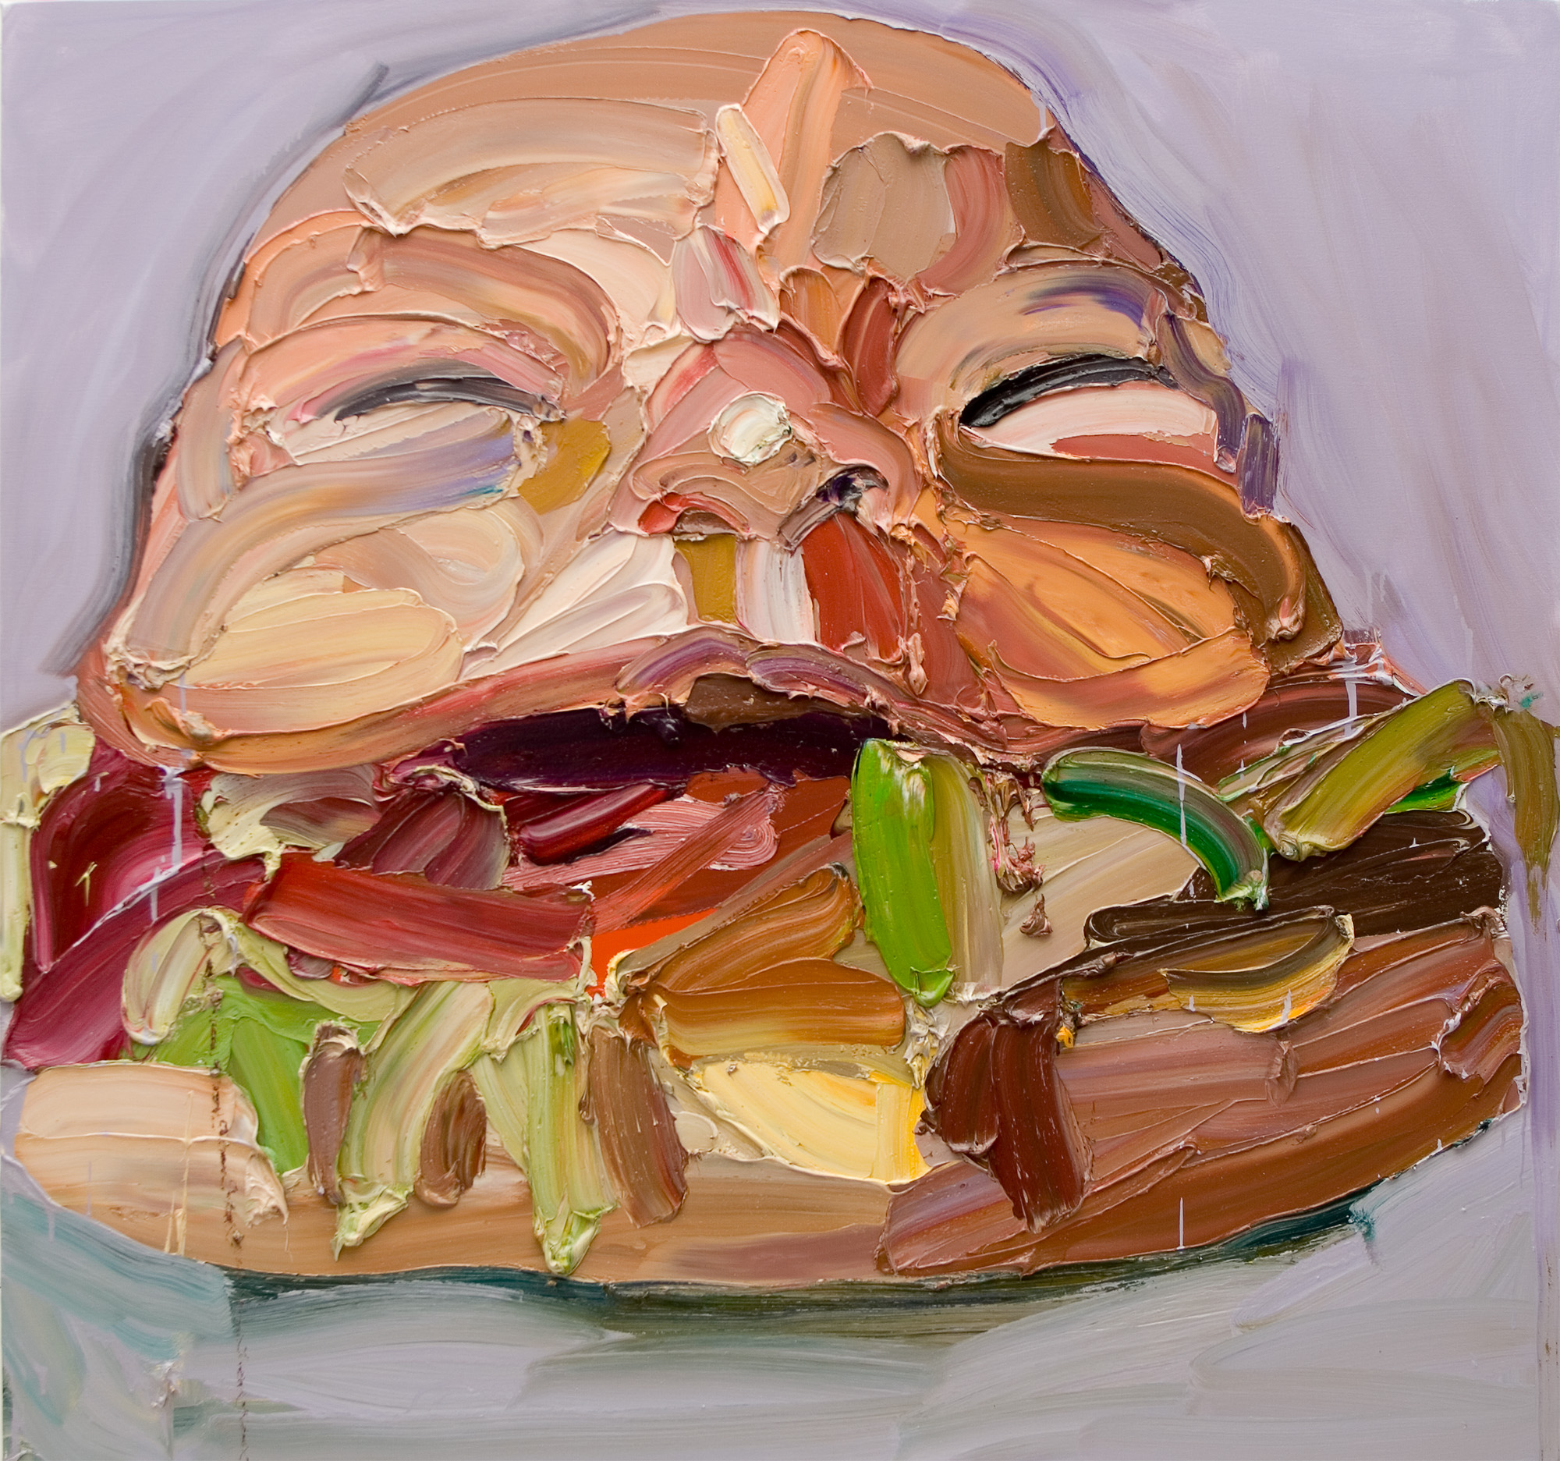
Ben Quilty, Australia, born 1973, Joe Burger, 2006, Southern Highlands, New South Wales, oil on canvas, 150.0 x 160.0 cm; Private collection, Courtesy the artist.
Notes:
About Ben Quilty
Ben Quilty was born in Sydney in 1973. He loved to draw from a young age and found success in art competitions as a teenager. Quilty’s love of thick paint and bold, large scale imagery was already evident in his year 12 work – as well as compassionate engagement with social issues. In 2011 he won the prestigious Archibald Prize for his portrait of fellow painter Margaret Olley and travelled to Afghanistan as a war artist. In 2016 he undertook a range of collaborative projects prompted by the Syrian refugee crisis. Quilty continues to challenge the conventions of painting while shining a light on the conflicts and paradoxes of contemporary life.
Check out Art Sets by the Art Gallery of New South Wales – ‘The art that made me: Ben Quilty’. Quilty discusses works of art that inspire, influence and delight him.
Responding
Ben Quilty’s son Joe has created a soundtrack of some of his favourite music to accompany the Studio. Create a soundtrack for Quilty the exhibition. What music would you pair with Quilty’s works of art?
Making
Quilty draws on his own personal experiences, such as the birth of his son, Joe. Create a work of art that celebrates a special moment in your life.
In some of Quilty’s paintings he combines objects, such as skulls and cars, baby and hamburger, bird and car. Select an object and an animal and create a painting where one transforms into the other.

Slide 3
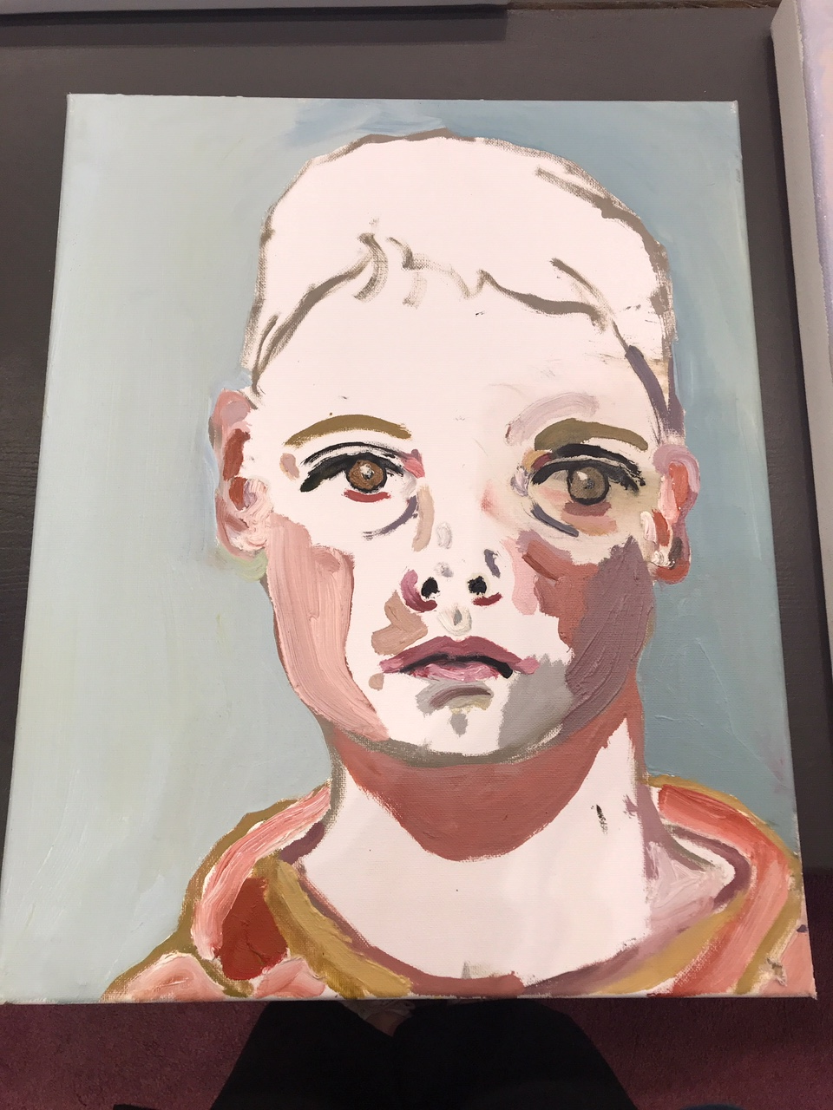
Meet Joe Quilty
Joe Quilty, son of Ben Quilty, is 13-years old and an avid artist in his own right. Joe likes to paint, creating still life subjects and landscapes – working from life.
What’s your favourite medium?
I like to use oil paint. I'm lucky because my Dad has a studio and he lets me use all his oil paint. For kids who don’t have oil paint at home I would suggest using acrylic paint, oil pastels or coloured pencils.
Joe Quilty, Self Portrait, 2017

Slide 4
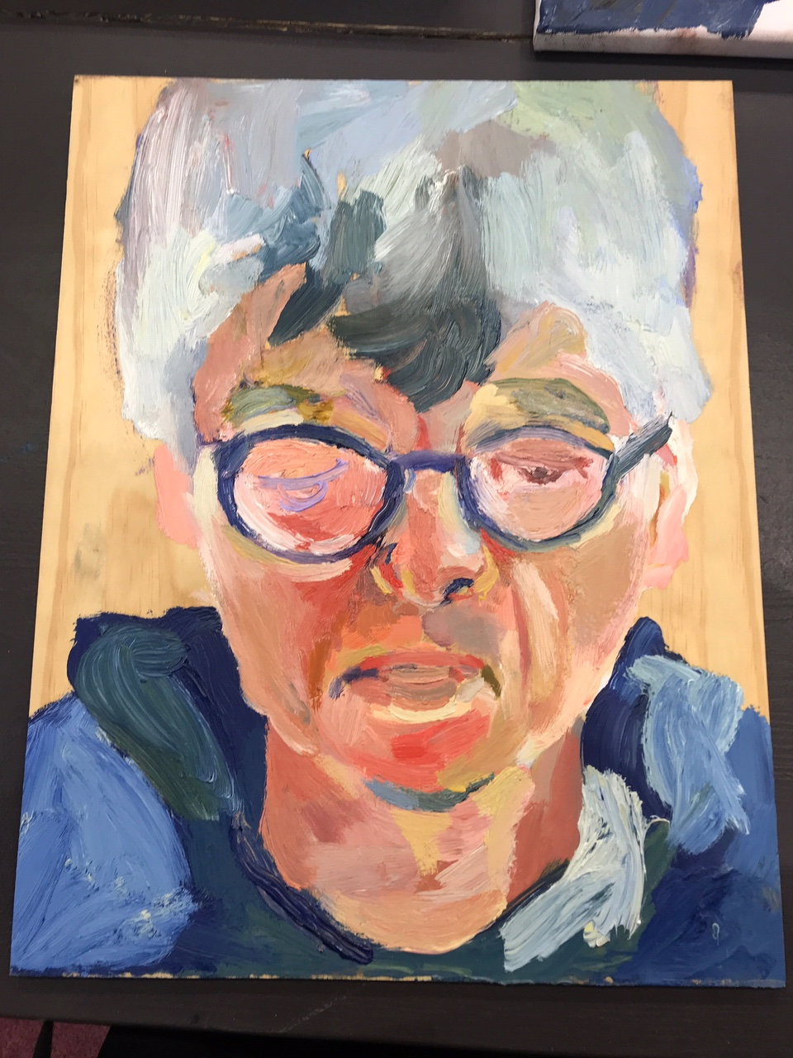
What are your top three tips for drawing a portrait?
Don't draw from a photograph. Ask your Mum or Dad to sit for you. Draw your family. I find my little sister hard to draw. Old people are easier to draw because they have a lot of lines.
Joe Quilty, Grandpa, 2017

Slide 5
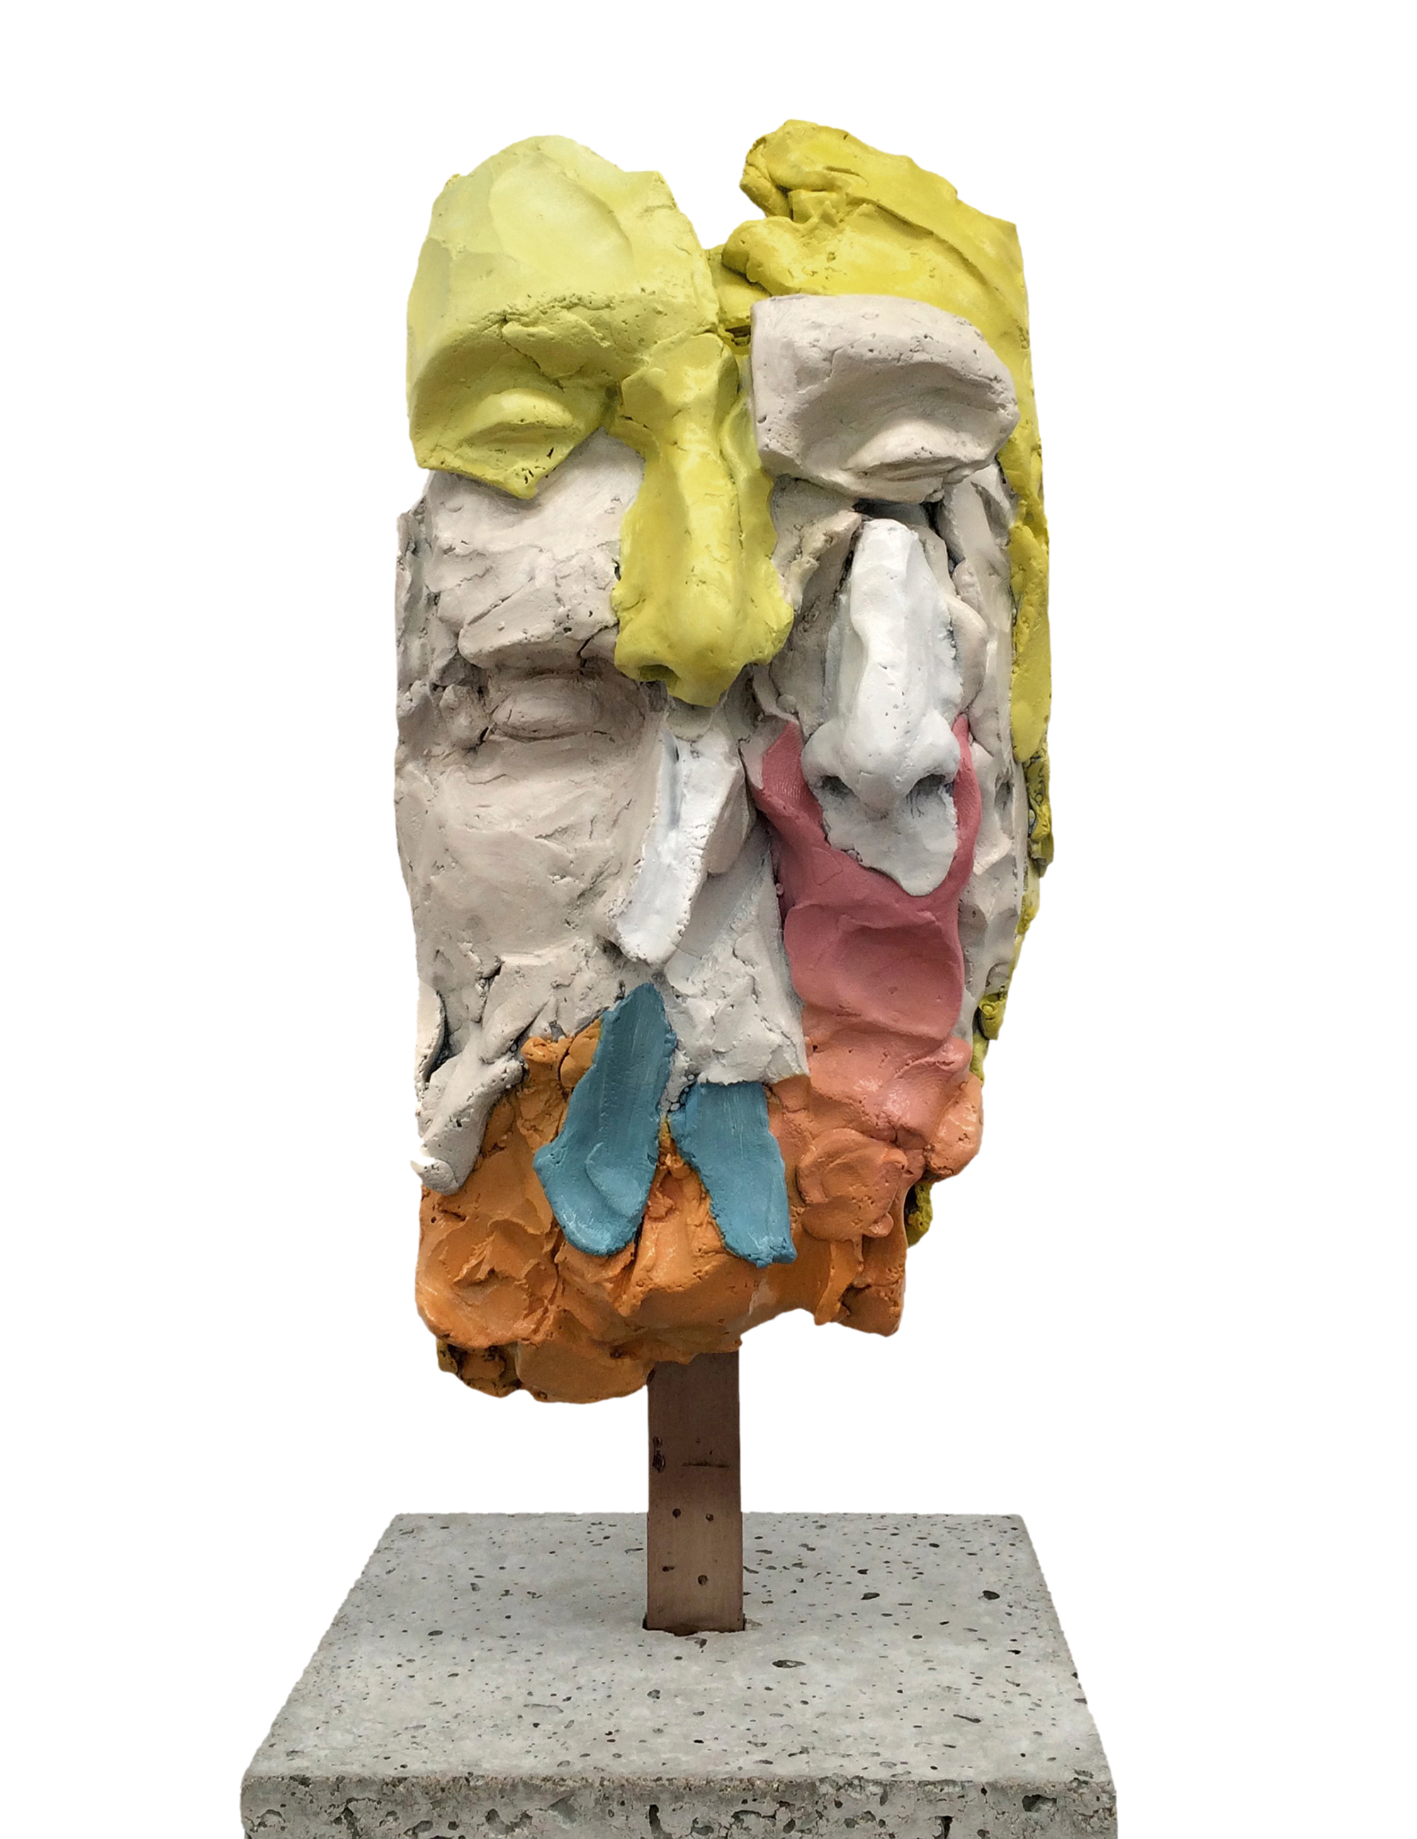
Who is your favourite artist?
I love Goya's 'Saturn Devouring His Son'. It's scary and freaks me out.
I like Sally Anderson, Guido Maestri and Luke Sciberras. They are also my friends.
I love Barbara Moore and Sylvia Ken. I have also met them.
p.s I haven't met Goya
image: Guy Maestri, Australia, born 1974, Xerox no. ll, 2016, painted bronze, concrete, 56.0 x 17.0 x 17.0 cm © Guy Maestri, courtesy Jan Murphy Gallery, Brisbane

Slide 6
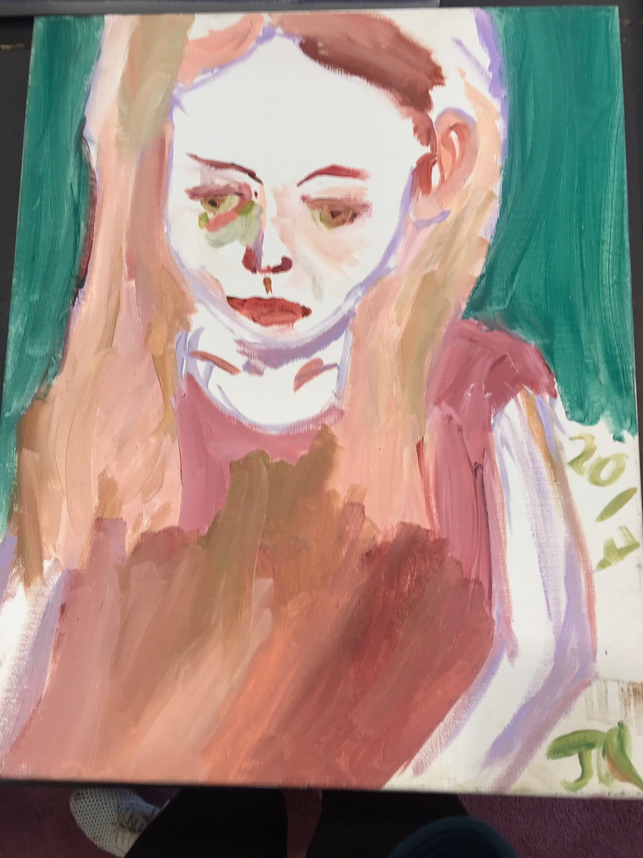
What inspires your artmaking?
Sometimes I don't like to start a painting but when I do I cannot stop. I love it. I also like playing my guitar. Mum and Dad say I am obsessed with cricket. I even named my dog cricket. Cold and rainy days are good days for making paintings. I often listen to Paul Kelly when I paint.
Joe Quilty, Olivia (my sister), 2017

Slide 7
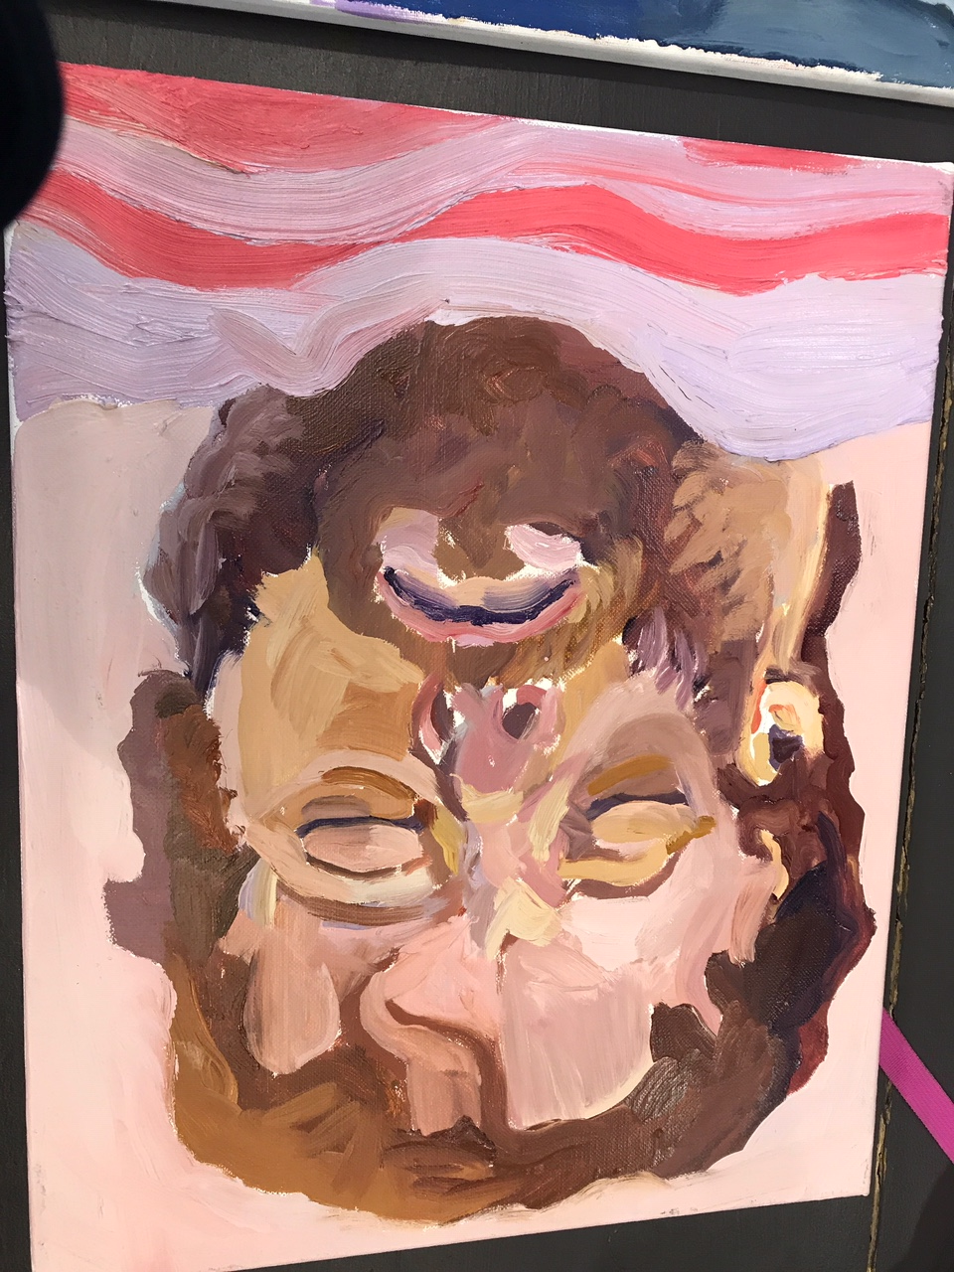
If you were to create a playlist of music to listen to while making a work of art, what songs would you include?
Time of Your Life by Greenday
House of the Rising Son by Animals
Knocking on Heavens Door by Dylan and Guns and Roses
To Her Door by Paul Kelly
King is Dead by the Herd
I will wait by Mumford and Sons
Snow by Red Hot Chilli Peppers
Rhiannon by Fleetwood Mac
Wonderwall by Oasis
Nosebleed Section by Hilltop Hoods
Joe Quilty, My Dad Injured , 2018

Slide 8
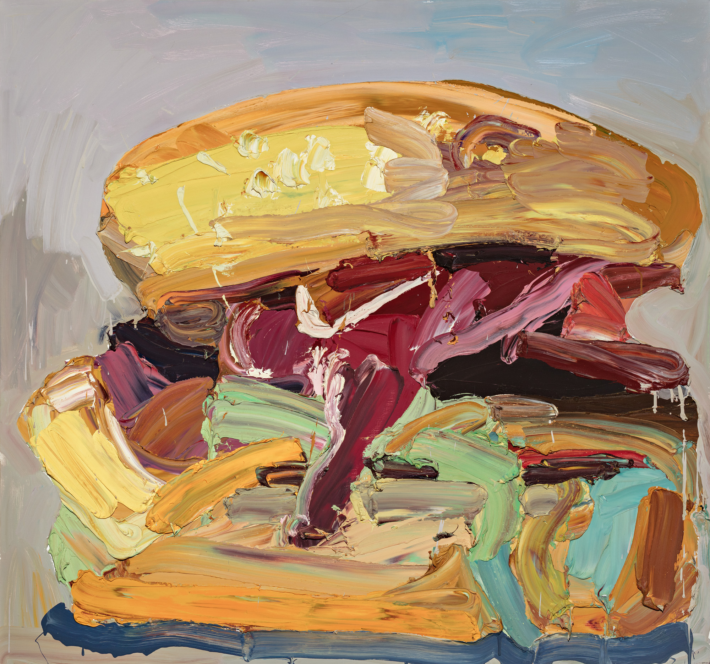
Ben Quilty, Australia, born 1973, The lot, 2006, Bowral, New South Wales, oil on canvas, 150.0 x 160.0 cm; Gift of Ben Quilty through the Art Gallery of South Australia Contemporary Collectors 2016. Donated through the Australian Government's Cultural Gifts Program, Art Gallery of South Australia, Adelaide, Courtesy the artist.
Notes:
Responding
Find a glossary of words used to describe food. Using words from this glossary, write a story or poem that describes Quilty’s paintings.
Making
The Lot is one of several burger paintings created from 2006-2010, exploring the power of pop culture items. They are big and bold, with lurid colours and loose gestural mark-making. The Lot has been described as juicy – how would you describe your favourite food? Create a work of art celebrating your favourite food, which captures the food ‘larger than life’ and the way you describe it.
About the work
Completed in 2006, The Lot is a work which displays Quilty’s signature gestural style in thick oil paint, applied with speed, confidence and first-hand knowledge of his fast-food subject matter. Quilty’s hamburger, a symbol of popular culture and consumerism is loaded with ‘the lot’. It is messy, juicy and packed with lashings of colour. Scaled-up, sitting centre-square and much larger than life, in this work Quilty is elevating the humble road-side burger to an iconic status. Quilty painted a number of burgers in 2006, including Skull-burger and Joe-burger, as well as his hallmark series of Holden Torana cars which affectionately but critically reflect on white Australian masculinity through the products of hoon culture and mateship.

Slide 9
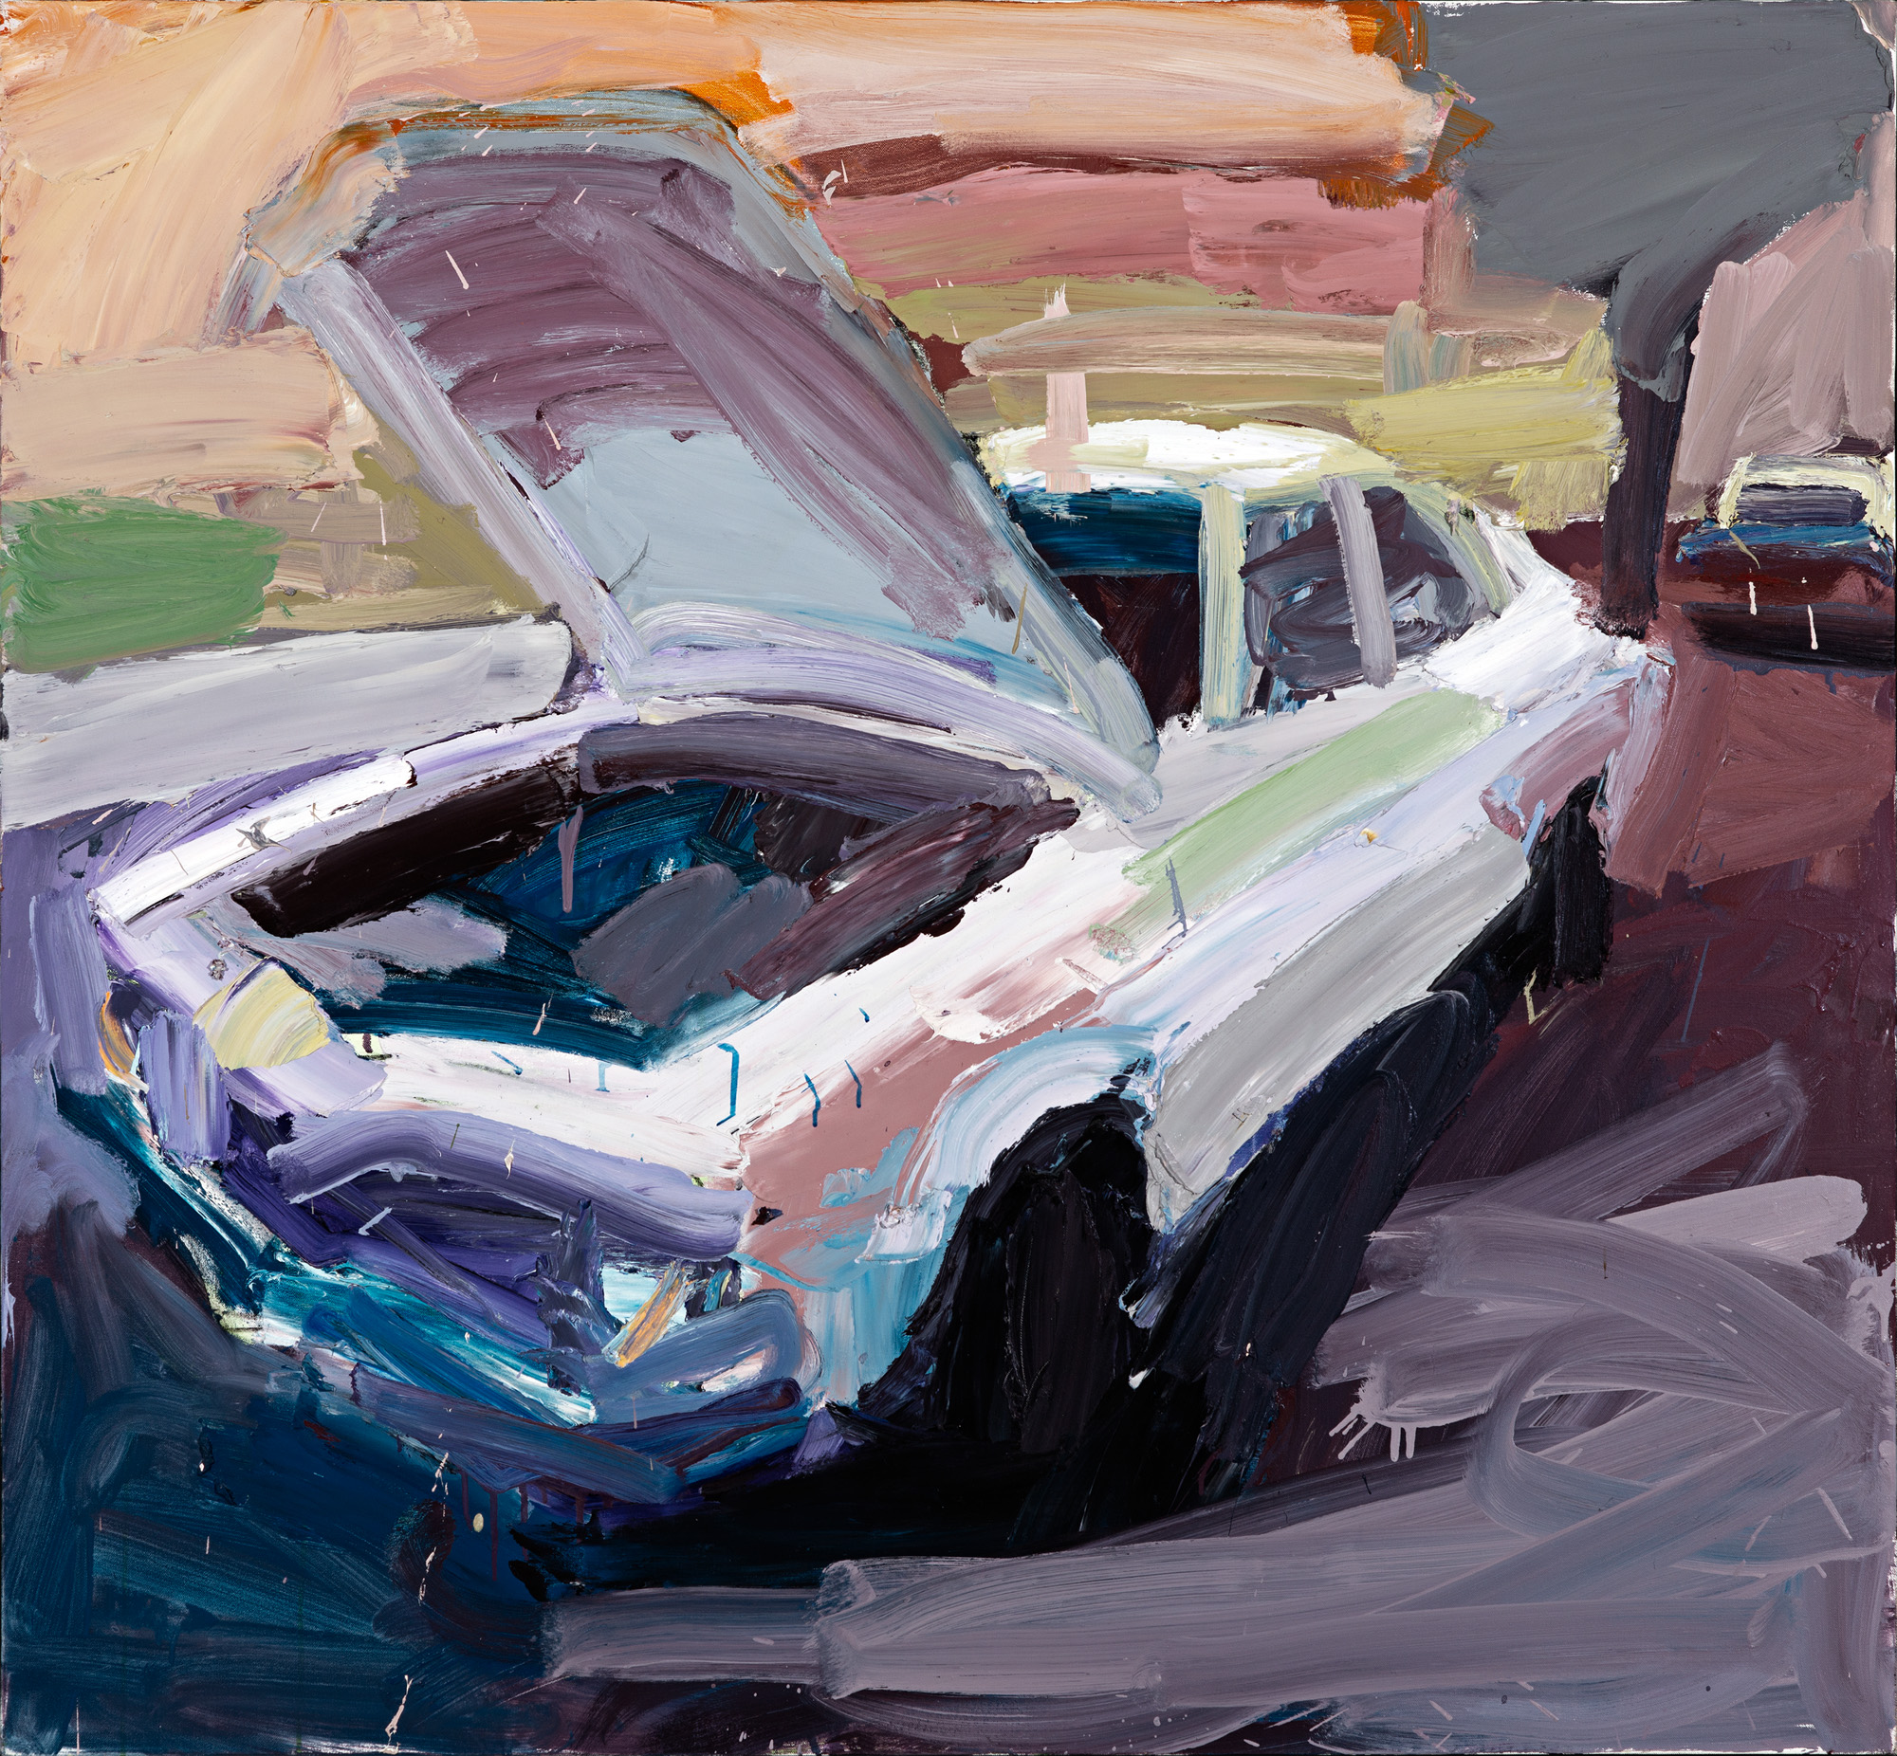
Ben Quilty, Australia, born 1973, Torana no. 5, 2003, Melbourne, oil on canvas, 120.0 x 130.0 cm; Private collection, Courtesy the artist, photo: Philip Betts.
Notes:
Responding
Look at one of Quilty’s paintings from different perspectives, close up and far away. How does the painting appear to change?
Quilty uses a technique called impasto, a thick application of paint, creating ridges and lumps of three-dimensional surface texture. Share a word to describe your favourite Quilty painting. Create a display in your classroom of these descriptive words.
Making
The colour lilac often appears in Quilty’s paintings. What is your favourite colour? Create a self-portrait using various tints and shades of your favourite colour.

Slide 10
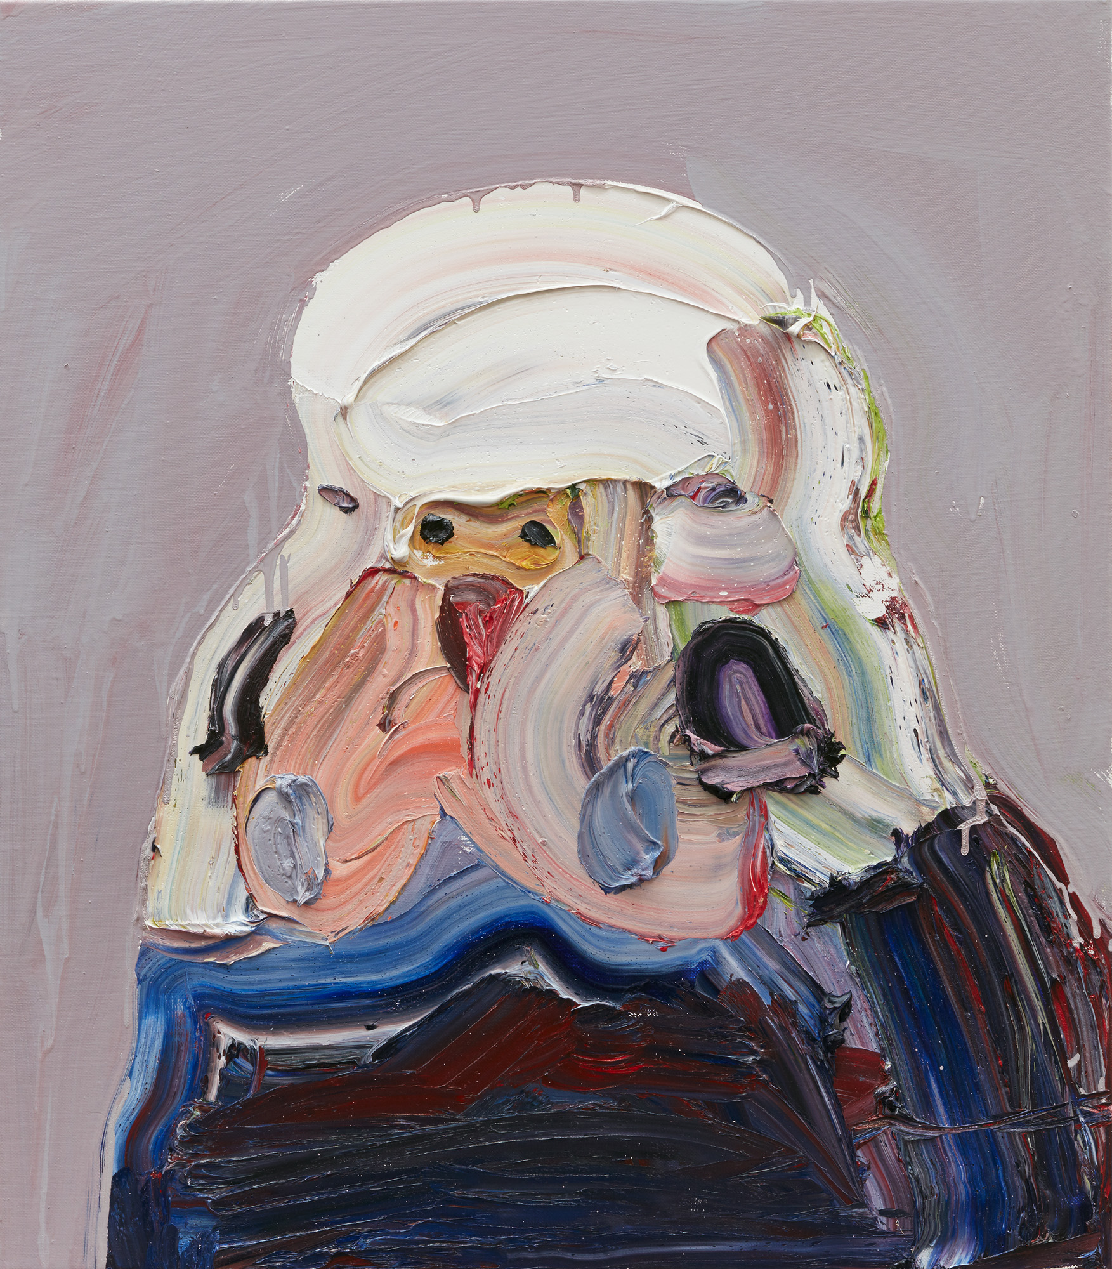
Ben Quilty, Australia, born 1973, New Bird, 2017, Southern Highlands, New South Wales, oil on linen, 80.0 x 70.0 cm; Private collection, Courtesy the artist, photo: Mim Stirling.
Notes:
Responding
Budgerigars are a small Australian parakeet, known for their bright blue, green and black scalloped markings. In 2004, Quilty painted some of his friends as budgerigars. If you could describe yourself as a bird or an animal, which would it be and why?

Slide 11
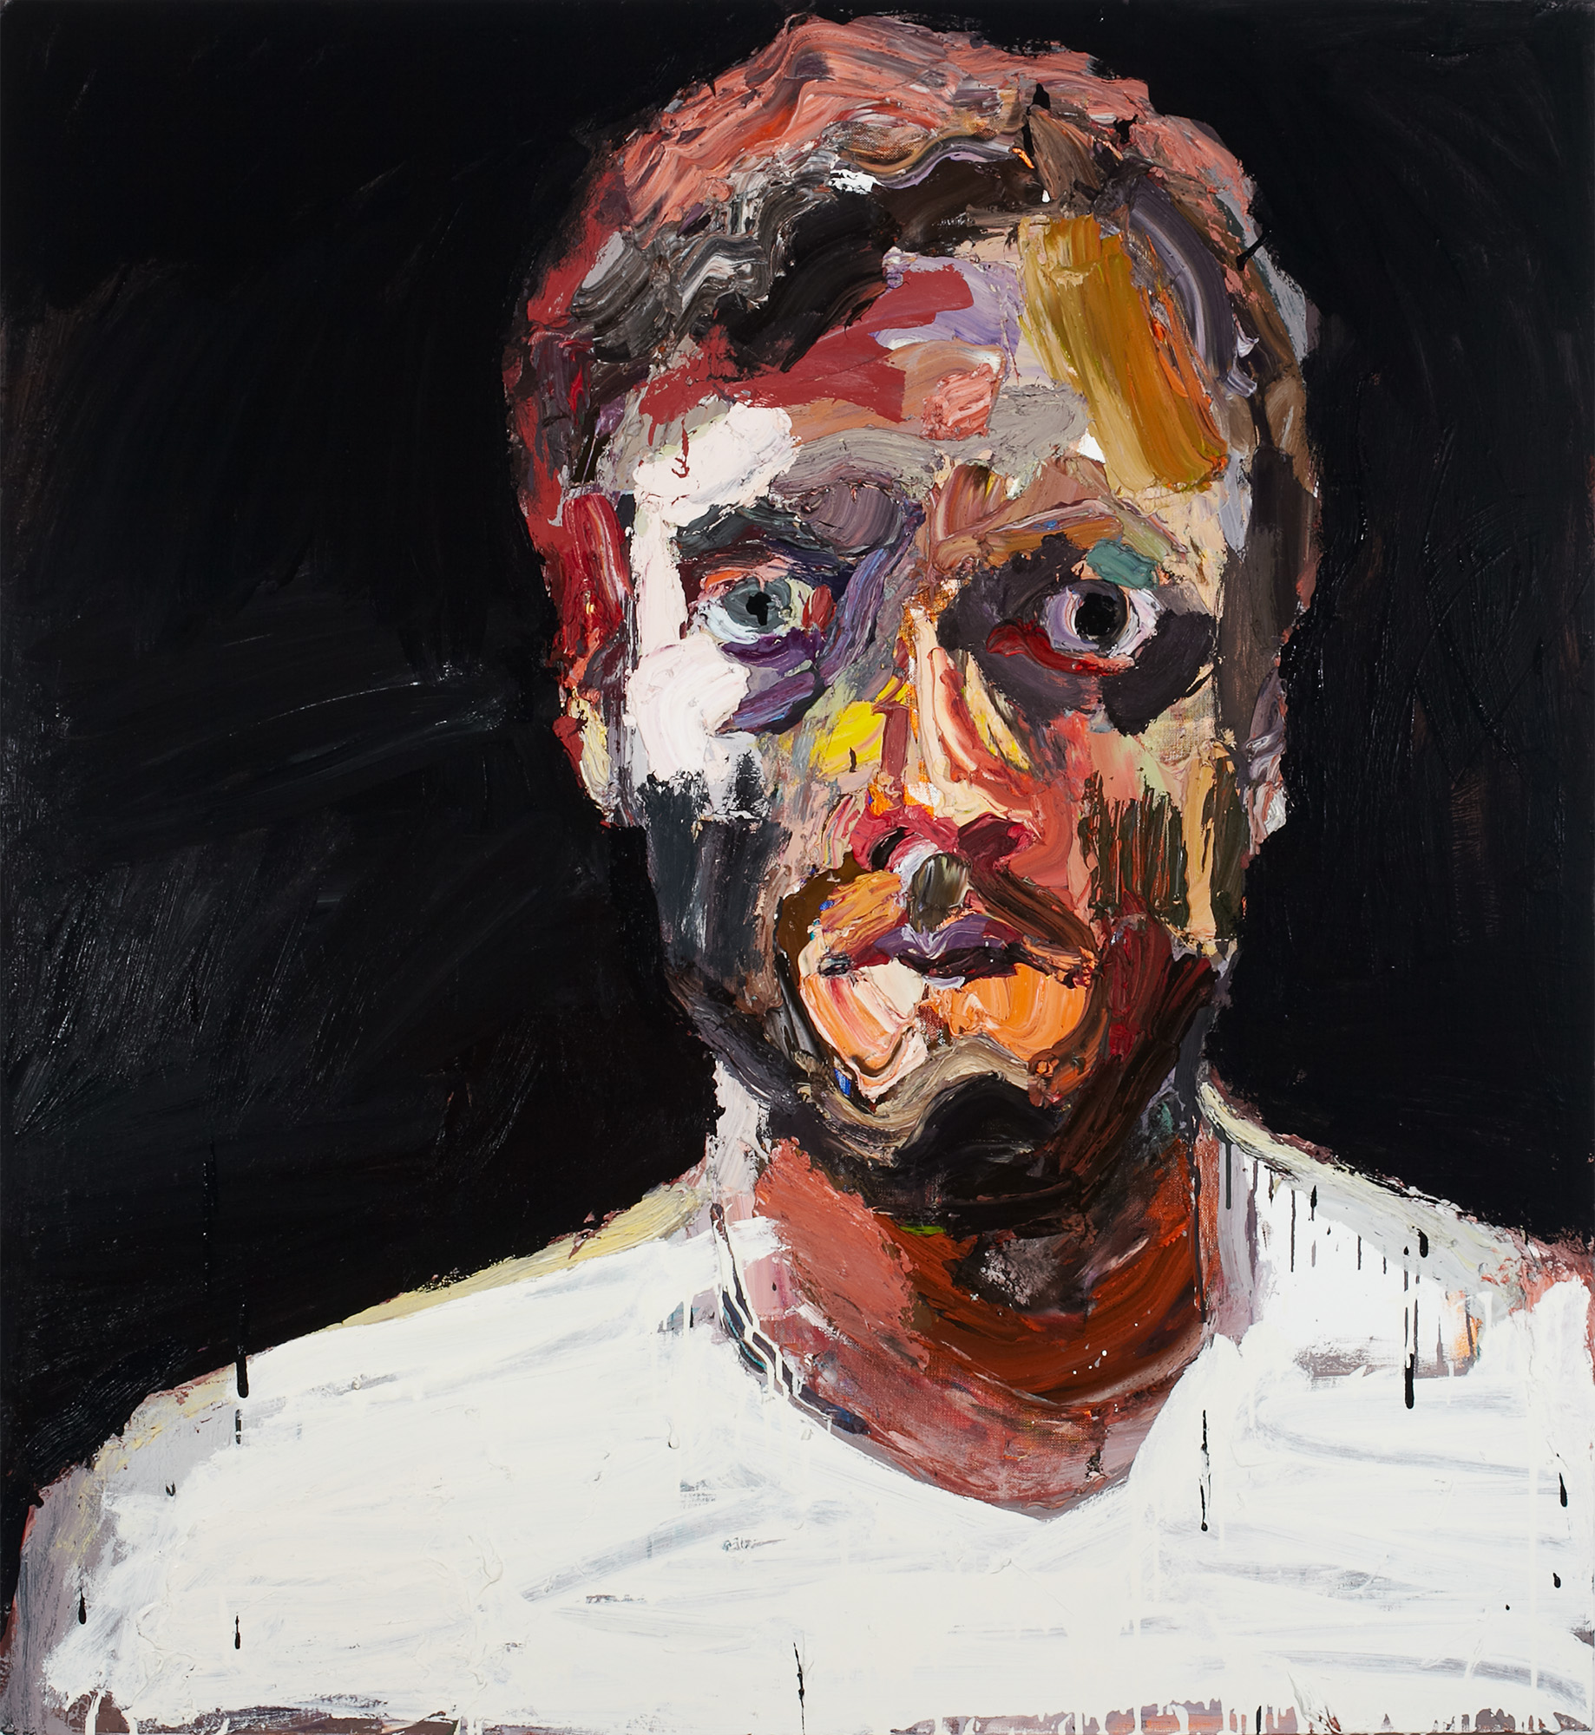
Ben Quilty, Australia, born 1973, Self-portrait after Afghanistan, 2012, Southern Highlands, New South Wales, oil on linen, 130.0 x 120.0 cm; Private collection, Sydney, Courtesy the artist, photo: Mim Stirling.
Notes:
Responding
The word portrait was invented in the 13th century and means to show a likeness. Ben Quilty has created multiple self-portraits throughout his career. Look at Self-portrait, after Afghanistan, Self-portrait smashed Rorschach and Self-portrait, the executioner. How has Quilty created a likeness in each?
Making
Look at yourself in a mirror and draw what you see using oil or chalk pastels. Cut up your portrait into large random shapes. Swap your shapes with other members of your class to create a remix portrait.

Slide 12
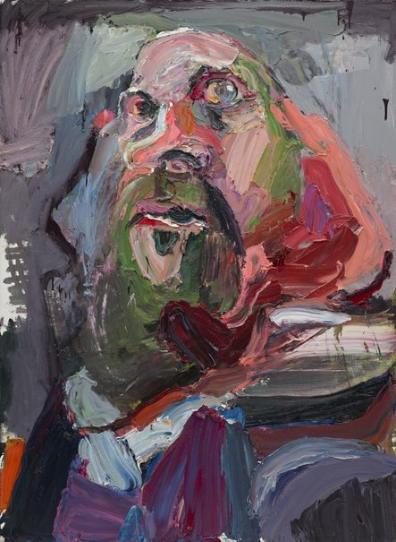
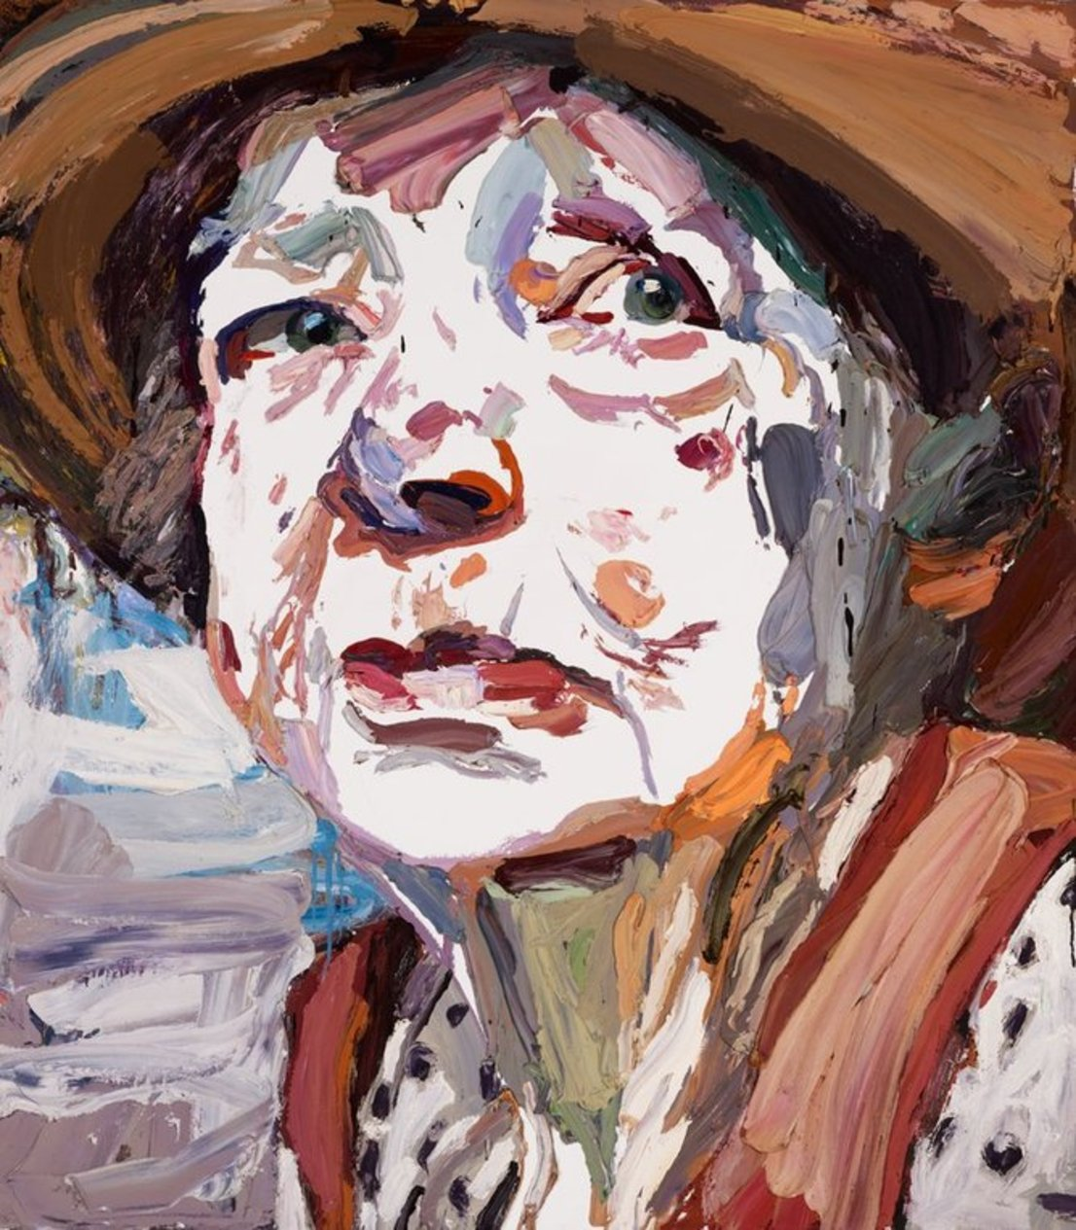
Ben Quilty, Australia, born 1973, Margaret Olley, 2011, Southern Highlands, New South Wales, oil on linen, 170.0 x 150.0 cm; Private collection, Courtesy the artist photo: Mim Stirling.
Ben Quilty, Australia, born 1973, Self Portrait, the executioner, 2015, Southern Highlands, New South Wales, oil on linen, 195.0 x 140.4 cm; Gift of the artist 2015. Donated through the Australian Government's Cultural Gifts Program, Art Gallery of New South Wales, Sydney, Courtesy the artist, photo: Mim Stirling.
Notes:
Responding
Look the portrait of artist Margaret Olley. How is this painting different to Quilty’s self-portraits? After looking at the range of Quilty’s portraits, how has his paintings changed throughout his career?
When Quilty went to university he was told that painting was dead, but he pursued painting anyway. Today, we live in a time where everyone has a camera with them at all times. What qualities do Quilty’s paintings have which can’t be captured with a camera?
Making
The Archibald Prize is held by the Art Gallery of New South Wales and invites artists to submit paintings of a person who is well known in art, literature, science or politics. In 2011 Ben Quilty was awarded the Archibald Prize for his portrait of painter Margaret Olley. If you were to enter the Archibald Prize, who would you paint and why? Tip: Visit the Archibald Prize to find out more and view past finalists.
Did you know?
The Art Gallery of New South Wales a Young Archie competition open to all children 18 years and under.

Slide 13
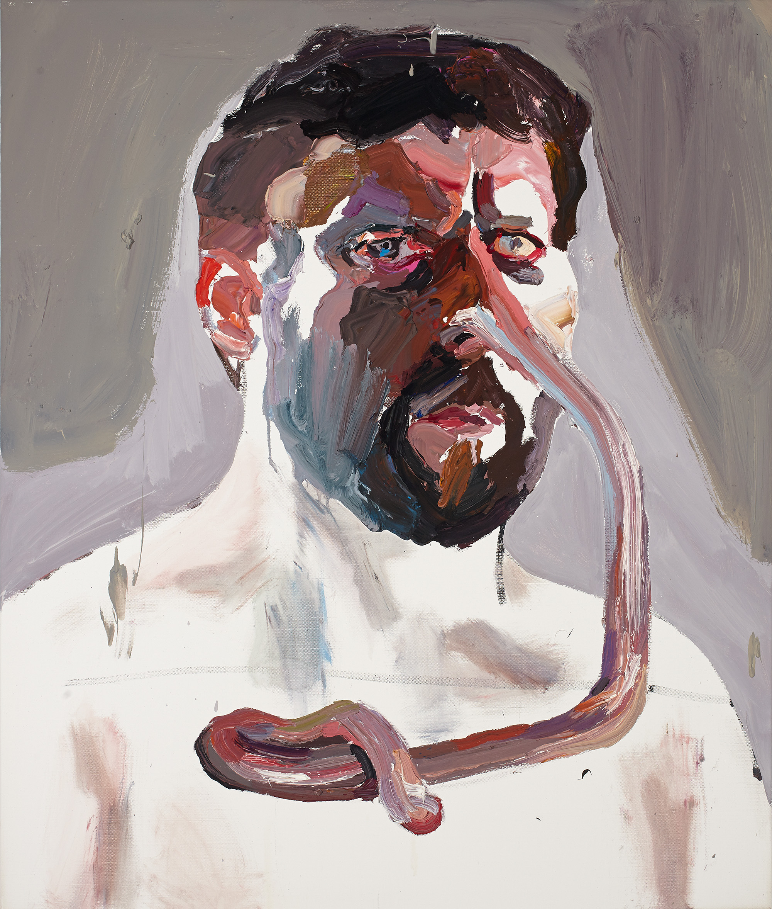
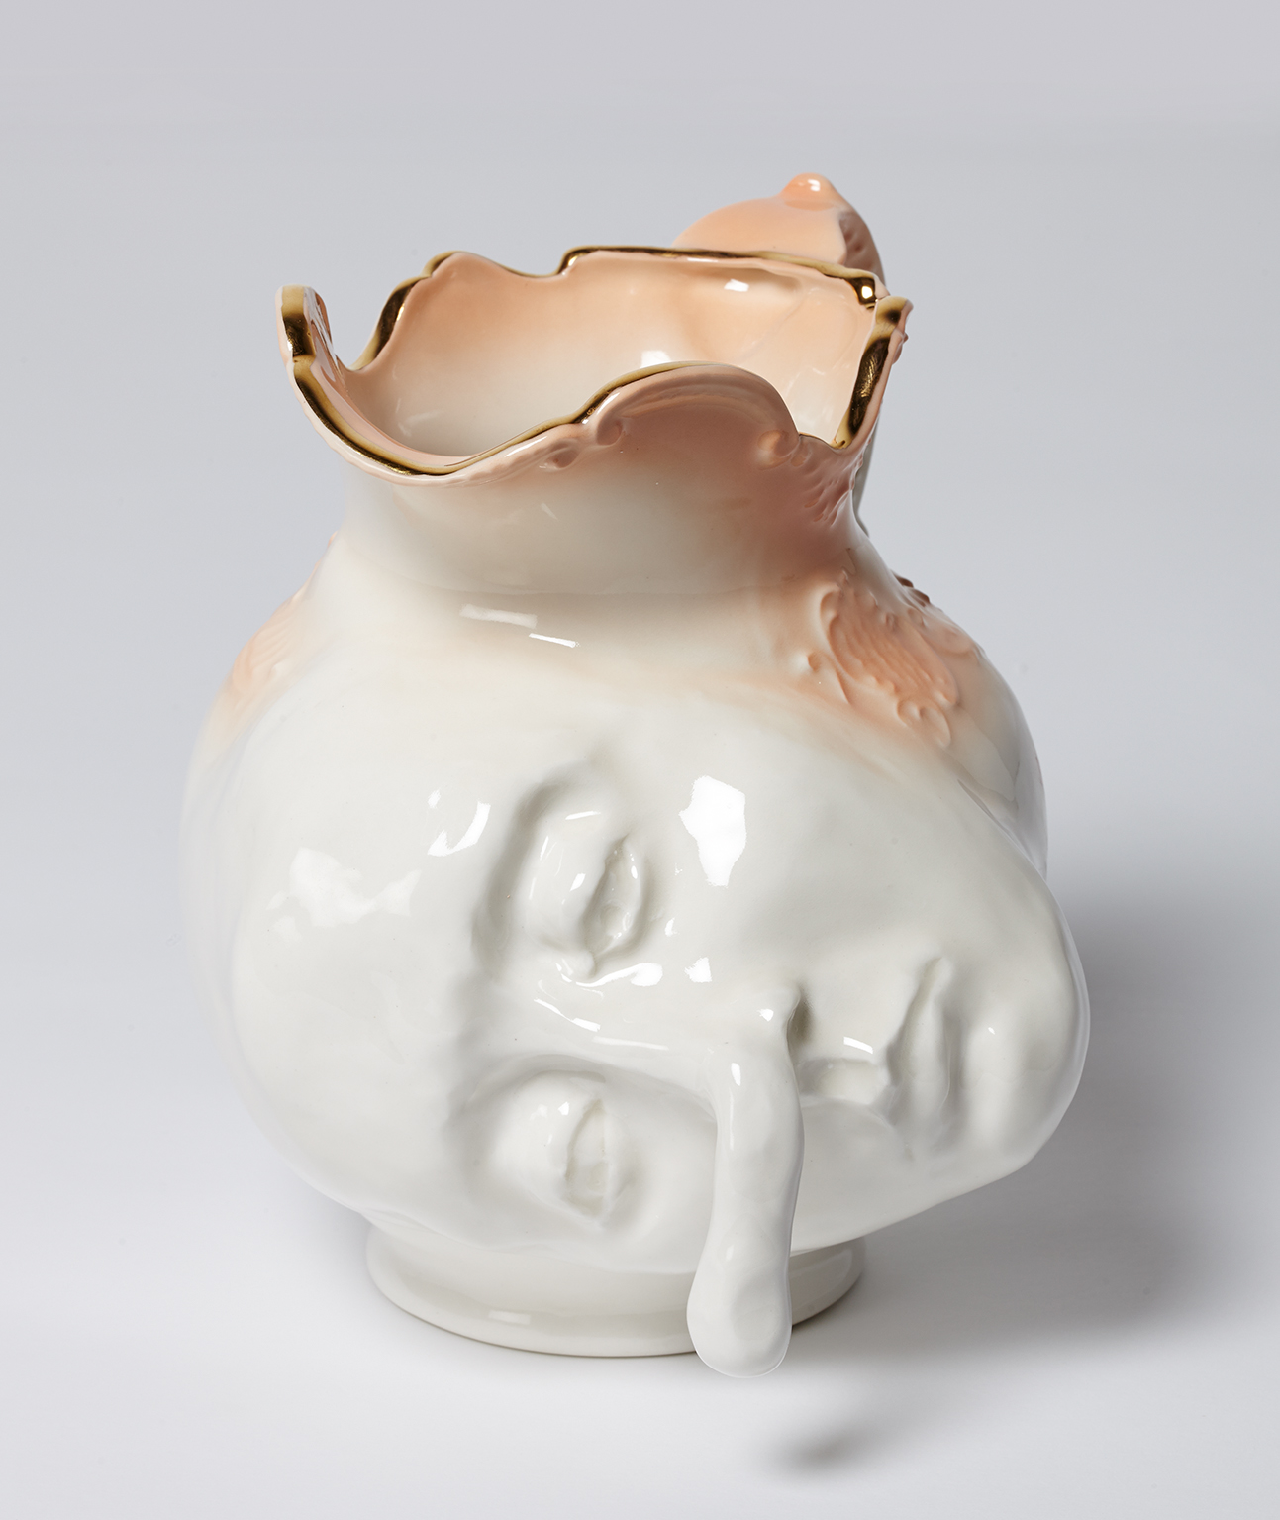
Ben Quilty, Australia, born 1973, Straight white male, nose self-portrait, 2014, Southern Highlands, New South Wales, oil on canvas, 130.0 x 110.0 cm; Private collection, Courtesy the artist
Ben Quilty, Australia, born 1973, Jug (Nose), 2014, Southern Highlands, New South Wales, porcelain, 23.0 x 23.0 x 23.0 cm; Private collection, Courtesy the artist
Notes:
Making
In 2014, Quilty created a number of portraits of family and friends with exaggerated or elongated features. Quilty asked his children Joe and Olivia to direct these distortions; their choices, he stated, were ‘as good as anyone’s when trying to describe the insanity of contemporary humansʼ. Create a distorted portrait of a family member. Write each feature on separate pieces of paper, select one feature at random and modify your portrait accordingly.
Ben Quilty enjoys listening to music and reads a lot. Create a work of art inspired by your favourite book or song.
Although Quilty is best known for his work with paint, he has also created three-dimensional works of art. In 2014, Quilty created a series of porcelain forms portraying misshapen faces, some with distressed expressions. These works are based on Toby Jugs or Character Jugs which often depict a well-known person, either as a full figure or the head and shoulders only. Similarly, in 1889 post-impressionist artist, Paul Gauguin (1848-1903) created Jug in the form of a Head, Self-portrait, after the artist had witnessed two traumatic events.
Investigate the history of face jugs. Create a character jug using your own face pulling an exaggerated expression.

Slide 14
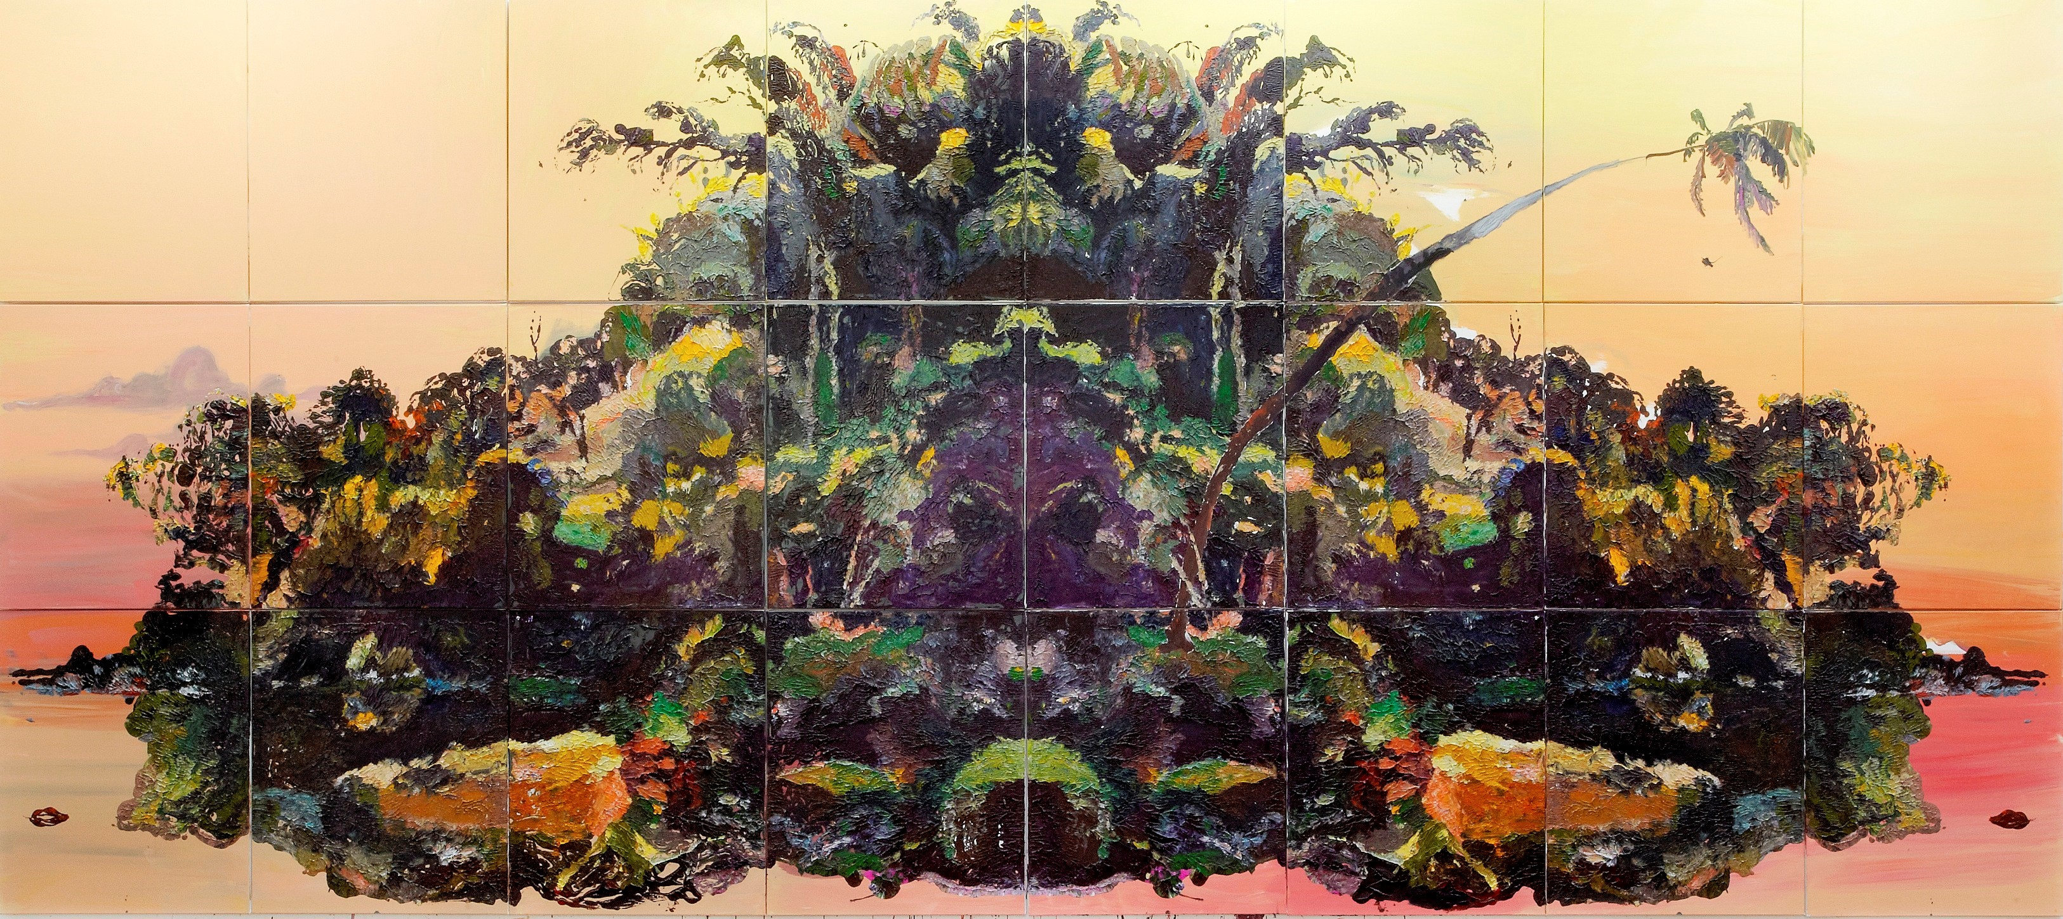
Ben Quilty, Australia, born 1973, The Island, 2013, Southern Highlands, New South Wales, oil on synthetic polymer pain on linen, 390.0 x 880.0.0 cm, Private Collection, Brisbane Courtesy the artist.
Notes:
About the work
‘Quilty’s The Island references Haughton Forrest’s late nineteenth-century painting of the Gordon River in Tasmania. Quilty has created a number of these post-colonial colossal paintings (The Island measures almost nine metres long), whereby he borrows the work of artists such as Eugene von Guérard and H.J. Johnstone, to transform landscape into a type of history painting. Tasmania, Australia’s only island state, represents one battlefield in our history – one haunted by the relentless enactment of violence against Aboriginal people; the grubby land-grabbing imperialism (Forrest came to Australia to take up a land grant); and environmental threats, including those made late last century to the Franklin River (a tributary of the Gordon River, the subject of Forrest’s work).
Quilty has re-created a section of Forrest’s painting, loading his surfaces with impasto paint and then pressing the unpainted canvases directly onto the wet surfaces. This process, which is repeated many times, requires meticulous control, but also invites chance. Devised by Herman Rorschach in the early twentieth century as a method of psychological assessment, ‘Rorschacing’, in Quilty’s words “forces the viewer to see or recognise themselves in history in order to reassess our colonial past, a past that has a dark heart”.’
- Dr. Lisa Slade, Dark Heart Catalogue, AGSA, 2014
Making
The Island references Haughton Forrest’s late nineteenth-century painting of the Gordon River in Tasmania. Investigate what life was like for Aboriginal people in Van Diemen’s Land prior to colonisation. How did life for Aboriginal people compare to other inhabitants?

Slide 15
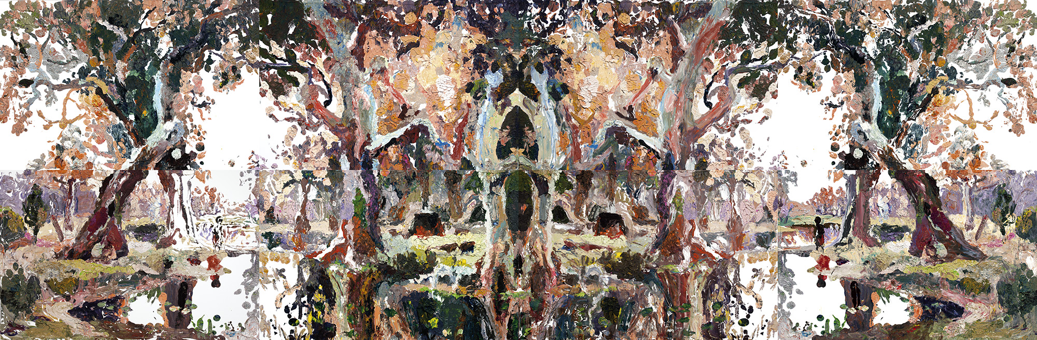
image detail: Ben Quilty, Australia, 1973, Evening shadows, Rorschach after Johnstone, 2011, Robertson, New South Wales, oil on linen, eight panels, 115.0 x 175.0 cm (each panel), 230.0 x 702.0 cm (overall); Gift of Ben Quilty through the Art Gallery of South Australia Contemporary Collectors to celebrate the 10th anniversary of Contemporary Collectors 2013. Donated through the Australian Government’s Cultural Gifts Program, Art Gallery of South Australia, Adelaide, Courtesy Ben Quilty
Notes:
About the work
‘In high school, Quilty received a book on Australian landscape painting as an art prize. The book included a reproduction of Evening Shadows, Backwater of the Murray, South Australia, painted in London in 1880 by H.J. Johnstone. Quilty recalls being seduced by the painting’s romanticism yet troubled by the accompanying interpretation of the painting offered in the book.
More than 130 years on, Quilty created Evening shadows, Rorschach after Johnstone (2012) in his hallmark Rorschach style. This technique is also one that was prized by the Surrealists – a version of their much-loved decalcomania, a technique of chance that invited free association and creative delirium.
Quilty loads the canvas with impasto oil paint, only to destroy the paint surface by pressing a second unpainted canvas directly onto the first. Chance intervenes in creating accidents and abstractions that invite the viewer to reflect on their own perceptions, desires and experiences’.
-Dr. Lisa Slade, 2019
Responding
After visiting the Quilty exhibition take a walk through the permanent collection. Select another work of art to pair with one by Quilty. Why did you make this selection?

Slide 16
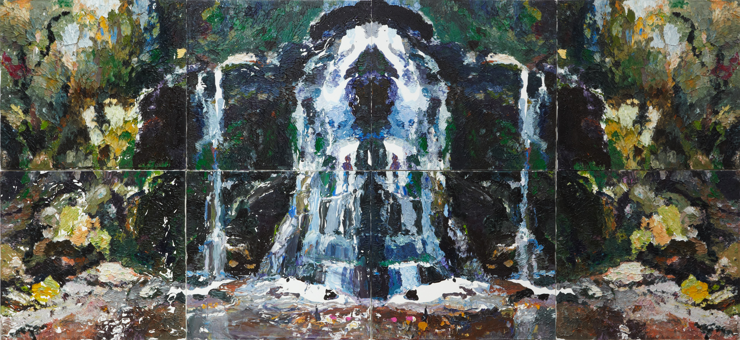
Ben Quilty, Australia, born 1973, Fairy Bower Rorschach, 2012, Southern Highlands, New South Wales, oil on linen (eight panels), 240.0 x 550.0 cm (overall); Purchased with funds provided by the Patrick White Bequest Fund, 2012, Art Gallery of New South Wales, Sydney, Courtesy the artist.
Notes:
About the work
‘Fairy Bower Rorschach (2012) was made after Quilty discovered the violent history of an idyllic picnic spot on Gundungarra country not far from his home, where in 1834 Aboriginal women and children were reputedly massacred. Fairy Bower Rorschach performs the double act of delusion whereby at face value a picturesque landscape, complete with waterfall, is presented but a darker story the painting’s central grotto.
The damaged and mirrored image is of a waterfall at Bundanoon in the Southern Highlands of New South Wales near where Quilty lives and works. Fairy Bower Falls is an idyllic and spectacular destination for tourists and locals. Photographs from the mid 19th century depict the full colonial splendour of women with parasols and men in top hats at the foot of the falls.
By Rorschaching this image of such a precarious site Quilty asks the viewer to reconsider their conception of this landscape as a place of idyllic beauty. The duplication and damage of the image echoes the disturbing and violent history this site may have witnessed’.
- Art Gallery of New South Wales
Making
Fairy Bower Falls is the site of a massacre of Aboriginal people in New South Wales in the early nineteenth century. Look at the Colonial Frontier Massacres map collated by the University of Newcastle. Select an event and write a newspaper article about this incident.

Slide 17
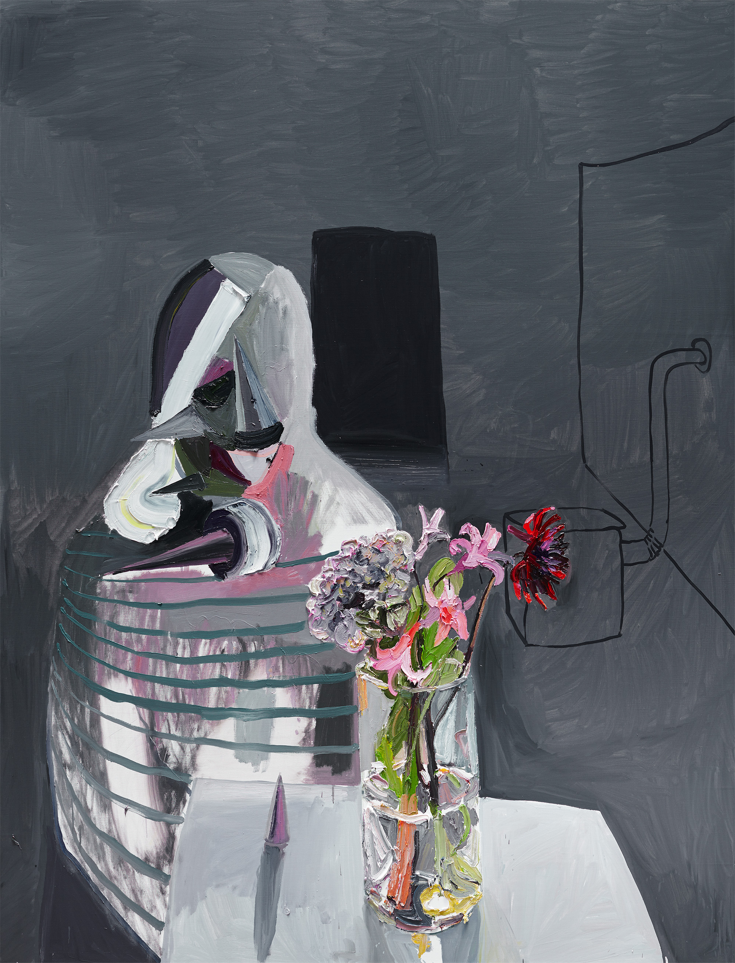
Ben Quilty, Australia, born 1973, Flowers for Heba, 2016, oil on linen, 265.0 x 202.0 cm; Private collection, Adelaide, Courtesy the artist.
Notes:
Responding
In 2018 Ben Quilty released a book called Home which included drawings by Syrian refugee children. This book is dedicated to Heba who was one of the first children Quilty met on his travels through the Middle East and Europe. Quilty asked Heba to draw her home. Look at the painting Flowers for Heba. Look at the colours, shapes and texture of the painting. Why do you think Quilty painted this work? What does the title suggest? Why might you give someone flowers?

