Slide 1
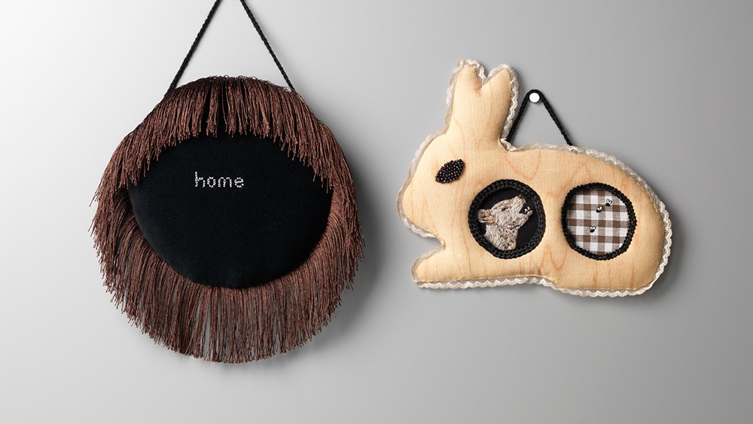
Stitching Home
Dr. Sera Waters
Website: www.serawaters.com.au
Email: sera@serawaters.com.au
Instagram: @serawaters

Slide 2
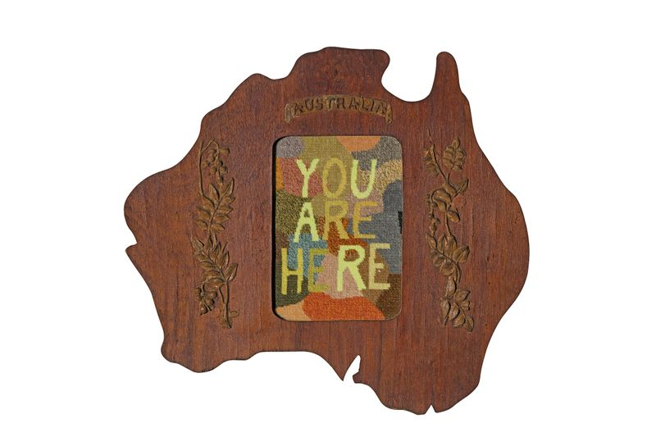
Sera Waters Australia 1979 The beginning 2013-14 cotton, found frame

Slide 3
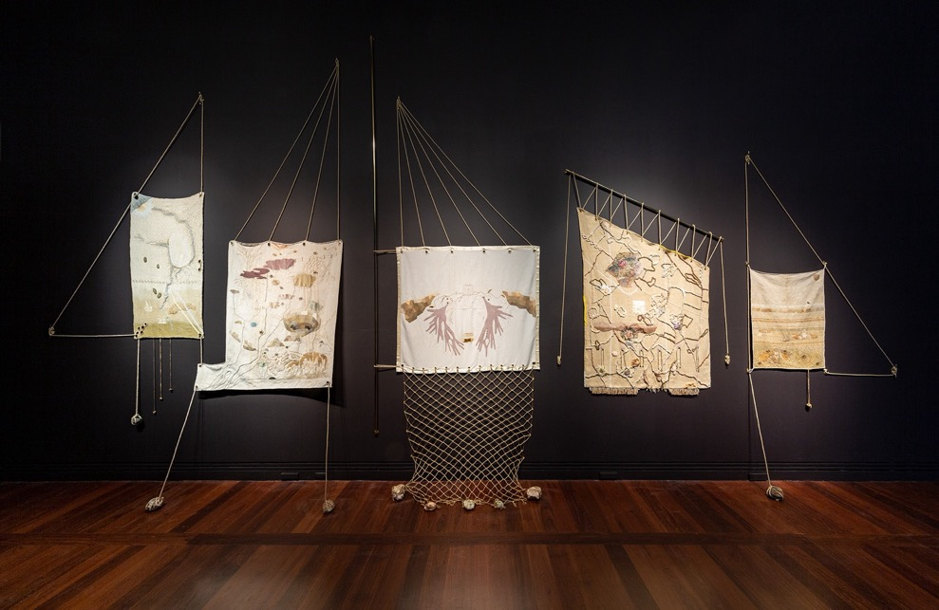
Sera Waters, Storied Sail Cloths, 2022, 600cm (W) x 400cm (H) x 30cm (D), various repurposed and hand-dyed threads, string, cotton, found fabrics, felt and beads upon vintage linen/hemp, Photograph Saul Steed.

Slide 4
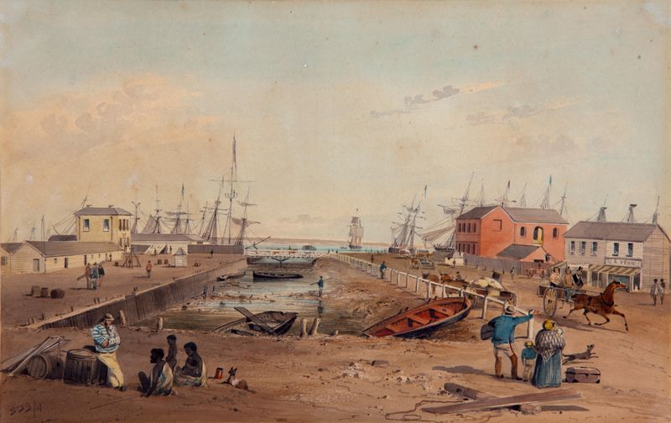
S. T. Gill Australia 21 May 1818 – 27 October 1880 Port Adelaide looking north along Commercial Road 1847 watercolour on paper

Slide 5
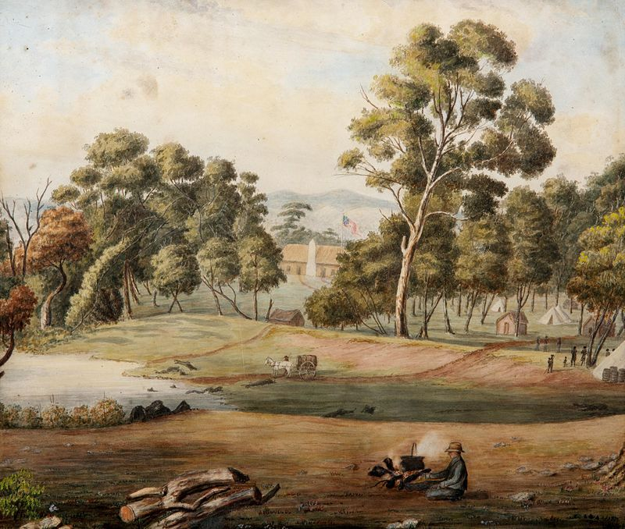
Martha Maria Snell Berkeley Australia 18 August 1813 – 7 July 1899 Government Hut, Adelaide c.1839 watercolour on paper

Slide 6
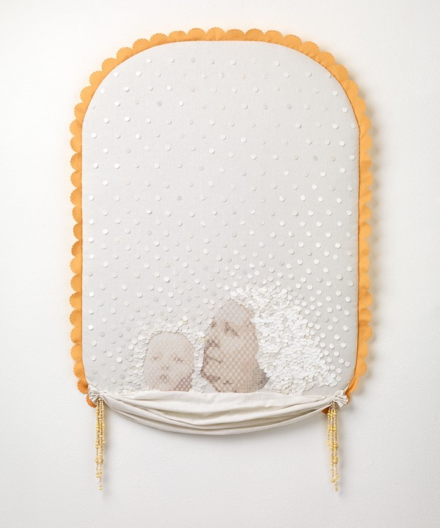
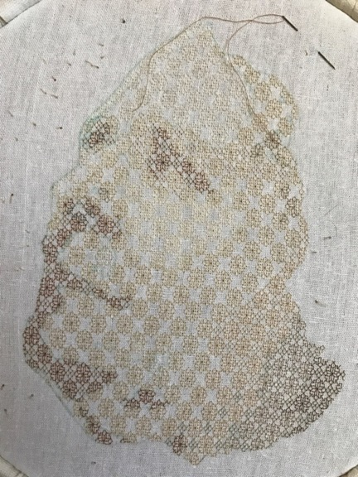
Sera Waters, Basking, 2017
linen, cotton, sequins, tablecloth, handmade glow-in-the-dark beads
92 x 60 cm
Photograph: Grant Hancock

Slide 7
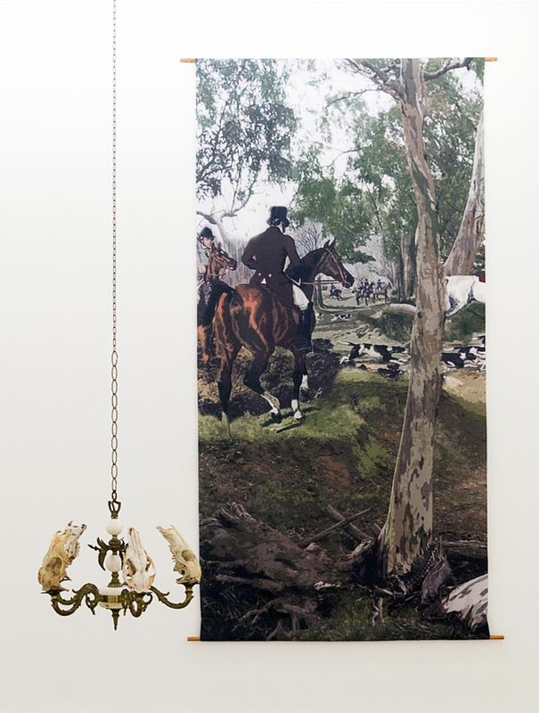
Sue Kneebone Australia 1963 The Find 2014 inkjet print on satin polyester

Slide 8
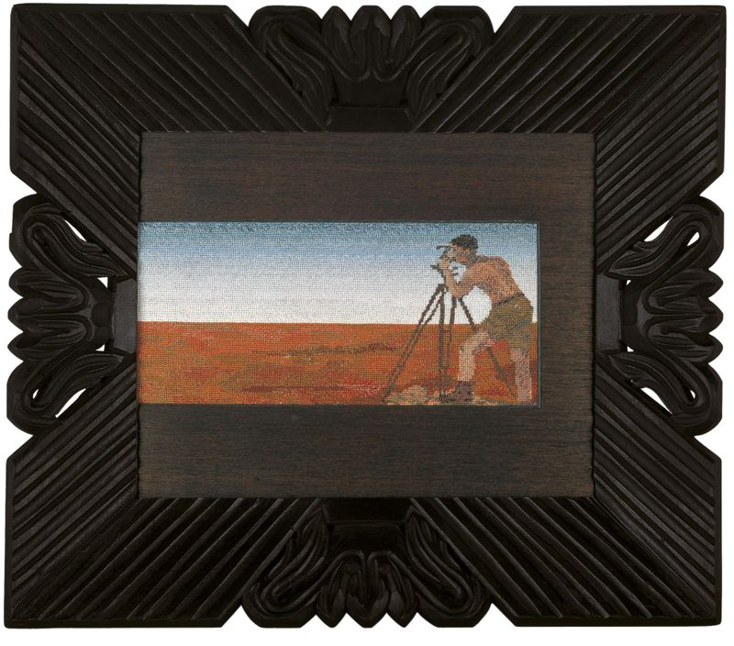
Narelle Jubelin Australia 1960 Surveyor, Woomera, South Australia 1989 cotton embroidery on canvas, carved and painted wood frame

Slide 9
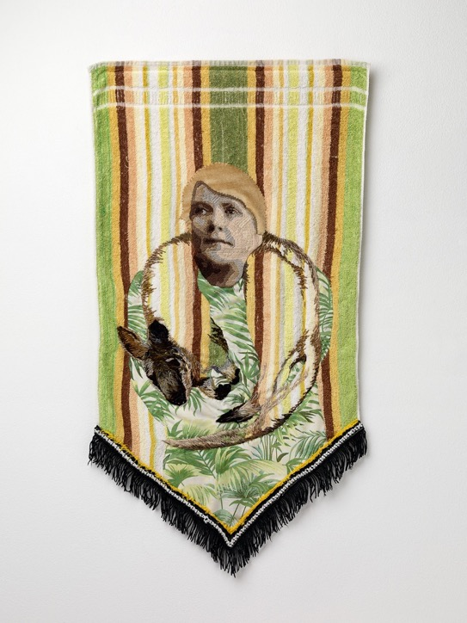
Sera Waters, Telling Tales on Terry Towelling: Fashioning Locals, 2017 towel, wool, cotton, bedsheet, velvet, trim, 95 x 46 cm
Photograph: Grant Hancock

Slide 10
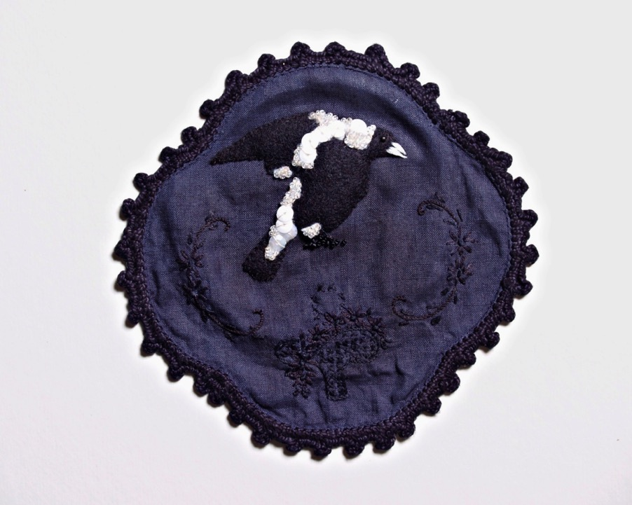
Sera Waters, Nasty Magpie: “Home watering the garden, swooped by magpie,ran down rockery & fell on porch- Haematoma or bruising”, 2009
Found doily, dye, felt, beads, sequins, cotton, glow-in-the-dark thread
Variable dimensions
Photograph Michal Kluvanek
Private Collection
*Nasty Magpie titles/ descriptions of injuries courtesy of AIHW National Injury Surveillance Unit, Flinders University, 1997 (published http://www.nisu.flinders.edu.au/pubs/shortreps/magpies.html)

Slide 11
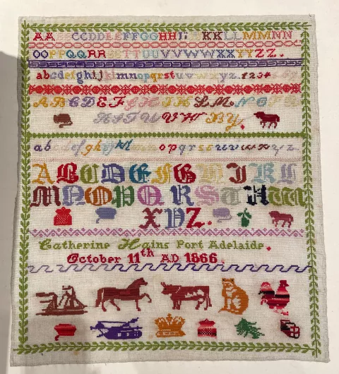
Catherine Hains Sampler, 1866
Collection: Art Gallery of South Australia

Slide 12
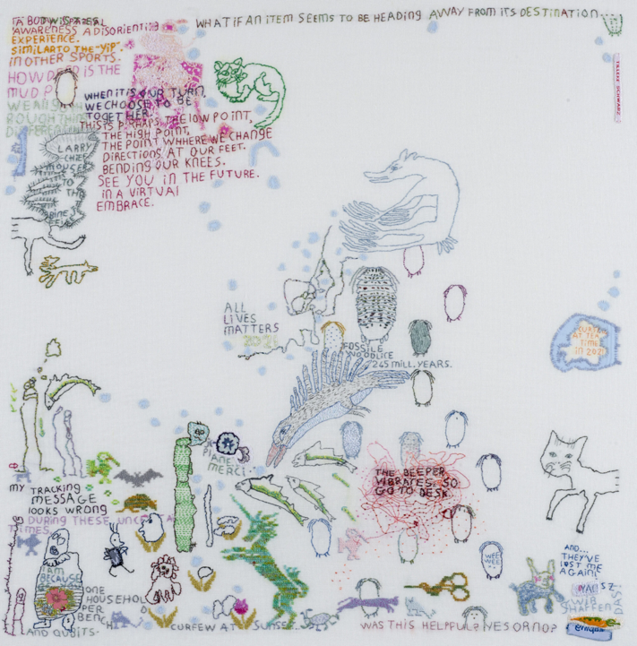
Tilleke Schwarz
All lives matter 2021, 64 x 65 cm
https://www.tillekeschwarz.com/medium/

Slide 13
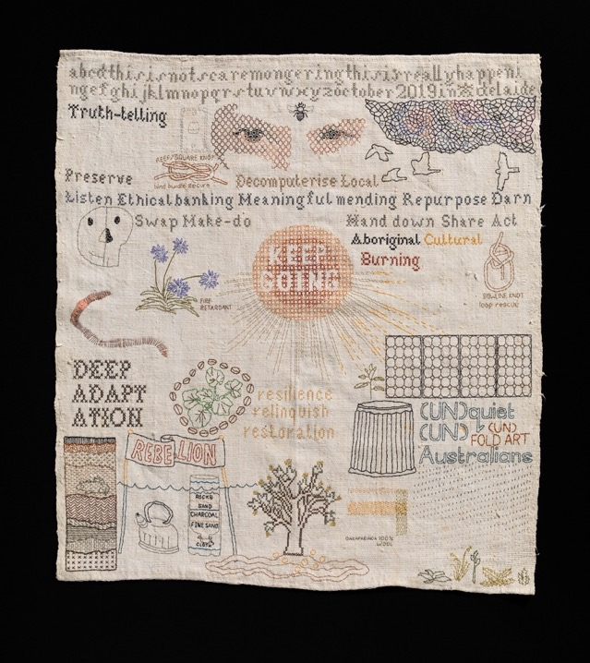
Sera Waters
Survivalist Sampler, 2019-2020
Cotton, glow-in-the-dark thread, found materials on repurposed linen
45 x 42 cm
Photograph: Grant Hancock

Slide 14
Sera Waters, Storied Sail Cloths, 2022, 600cm (W) x 400cm (H) x 30cm (D), various repurposed and hand-dyed threads, string, cotton, found fabrics, felt and beads upon vintage linen/hemp, Photograph Saul Steed.

Slide 15
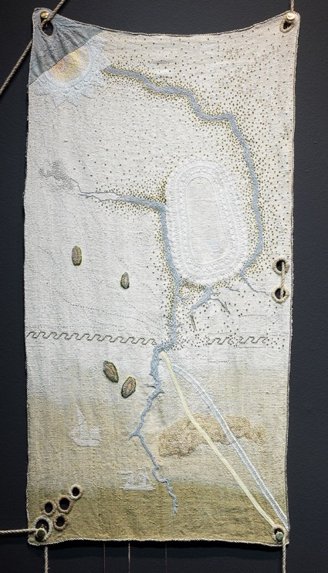
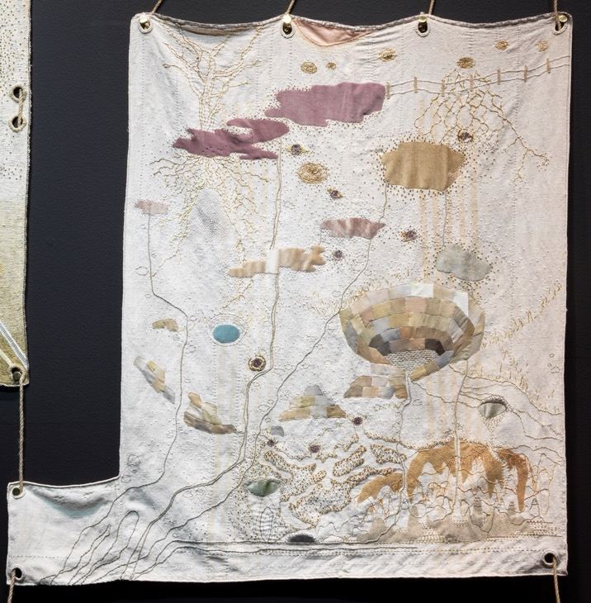

Slide 16
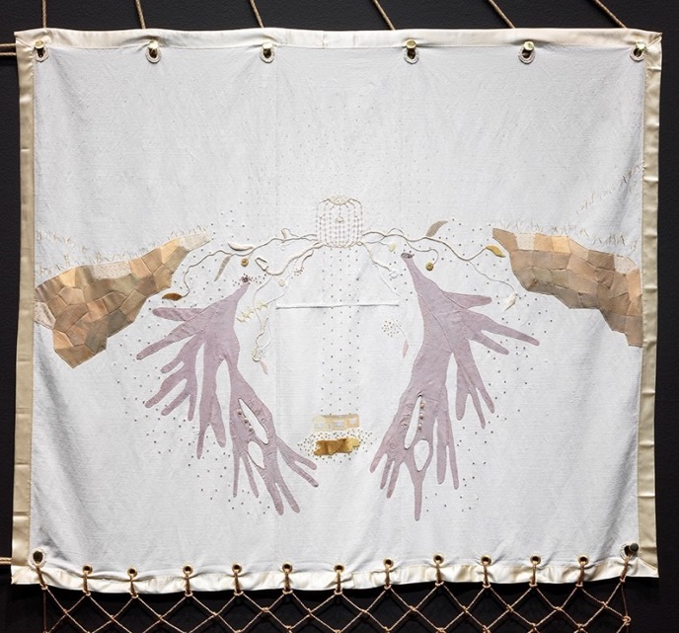
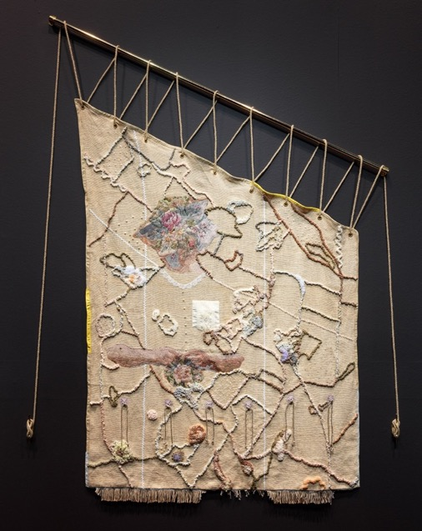

Slide 17
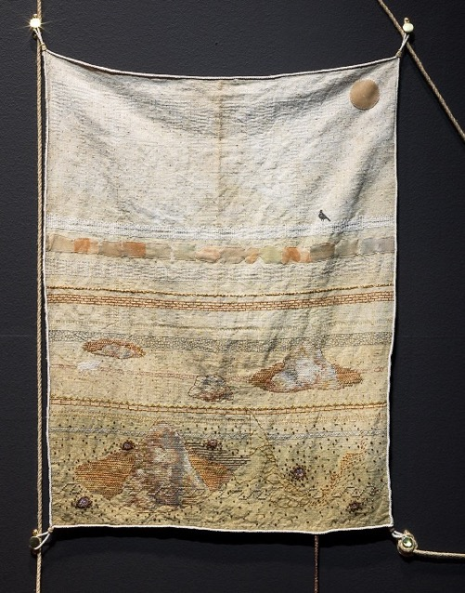
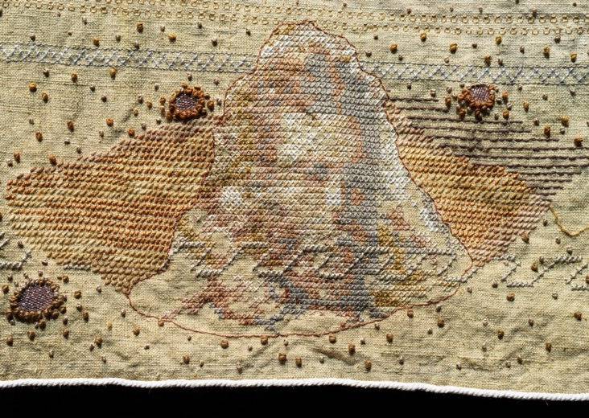

Slide 18
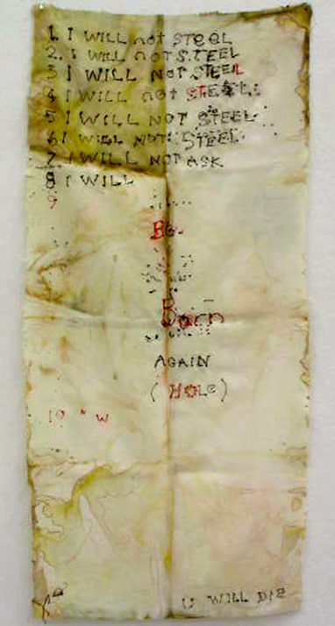
John Barbour
From the exhibition Human Need, 2003
https://www.johnbarbour.com.au/exhibitions.html

Slide 19
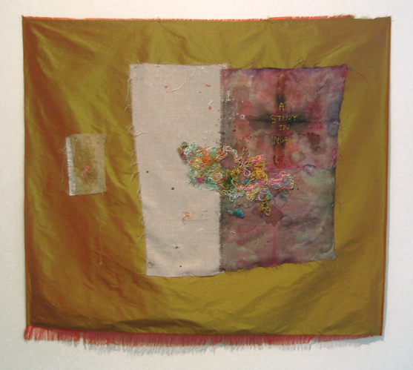
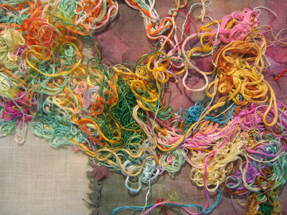
John Barbour
From the exhibition Worm in the Silk, 2005
https://www.johnbarbour.com.au/exhibitions.html

Slide 20
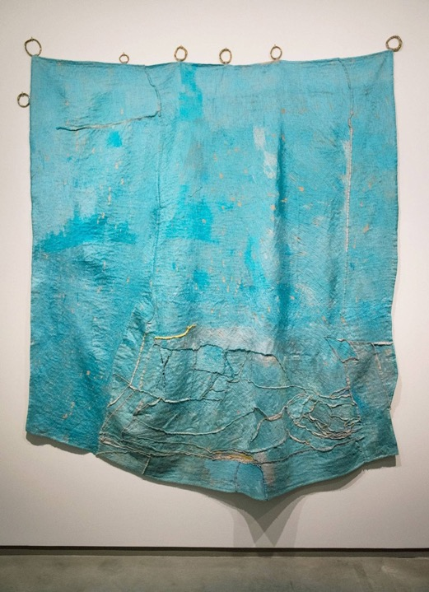
Teelah George, Sky Piece, 2016-2017. thread, linen, bronze and oil paint. 270 x 210cm irreg

Slide 21
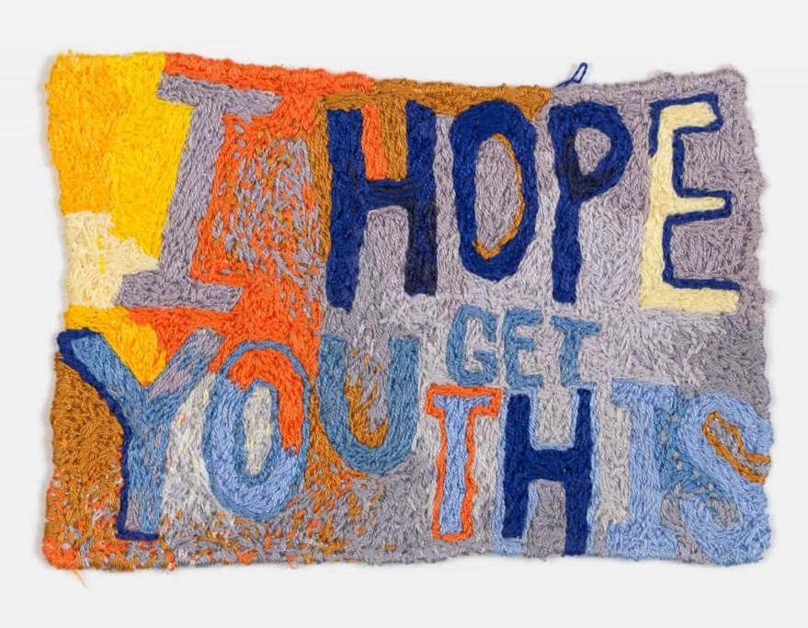
Raquel Ormella, All these small intensities (detail), 2017, silk and cotton embroidery thread on linen, Photo: David Patterson

Slide 22
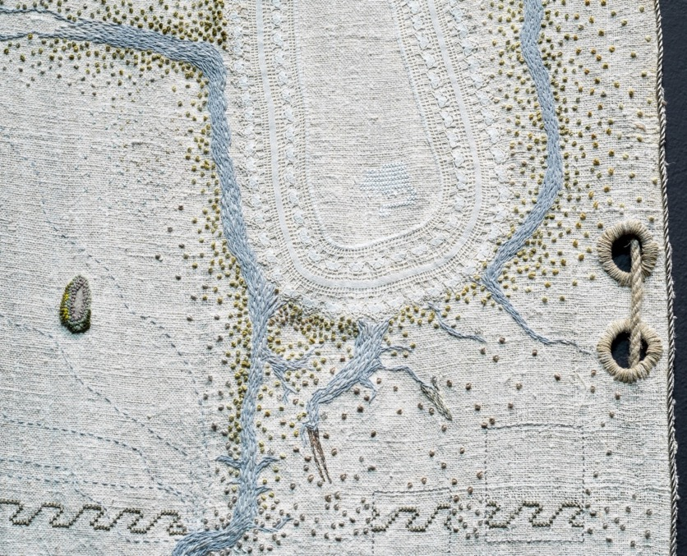
Colonial knots
Seed stitches
Applique
Running Stitch

Slide 23
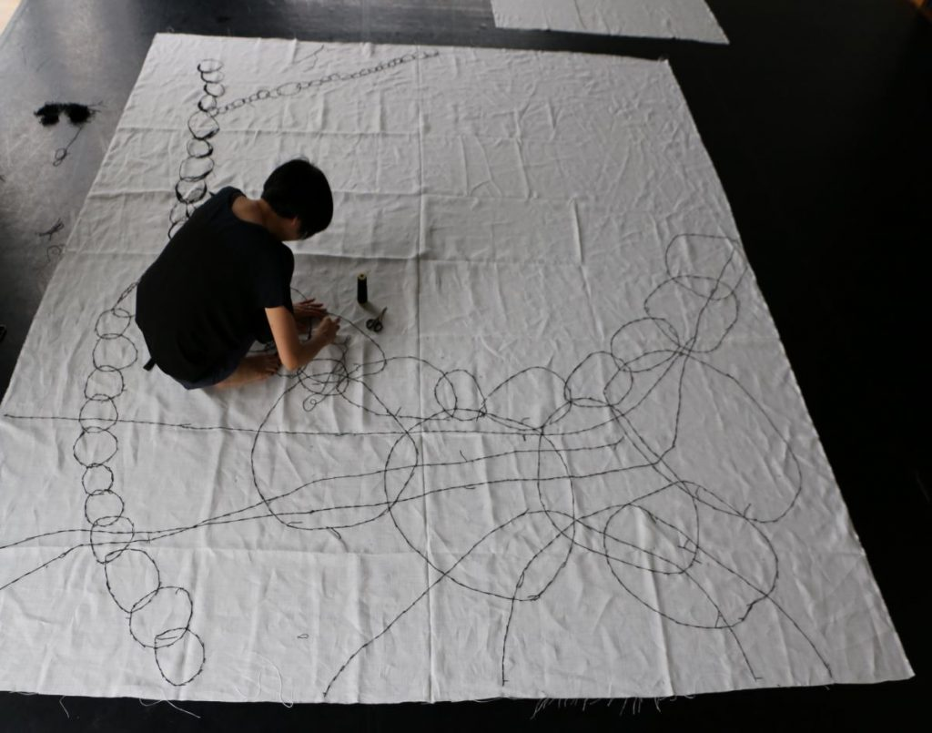
Rieko Koga, Making « Departure » 2014. Hand embroidery on linen. 317cm x 300cm. Photo Catherine Mary-Houdin

Slide 24
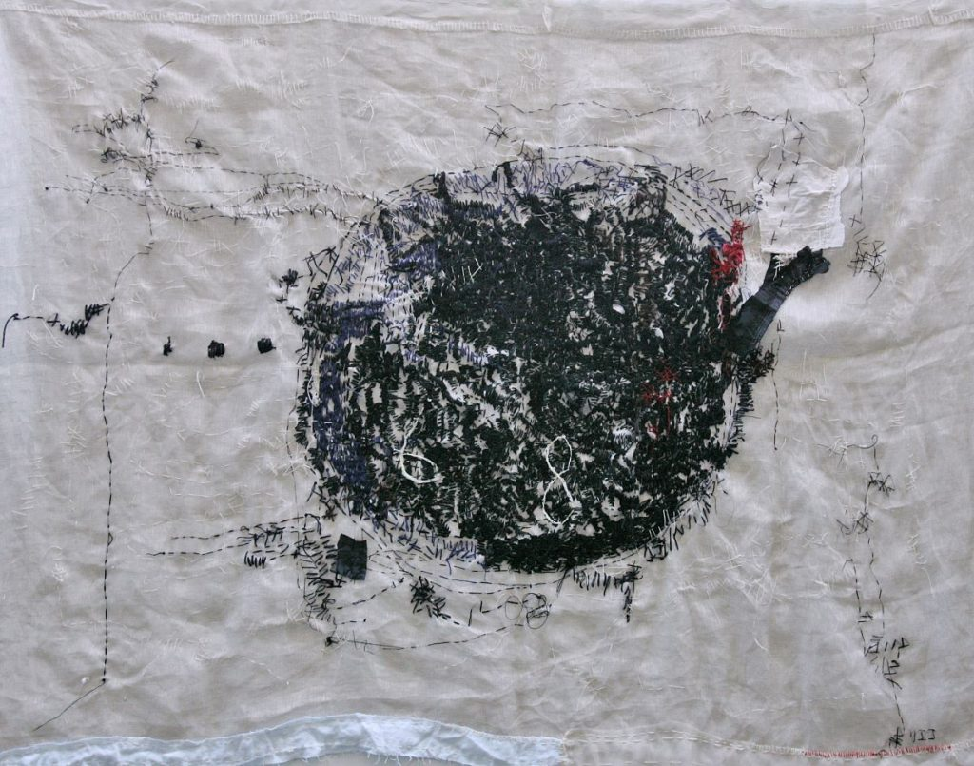
Rieko Koga, KODO-BEAT. 2009. Hand embroidery on linen. 123cm x 170cm. Photo Gilles Desrozier

Slide 25
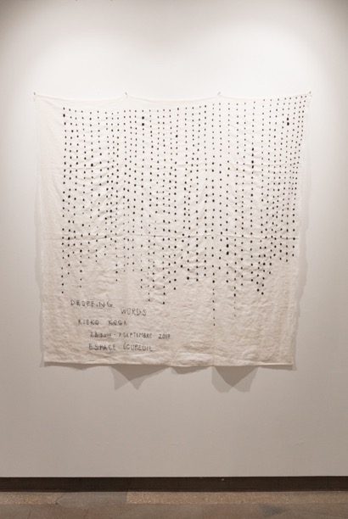
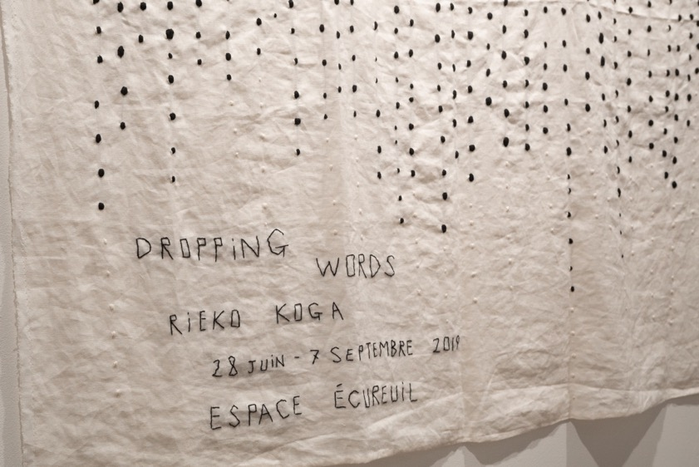
Rieko Koga, I AM HERE FOR YOU, Pamėnkalnio Gallery, Vilnius. 1 October – 4 November, 2021,

Slide 26
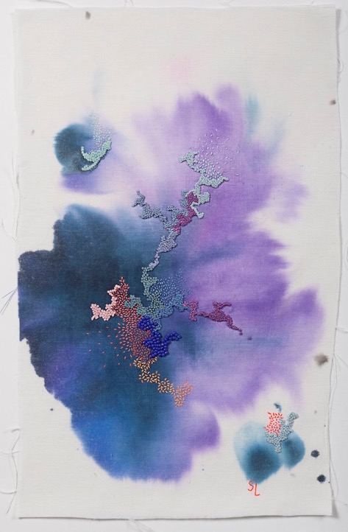
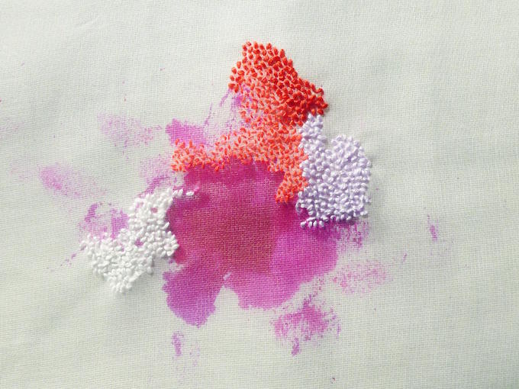
Sabatina Leccia, 2015, Ink and embroidery on linen
https://www.sabatinaleccia.com/projects

Slide 27
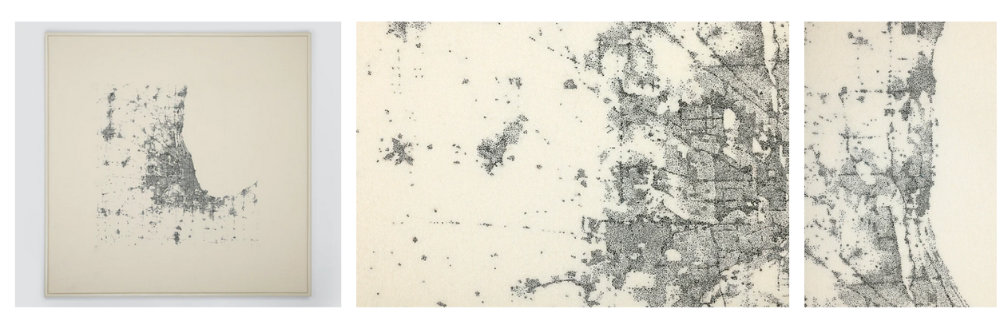
Richard McVetis, Light Abstracts,
Hand embroidery, cotton on wool 80 x 80cm 2021

Slide 28
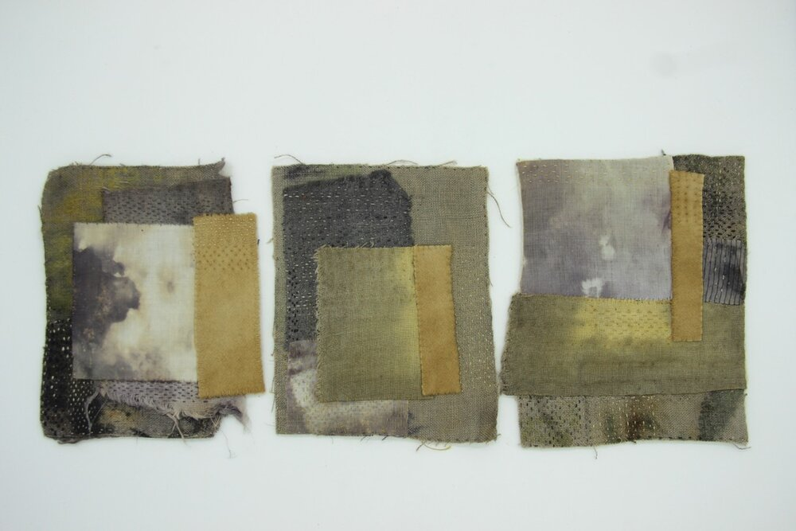
Claire Wellesley-Smith,
Dyer’s Field, field notes, 2014
http://www.clairewellesleysmith.co.uk

Slide 29
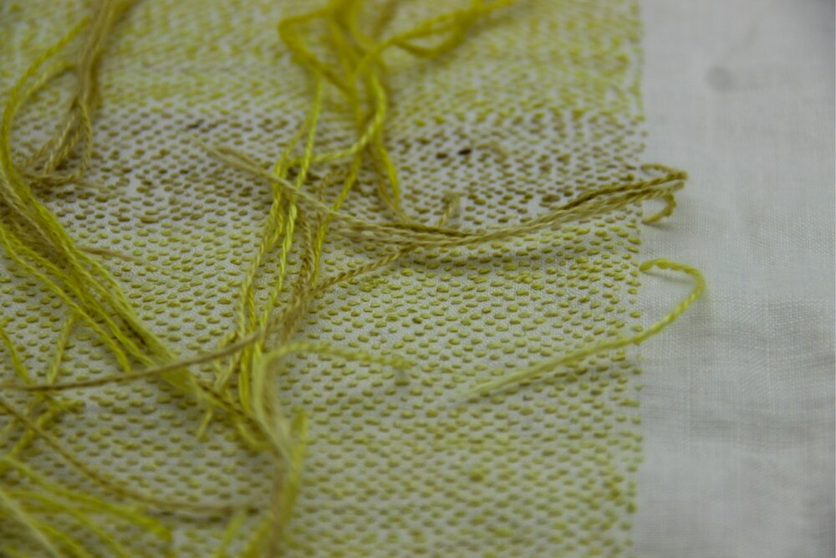
Claire Wellesley-Smith,
Lull, 2016-2017, Dean Clough Gallery, Halifax
http://www.clairewellesleysmith.co.uk

Slide 30
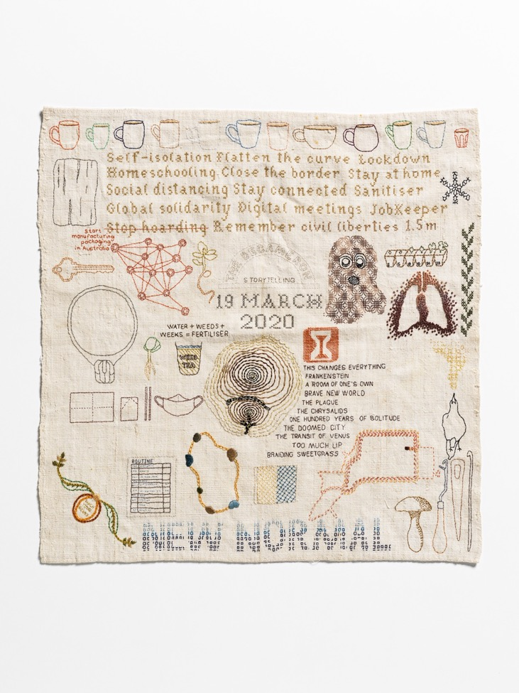
Sera Waters
Survivalist Sampler #2, 2020-2021
Cotton, glow-in-the-dark thread, found materials on repurposed linen
45 x 42 cm

Slide 31
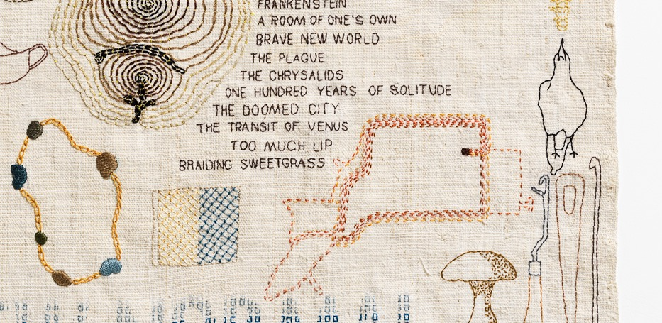

Slide 32
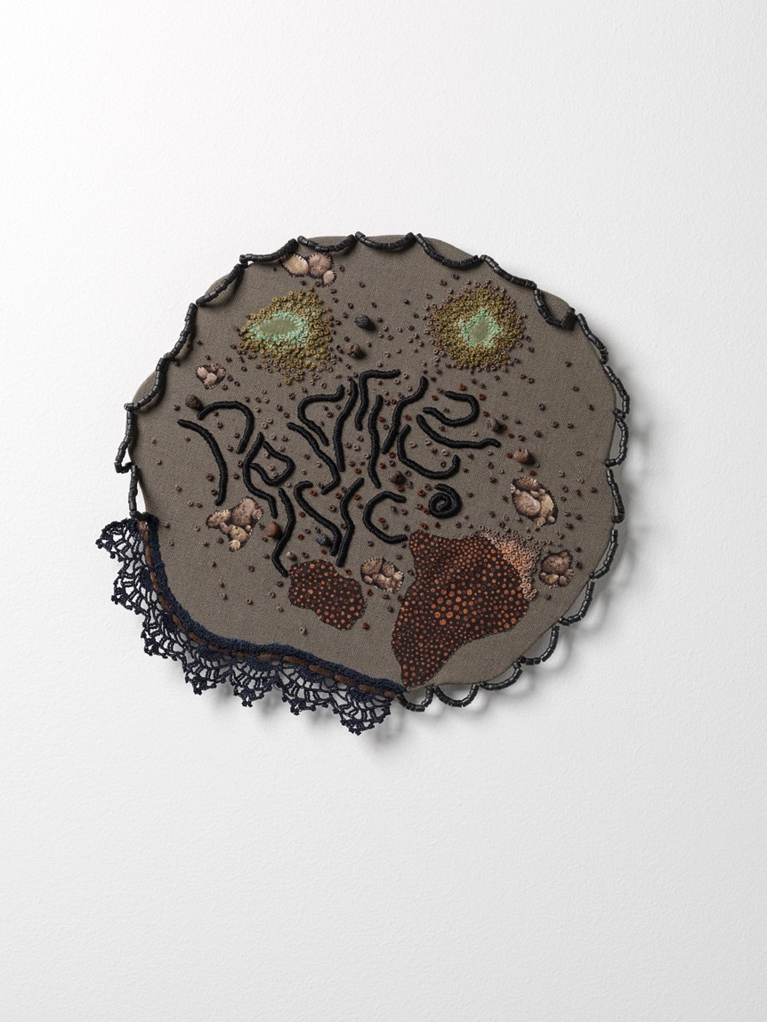
Sera Waters, Pestillpedes, 2020
Cotton, linen, trim, beads, crewel, velvet and card
27 (w) x 25 (h) cm
Photograph Grant Hancock

Slide 33
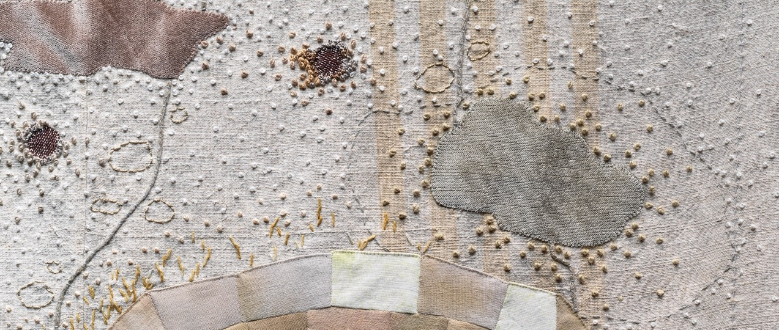

Slide 34
Activity:
Experiment with how stitched marks upon repurposed fabric can reflect upon ideas of ‘home’ and home-making traditions.
Ideas to get you started:
Think about home-making traditions and daily routines: eg cooking or mending or cleaning. How could you represent these ideas in stitch?
Think about how you move around home spaces? What objects/furniture/spaces are you drawn to? How could you represent these sites of activity or pathways?
Are there areas where certain emotions or memories are connected? Think about forms, colours, marks which can begin to reflect these?
Reflect upon the patterns, marks, stains, remnants which mark your home?
Experiment!
Stitch Techniques: running stitch, colonial knots, applique/couching, speckling

