Slide 1
Visual Arts Planning Resource Early Years & Primary
Australian Curriculum:
Visual Arts Content Descriptors and Strands explained through an AGSA lens

Slide 2
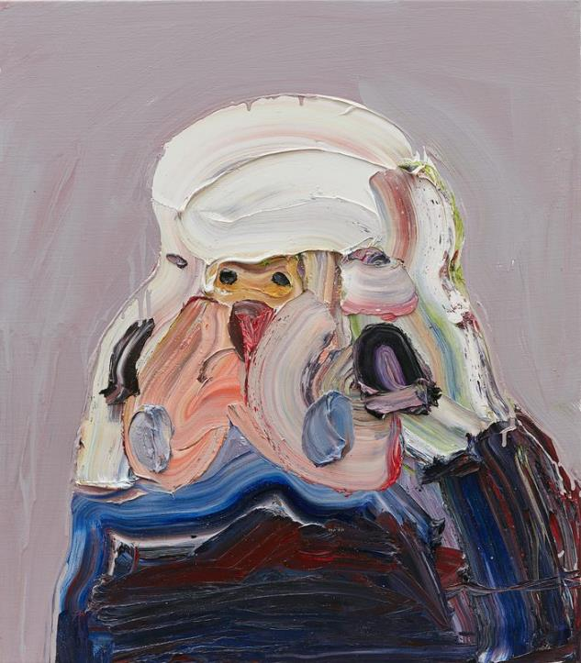
About this resource
This resource links the Visual Arts Australian Curriculum Strands to artworks in AGSA’s collection. It will support you in prioritising the way ideas and intentions are communicated by artists and help children to think laterally about the way in which artworks are made and displayed.
We have made a selection of the ‘knowledge and skills of Visual Arts’ (viewpoints, forms, skills, processes and visual conventions) as outlined in the Australian curriculum and highlighted how these can be incorporated in a visit to the Gallery. The Visual Arts sub-strands have been paired with potential elaborations explored through an AGSA lens, incorporating suggested activities that relate to a visit to the Gallery.
With a focus on visual conventions, forms, skills, viewpoints and processes, the suggested activities highlight how to use artists as a starting point and how an artist’s work can connect to the world of your students in a meaningful way.
Ben Quilty, Australia, born 1973, New Bird, 2017, Southern Highlands, New South Wales, oil on linen, 82.0 x 71.5 x 3.5 cm; Gift of Ben Quilty through the Art Gallery of South Australia Contemporary Collectors 2019. Donated through the Australian Governments Cultural Gifts Program, Art Gallery of South Australia, Adelaide, Courtesy the artist, photo: Mim Stirling.

Slide 3
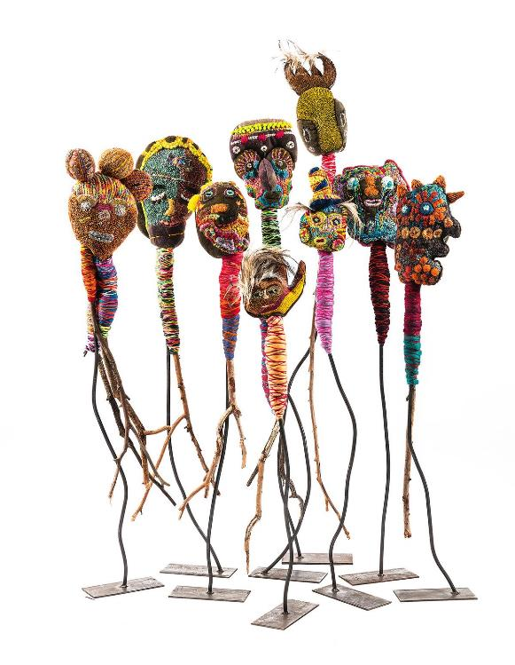
Foundation to Year 2: Selected Representations and Practices
Visual Conventions identifying, using and interpreting line, shape, colour, texture, space, tone and value.
Viewpoints contexts – recognising artworks from different cultures particularly Aboriginal and Torres Strait Islander Peoples, and works from Asia, and from different times
Forms drawing, painting, sculpture, printmaking, fibre crafts and digital imaging
Skills observational – seeing, noticing and viewing critically
Processes describing, explaining, exploring, questioning, selecting, interpreting, imagining, designing, experimenting, constructing, creating and displaying
Trudy Inkamala, Australia, born 1940, Arrernte/Luritja people, Nor thern Territory; Roxanne Petrick, Australia, born 1986; Marlene Rubuntja, Australia, born 1961; Rosabella Ryder, Australia, born 1975, Arrernte people, Northern Territory; Dulcie Raggett, Australia, born 1970 ; Dulcie Sharpe, Australia, born 1957; Rhonda Sharpe, Australia, born 1977; Roxanne Sharpe, Australia, born 1985, Luritja people, Northern Territory; Valerie Stafford, Australia, born 1963, Anmatyerre people, Northern Territory, Every face has a story, every story has a face: Kulila!, 2016, Alice Springs, Northern Territory, soft sculpture mixed media, dyed blankets, polyester wadding, embroidery thread, twigs, 228.0 x 120.0 x 100.0 cm (overall dimensions for all 9 works); Acquisition through TARNANTHI: Festival of Contemporary Aboriginal & Torres Strait Islander Art suppor ted by BHP 2017, Ar t Gallery of South Australia, Adelaide. © Yarrenyty Arltere Artists

Slide 4
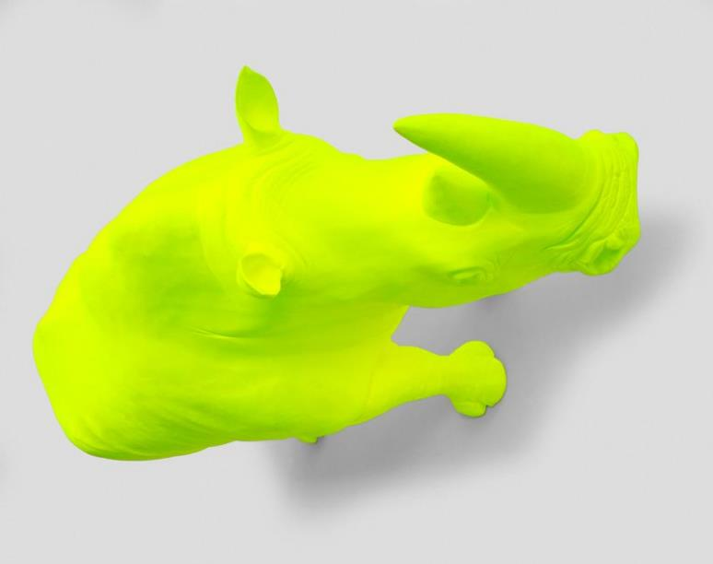
Year 3 and 4: Selected Representations and Practices
Visual Conventions identifying, using and interpreting a selection of design elements and design principles
Viewpoints contexts – recognising artists and artworks from the past, and from different cultures, particularly Aboriginal and Torres Strait Islander Peoples, and peoples from Asia
Forms drawing, design, painting, sculpture, printmaking, photography and film
Skills investigative – researching, discovering and reinterpreting artworks from various viewpoints as artist and audience observational – seeing, noticing and viewing critically practical – use of visual arts materials, equipment and instruments
Processes investigating, determining, conceiving, experimenting, questioning, predicting, testing, evaluating, comparing, analysing, observing, identifying and connecting
James Angus, Australia, born 1970, Rhinoceros, 1995, Fremantle, Western Australia, fibreglass, synthetic polymer paint, aluminium, 105.0 x 320.0 x 165.0 cm, 40.0 (weight -); Gift of Helen Brown 1996, Art Gallery of South Australia, Adelaide, Courtesy of the artist and Roslyn Oxley9 Gallery, Sydney.

Slide 5
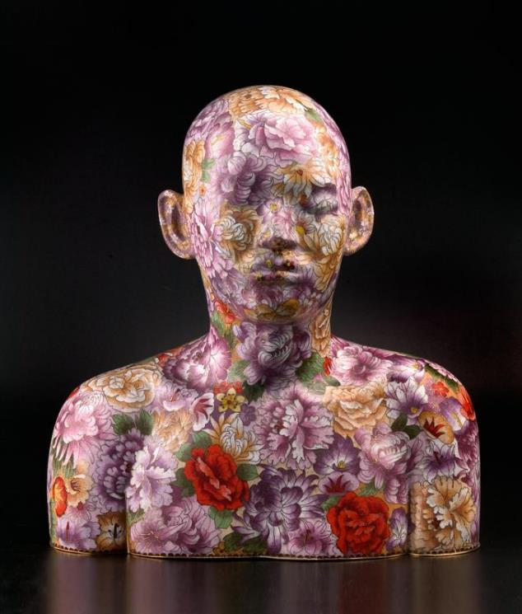
Years 5 and 6: Selected Representations and Practices
Visual Conventions identifying, using and interpreting a selection of design elements and design principles
Viewpoints expression – physical, psychological, sensory and intuitive contexts – recognising artists and artworks who work in cross-media and those who install their artworks in various locations. Refer to artists and audiences from different cultures, particularly Aboriginal and Torres Strait Islander Peoples, and peoples from Asia
Forms cross-media – drawing, design, painting, sculpture, printmaking, photography, film, etc.
Skills expressive – interpreting subject matter through various contexts and/or viewpoints to enhance understanding and create a personal response to stimuli conceptual – developing a thought or idea into a visual representation practical – using visual arts materials, equipment and instruments
Processes investigating, conceiving, experimenting, selecting, refining, predicting, testing, evaluating, comparing, analysing, identifying, evaluating, judging and displaying
Ah. Xian, China/Australia, born 1960, Jingdong Cloisonné Factory, manufacturer, China, Human human - cloisonné bust 3, 2001, Dachang County, Hebei Province, cloisonné enamel on copper, 45.0 x 42.5 x 25.5 cm; Gift of ETSA Utilities and the Art Gallery of South Australia Foundation 2006, Art Gallery of South Australia, Adelaide, © courtesy the artist.

Slide 6
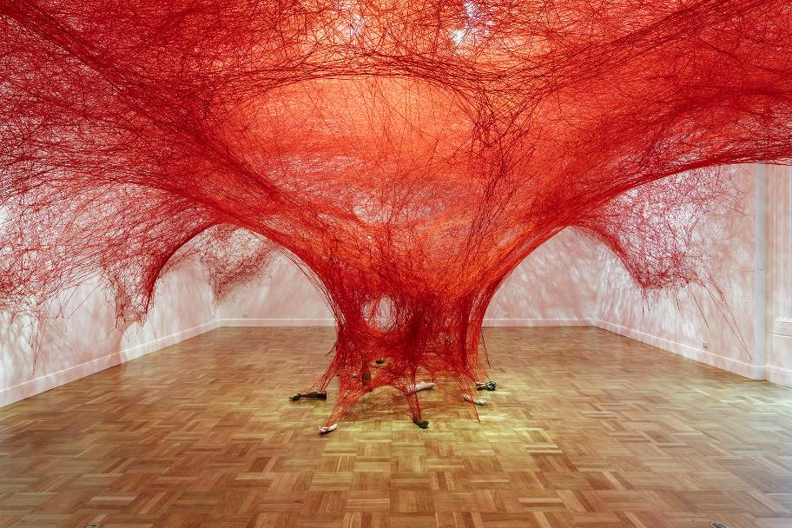
A visit to the Art Gallery of South Australia
Seeing artworks in situ and engaging with primary sources is a unique experience, one which all children should have the opportunity to experience. The detail in a painting or print, the texture of a surface or the scale of a sculpture can sometimes only be appreciated when in front of the work itself.
In each year level, at least one elaboration within the Australian Curriculum for Visual Arts requires students to respond to artworks. In some instances, students are required to analyse how artists use visual conventions in artworks, by visiting and critiquing a physical or virtual exhibition of art.
Installation view: Chiharu Shiota: Embodied, 2018, Art Gallery of South Australia, Adelaide; photo: Saul Steed

Slide 7
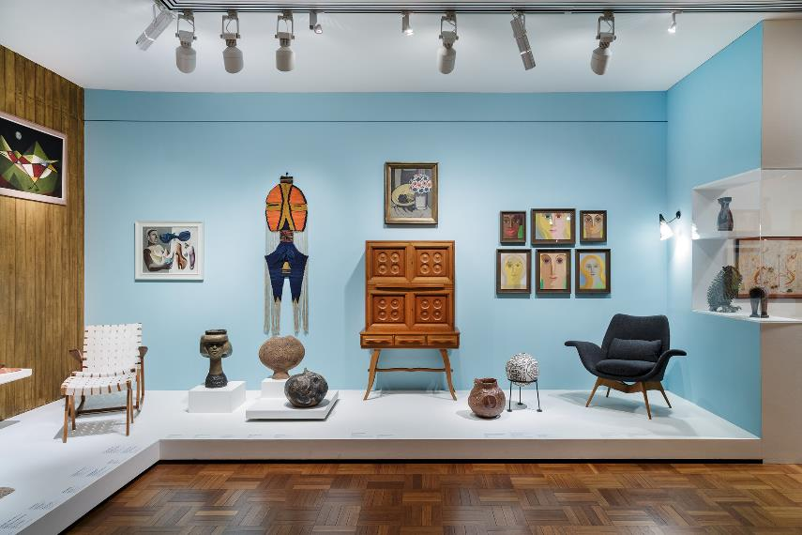
Tips for planning an excursion
Pre-visit
A visit to the gallery is really no different from a lesson in the classroom and therefore needs to be prepared for in a similar way:
• Visit the gallery before taking your students there. This will allow you to see what is on display and decide what is suitable for them. Displays can change regularly.
• Plan your journey throughout the space, considering where you will stop to discuss artworks. Remember you know your students best. Plan your visit to suit them.
• Prepare some questions to spark discussion, rather than rehearse and disseminate content. If you are not sure where to start use AGSA’s Curiosity Cards or online interpretive resources.
Installation view: Gallery 6, Art Gallery of South Australia, Adelaide; photo: Saul Steed

Slide 8
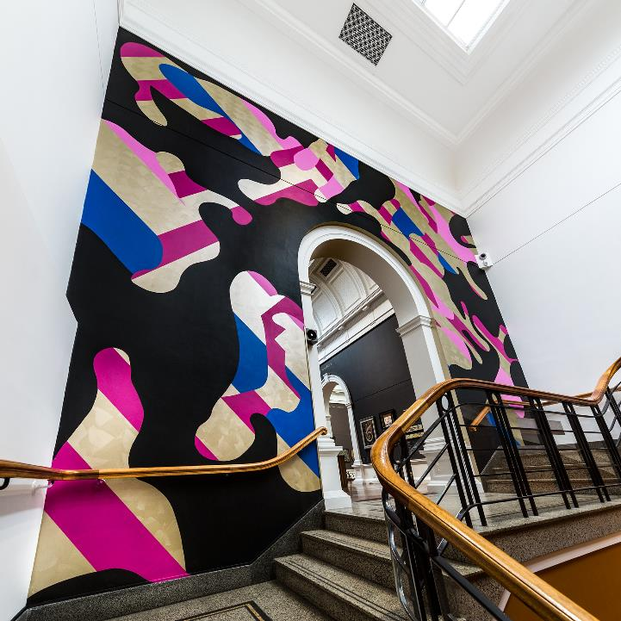
Tips for planning an excursion
During your visit
• Often the only time that students visit a cultural institution is on a school excursion, so where possible prioritise time with artworks or objects. Emphasise looking and discussing rather than keeping students preoccupied with worksheets.
• Arrange your class into small groups. This will make your movement through gallery spaces easier to manage.
• You won’t have time to see everything. Plan to stop at five or six works to use as starting points for inquiry, but be flexible – students’ interest may be piqued by a you don’t have on your list. If you have prepared a range of critical thinking questions, it won’t matter which your students are drawn to, provided you have allowed time for discussion.
• Most of all, have fun! The more you enjoy it, the more they will.
image detail: Reko Rennie, Kamilaroi people, New South Wales, OA_CAMO, Adelaide, 2017; Commissioned for TARNANTHI : Festival of Contemporary Aboriginal & Torres Strait Islander Art supported by BHP 2017, Art Gallery of South Australia, Adelaide, Courtesy of the artist and blackartprojects, Melbourne, photo: Saul Steed

Slide 9
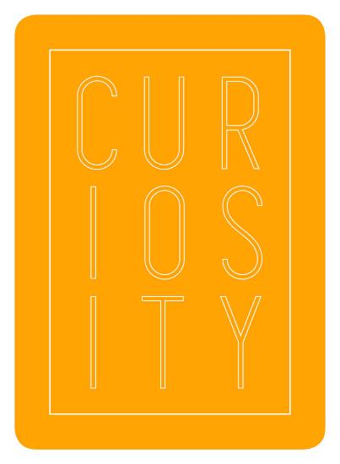
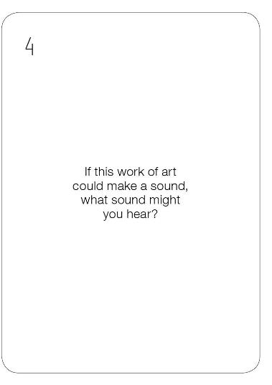
Curiosity Cards
Curiosity Cards promote critical and creative thinking and encourage ‘long looking’, resulting in students actively engaging with artworks, with ideas and with each other. The questions provide students with an alternative ‘way in’ to a , sparking their curiosity and developing their confidence in responding to visual information. Some questions require a quick response, and so are great icebreakers for all students to have an opportunity to share, while other questions are designed to stimulate extended activities and could be completed in pairs or small groups.
A self-guided visit can often be a daunting experience with students seeing artworks in situ, sometimes for the first time. The Curiosity Cards assist you to plan a visit to a gallery, without the pressure of disseminating content in the exhibition space. Rather, slow down the gallery experience by providing opportunities for students to make connections and respond, emphasising that every student’s opinion is acknowledged and valid.
Curiosity Cards are available online from the AGSA Store or a sample can be downloaded from our website

Slide 10




The Arts: Visual Arts Sub-strand F - 6
Exploring ideas and improvising with ways to represent ideas
Developing understanding of practices
Sharing artworks through performance, presentation or display
Responding to and interpreting artworks
For more information refer to ACARA: https://docs.acara.edu.au/resources/The_Arts_-_Sequence_of_content.pdf

Slide 11
Exploring ideas and improvising with ways to represent ideas
Suggested approaches: AGSA Themed Elaborations (F – 2)
Viewpoints contexts – recognising artworks from different cultures
Skills observational – seeing, noticing and viewing critically
Processes describing, explaining, exploring, questioning, selecting, interpreting, imagining
Visit AGSA and find artworks that share a similar theme, subject matter or style.
What is similar about these works and what do you notice that is different?
Tip: You may like to focus on one collection area or space within the Gallery. Consider using artworks from different cultures and times.

Slide 12
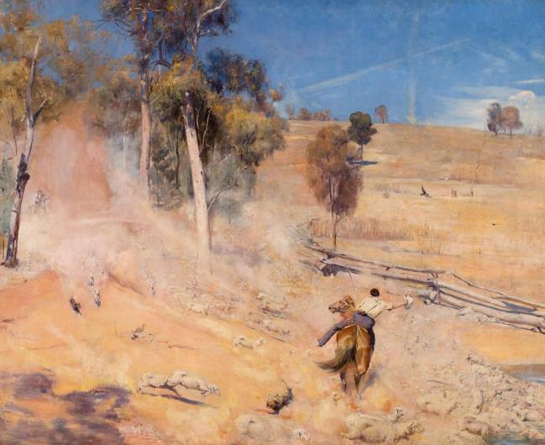
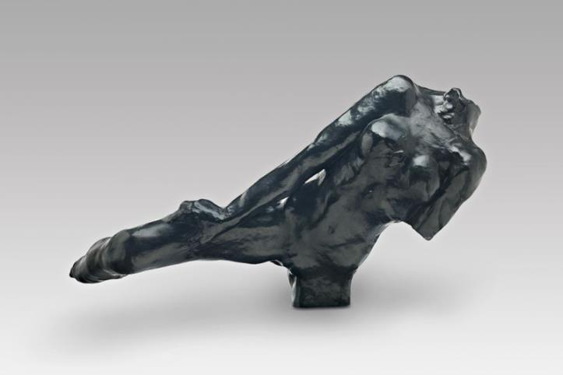
F - 2: Viewpoints, skills and processes
Why do you think these works have been paired together?
Find another to pair with one of these works. Share your selection with the class. How did you make your choice?
Tom Roberts, Australia, 1856 - 1931, A break away!, 1891, Corowa, New South Wales and Melbourne, Victoria, oil on canvas, 137.3 x 167.8 cm; Elder Bequest Fund 1899, Art Gallery of South Australia, Adelaide.
Auguste Rodin, France, 1840 - 1917, Flying Figure, large version, 1890-91, enlarged 1895 ?, (Georges Rudier Foundry, cast 1968), Paris, bronze, 53.0 x 78.0 x 30.0 cm; William Bowmore AO OBE Collection. Gift of the South Australian Government, assisted by the Art Gallery of South Australia Foundation 1996, Art Gallery of South Australia, Adelaide.

Slide 13
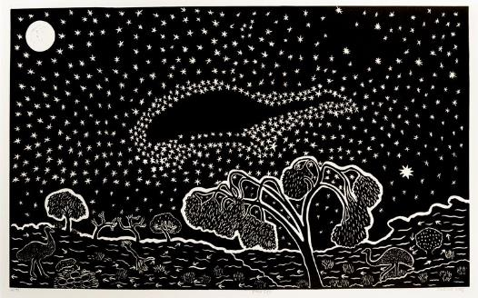
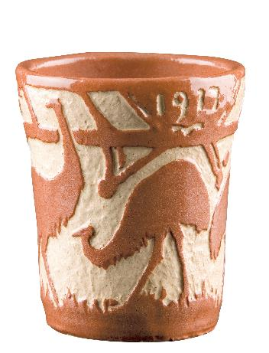
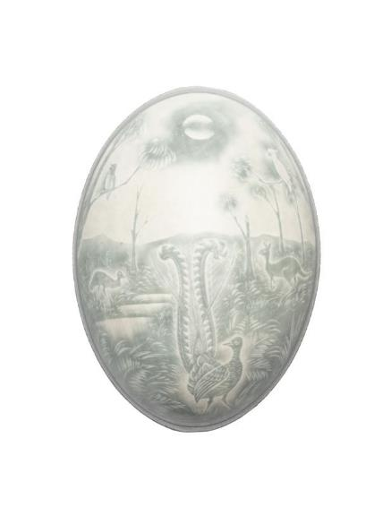
F - 2: Viewpoints, skills and processes
Which is the odd one out?
Organise a class debate on which is the odd one out. Provide students with some basic contextual information about the works which may inform their decision making for example the name and nationality of the artist, medium, title, date and place the work was made. Remember, there is no right or wrong answer to this question. This activity will provide students an opportunity to discuss what they see, make connections and judgments based on what they see and draw conclusions by considering all the information. This is an ideal activity for practicing observational skills and critical thinking while describing, questioning, selecting and interpreting.
This activity can be easily adapted and extended for the classroom. Our online collection has a range of high quality images, why not create your own selections to have on hand for warm up activities or last minute relief lessons.

Slide 14
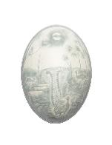

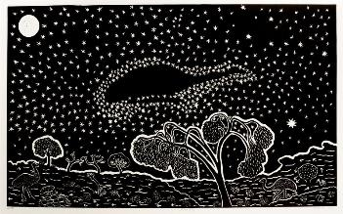
Captions
Jonaski Takuma, Australia, working 1893-1910, The lyre bird's retreat [cameo carved emu egg], c.1897, Sydney, emu egg, 13.0 x 9.0 x 9.0 cm; J.C. Earl Bequest Fund 2014, Art Gallery of South Australia, Adelaide.
Gladys Reynell, Australia, 1881 - 1956, Emu beaker, 1917, London, earthenware, sgraffito decoration, 10.0 x 8.7 cm; South Australian Government Grant assisted by the Crafts Board of the Australia Council 1980, Art Gallery of South Australia, Adelaide, © Art Gallery of South Australia.
Badger Bates, Barkandji people, New South Wales, born 1947, Wilcannia, New South Wales, Emu sky, 2008, Broken Hill, New South Wales, linocut on paper, 43.1 x 70.9 cm (image), 54.4 x 87.8 cm (sheet); Acquisition through TARNANTHI: Festival of Contemporary Aboriginal & Torres Strait Islander Art supported by BHP 2019, Art Gallery of South Australia, Adelaide, © Badger Bates, photo: Alexandra Rosenblum.

Slide 15
Exploring ideas and improvising with ways to represent ideas
Suggested approaches: AGSA Themed Elaborations Years 3 and 4
View artworks on display. Organise your class into small groups and assign them an art element or design principle (visual convention). Document five artworks (photograph/sketch), what visual elements do you notice most in these works?
What materials have the artists used?
Without looking at the wall label, arrange these works from the oldest to newest (most contemporary). Are these works all made by Australian artists, what can you see that suggests they are made by an Australian artist or not?
Select one of the artworks you encountered. Imagine if this work was created using different colours or mediums – e.g. something made from bronze now made from glass or paper, or a painting transformed into a sculpture - how might this change the meaning or your impression of the work?
Visual Conventions identifying, using and interpreting a selection of design elements and design principles
Processes determining, questioning, comparing, analysing, observing, identifying and connecting
Forms drawing, design, painting, sculpture, printmaking, photography and film
Viewpoints contexts – recognising artists and artworks from the past, and from different cultures, particularly Aboriginal and Torres Strait Islander Peoples, and from Asia
Skills observational – seeing, noticing and viewing critically

Slide 16
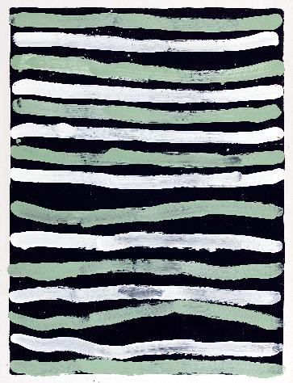
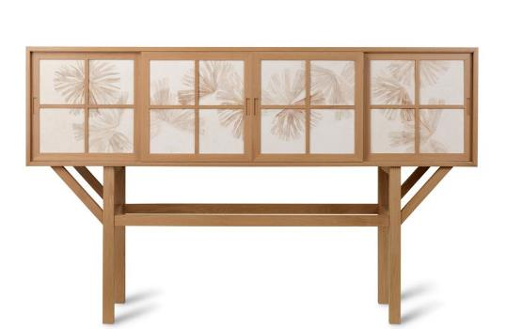
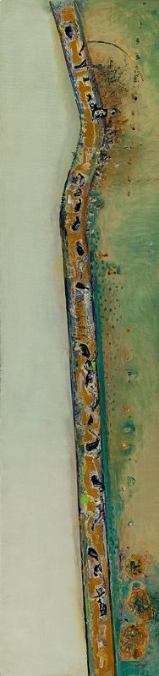
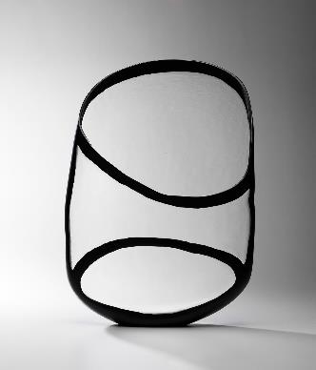
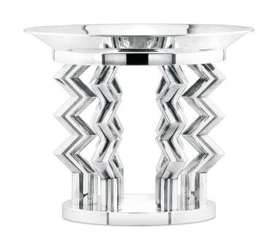
Years 3 and 4: Viewpoints, skills and processes
Treasure hunt! Find 5 artworks which have an emphasis on line.
If a visit to the Gallery is not possible, this activity can be easily replicated in the classroom. Provide students with a variety of postcards or coloured photographs of artworks and have students select the which best describes each element or principle.

Slide 17
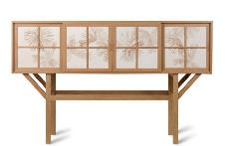



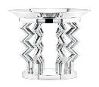
Captions
Khai Liew, designer, Australia, born 1952, Bruce Nuske, ceramist, Australia, born 1949, Bruce [cabinet on stand], Collec+tors, 2010, Cabinet, Norwood, South Australia; tiles, Adelaide, South Australia, American white oak, porcelaneous stoneware, sgraffito decoration, 130.0 x 212.0 x 50.0 cm; Gift of Michael Armitage, Susan Armitage, Philip Bacon AM, Colin and Robyn Cowan, Julian and Stephanie Grose, Andrew and Hiroko Gwinnett, Jim and Andrea Katsaros, Diana Laidlaw AM, Sonia Laidlaw, Macquarie Group Foundation, David McKee, Pam McKee, Jillian Russell, Peter and Mary Sutherland, Janet Worth to the Collec+ors Appeal through the Art Gallery of South Australia Foundation 2012, Art Gallery of South Australia, Adelaide, Courtesy the artist, photo: Grant Hancock.
image: Fred Williams, Australia, 1927 – 1982, Flood bound cattle, 1975, Melbourne, oil on canvas, 256.0 x 62.0 cm; Gift of Lyn Williams AM 1995, Art Gallery of South Australia, Adelaide. © Estate of Fred Williams
Tim Edwards, Australia, born 1967, Elements #8 Outline, 2018, JamFactory, Adelaide, blown and wheel cut glass, 54.5 x 38.0 x 11.0 cm; Gift through the Adelaide Biennial Ambassadors Program 2018, Art Gallery of South Australia, Adelaide
Emily Kame Kngwarreye, Anmatyerre people, Northern Territory, born 1910, Alhalkere (Alalgura) soakage, Northern Territory, died 1996, Alice Springs, Northern Territory, Awelye V, 1994, Utopia, Northern Territory, synthetic polymer paint on canvas, 128.5 x 98.5 cm (irreg); South Australian Government Grant, Art Gallery of South Australia, Adelaide, © Estate of Emily Kame Kngwarreye/Copyright Agency.
Ettore Sottsass, designer, Italy, 1917 - 2007, MEMPHIS, Milan, Italy, manufacturer, 1981 - 1988, ROSSI & ARCANDI, Vicenza, manufacturer, Italy, est. 1959, Murmansk centrepiece, 1982-86, designed 1982, Vicenza, silver, 28.6 x 36.8 cm (diam.); Gift of the Art Gallery of South Australia Foundation 2011, Art Gallery of South Australia, Adelaide, © Archivio Ettore Sottsass.

Slide 18
Exploring ideas and improvising with ways to represent ideas
Suggested approaches: AGSA’s Themed Elaborations (Years 5 and 6)
Viewpoints expression – physical, psychological, sensory and intuitive contexts – recognising artists who work in cross-media and those who install their artworks in various locations. Refer to artists and audiences from different cultures, particularly Aboriginal and Torres Strait Islander Peoples, and from Asia
Skills expressive – interpreting subject matter through various contexts and/or viewpoints to enhance understanding and create a personal response to stimuli conceptual – developing a thought or idea into a visual representation practical – using visual arts materials, equipment and instruments
Processes investigating, conceiving, experimenting, selecting, refining, predicting, testing, evaluating, comparing, analysing, identifying, evaluating, judging and displaying
Take a walk to find some artworks which are located outside of the Gallery. Why might artists choose to create public artworks? What are some things you would need to consider when creating such a work?
View artworks from different times and cultures. What do these artworks tell us about the people, place or time in which they were made?
Create an artwork that represents the time you live in or your cultural heritage. Display your work as part of a class exhibition.
Reading a wall label can reveal a great deal of information about a artwork, including the name of the artist, the place and year the work was made, the medium and sometimes may include an extended text.

Slide 19
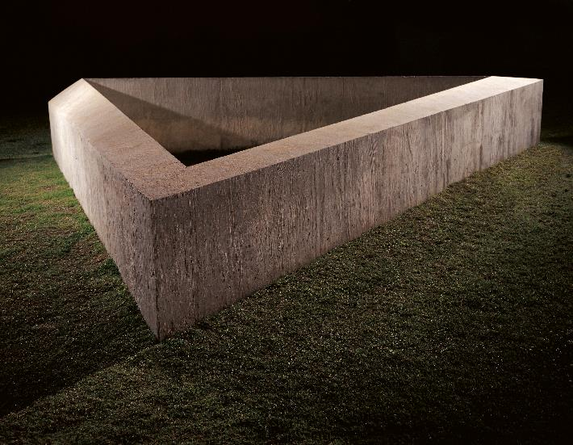
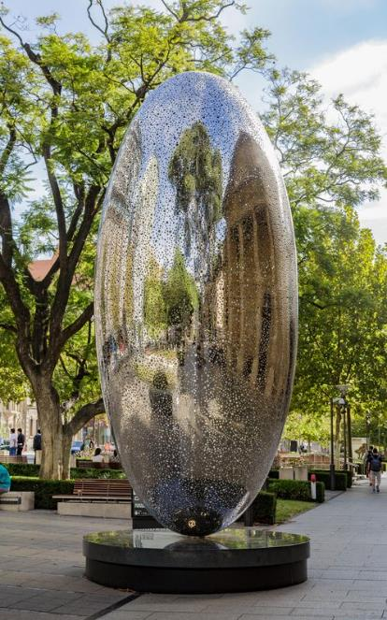
Years 5 and 6: Viewpoints, skills and processes
Take a walk to find some artworks which are located outside of the Gallery.
Why might artists choose to create public artworks? What are some things an artist would need to consider when creating artworks which will be on display outside?
Donald Judd, United States, 1928 - 1994, Untitled, 1974-75, Adelaide, reinforced concrete, 126.0 x 760.0 x 660.0 cm (irreg); South Australian Government Grant in association with Marshall & Brougham Pty Ltd 1974, Art Gallery of South Australia, Adelaide.
Installation view: Lindy Lee, The Life of Stars, 2017, Art Gallery of South Australia, Adelaide.

Slide 20
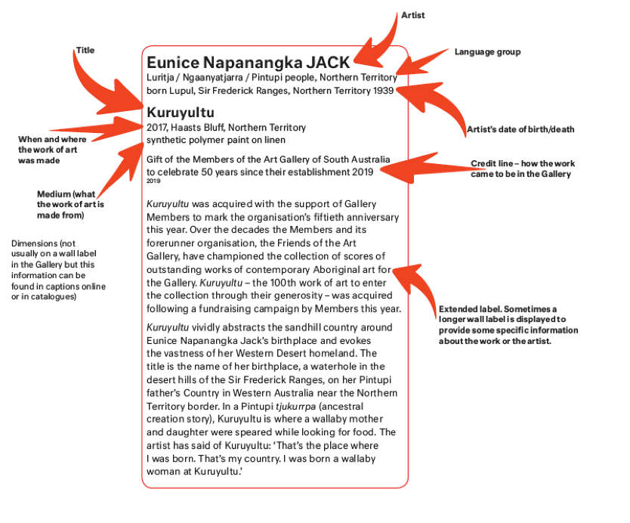
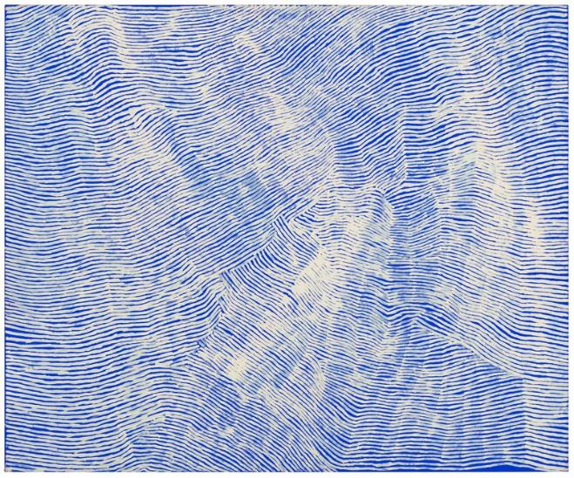
Years 5 and 6: Skills and processes
Reading a wall label
While we prioritise long looking at artworks, a wall label can provide you with some valuable information about an artist, where they are from and where and when the artwork was made. This information can be ‘drip fed’ into discussion or used to add further context back in your classrooms. For example, you may locate the artist’s language group on a map of Australia or investigate what else was happening in Australia when the artwork was made.
Eunice Napanangka Jack, Luritja/Ngaanyatjarra/Pintupi people, Northern Territory, born 1939, Lupul, Sir Frederick Range, Northern Territory, Kuruyultu, 2017, Haasts Bluff, Northern Territory, synthetic polymer paint on linen, 152.0 x 183.0 cm; Gift of the Members of the Art Gallery of South Australia to celebrate 50 years since their establishment 2019, Art Gallery of South Australia, Adelaide, © Eunice Napanangka Jack/Copyright Agency.

Slide 21

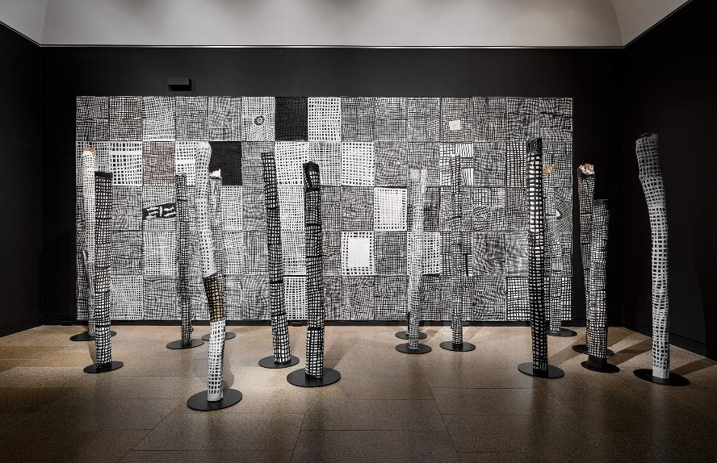
Developing understanding of practice
Suggested approaches: AGSA Themed Elaborations F – 2
During your visit to AGSA make a list of the different materials artworks are made from. What was the most unusual material you discovered? Share these observations with your class.
Create a that illustrates a special memory in your life. Re-create this image using three different materials (e.g. drawing, watercolour painting, Styrofoam print onto paper, collage or a clay). Compare the qualities and properties of the material. Which best illustrates your story and why?
installation view: Tarnanthi 2019 featuring Djapu by Noŋgirrŋa Marawili, Art Gallery of South Australia, Adelaide; photo: Saul Steed

Slide 22
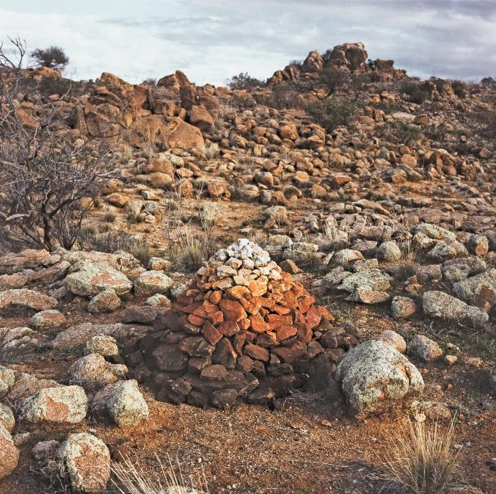
Developing understanding of practice
Suggested approaches: AGSA Themed Elaborations Years 3 and 4
Locate artworks in the Gallery which are made from natural materials. Look closely at how the work was made. Record these observations along with the processes and techniques the artist may have used. Create a made from natural materials with consideration of at least 2 visual conventions (line, pattern, shape, colour, texture, space, contrast, balance etc).
Transform a piece of string into a drawing tool – for example, tie knots, attach other pieces of string or fray the ends. Dip your tool into ink and move your string over a sheet of paper. How do your marks differ from those made by others in your class?
Did you know there is a work by Andy Goldsworthy Sculptor of Slate (made in 1992) in the Adelaide Botanic Garden?
Andy Goldsworthy, Britain, born 1956, Cairn to follow colours in rock for the day, 1991, Mount Victor Station, South Australia, direct positive colour photograph, 76.0 x 76.0 cm (image), 105.0 x 102.5 cm; South Australian Government Grant 1992, Art Gallery of South Australia, Adelaide.

Slide 23
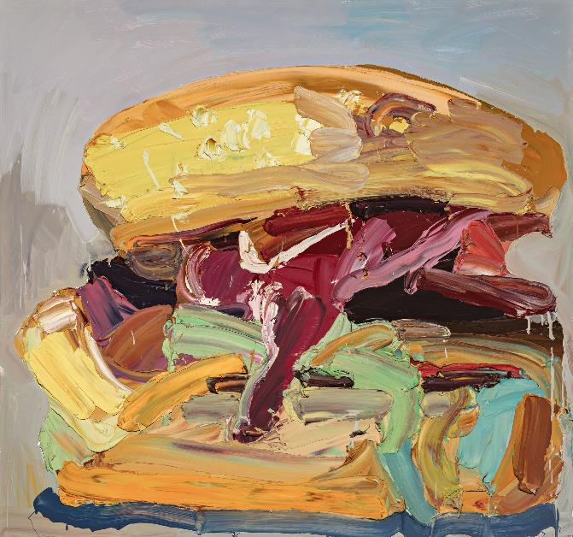
Developing understanding of practice
Suggested approaches: AGSA Themed Elaborations Years 5 and 6
Drawing can sometimes be performative, so let’s loosen up. Using charcoal make a mark like a grandmother, a baby, a gorilla or a mouse.
Cover a sheet of paper with charcoal. Use an eraser as your drawing tool to create a portrait of the person opposite you.
Draw an object as if your hand is on fire. Draw the same object as if you have a weight tied to your wrist.
Tear a sheet of coloured paper into random fragments. Drop these pieces from a height onto a new sheet of white paper. Glue the fragments to the paper. What can you see? Draw on and around your fragments to transform this collage into an imaginary scene.
Investigate other artists who have used non-traditional tools or methods to create their work. Create a self-portrait using tools only found in a kitchen. Tip: James Dodd and Cameron Robbins.
Our 10 Ways of Thinking Through Drawing is a great resource to get your students developing an understanding of an artists’ practice.
Available to download online – see past exhibitions.
Did you know Ben Quilty has been known to use cake decorating tools in the application of paint?
Ben Quilty, Australia, born 1973, The lot, 2006, Southern Highlands, New South Wales, oil on canvas, 150.0 x 160.0 cm; Gift of Ben Quilty through the Art Gallery of South Australia Contemporary Collectors 2016. Donated through the Australian Government's Cultural Gifts Program, Art Gallery of South Australia, Adelaide, Courtesy the artist.

Slide 24

Sharing artworks through performance, presentation or display
Suggested approaches: AGSA Themed Elaborations F- 6
How have artworks been presented in the Gallery? In small groups list some of the different ways the curator has arranged artworks, on the wall, on the floor or in an entire room.
During your visit to the Gallery select 5 artworks to present as a hypothetical exhibition.
Create an online platform for presenting student artworks. Consider online safety and discuss with students the benefits and limitations of presenting artworks online. Students could curate their own page or theme and exhibition developed from artworks created throughout the year.
Viewpoints expression – physical, psychological, sensory and intuitive contexts – recognising artists and artworks who work in cross-media and those who install their artworks in various locations. Refer to artists and audiences from different cultures, particularly Aboriginal and Torres Strait Islander Peoples, and from Asia
Skills expressive – interpreting subject matter through various contexts and/or viewpoints to enhance understanding and create a personal response to stimuli conceptual – developing a thought or idea into a visual representation practical – using visual arts materials, equipment and instruments
Visual Conventions identifying, using and interpreting a selection of design elements and design principles
Processes conceiving, selecting, refining, predicting, testing, evaluating, comparing, analysing, identifying, evaluating, judging and displaying

Slide 25
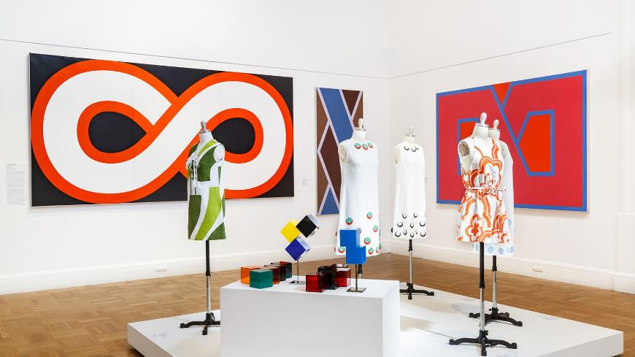
Sharing artworks through performance, presentation or display
Suggested approaches: AGSA Themed Elaborations F– 2
During your visit to the Gallery identify artworks which share common themes. Brainstorm some themes for your works which could be displayed as a class exhibition. Who is your audience? For example is your work about the place where you live – who else in your community might be interested in seeing the artworks?
Make a list of the different ways artworks have been displayed at the Gallery. What might be some of the reasons artworks are displayed differently. How does the display change the way you view or interpret the work? Back in the classroom create an exhibition considering the display techniques you have learnt during your visit to the Gallery. How could you create your own frames or plinths? How might you group certain works together?
Installation view Adelaide cool, Art Gallery of South Australia, Adelaide, 2019; photo; Saul Steed.

Slide 26
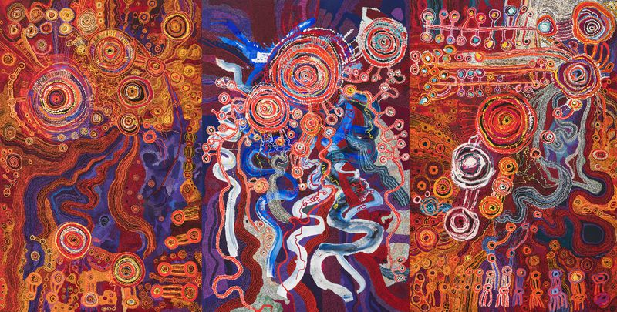
Sharing artworks through performance, presentation or display
Suggested approaches: AGSA Themed Elaborations Years 3 and 4
Look at artworks which have been been created collaboratively, such as the Ken family’s Kangkura-KangkuraKu Tjukurpa - A Sister's Story 2017. What would be the challenges in creating a collaborative piece such as this? What planning and negotiations would be required? Create a collaborative to be displayed in your school. The could be temporary, permanent or even hypothetical. As a class, consider the audience, location, theme, intention and visual conventions you will include in the piece.
Yaritji Young, Pitjantjatjara people, South Australia, born 1956, out bush near the creek Pukatja (Ernabella), South Australia, Maringka Tunkin, Pitjantjatjara people, South Australia, born 1959, Mulga Park, Northern Territory, Paniny Mick, Pitjantjatjara people, South Australia, born 1939, Rocket Bore, South Australia, Tjungkara Ken, Pitjantjatjara people, South Australia, born 1969, Amata Community, South Australia, Sandra Ken, Pitjantjatjara people, South Australia, born 1968, Amata Community, South Australia, Freda Brady, Pitjantjatjara people, South Australia, born 1961, Amata Community, South Australia, Kangkura-KangkuraKu Tjukurpa - A Sister's Story, 2017, Amata, South Australia, synthetic polymer paint on linen, 3 panels, 300.0 x 200.0 cm (each); Acquisition through TARNANTHI: Festival of Contemporary Aboriginal & Torres Strait Islander Art supported by BHP 2018, Art Gallery of South Australia, Adelaide, © Ken Family Collaborative/Copyright Agency.

Slide 27
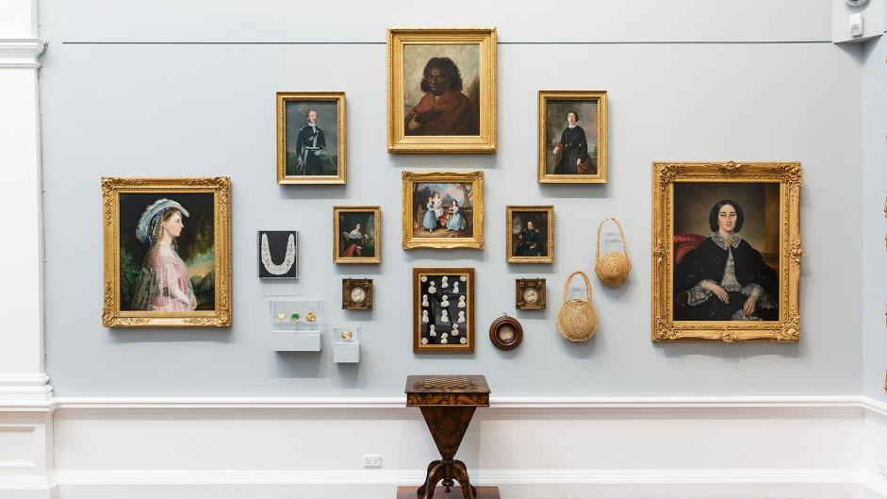
Years 5 and 6: Viewpoints, skills and processes
Spend time in one space in the Gallery. How have artworks been presented in this room? In small groups list some of the different ways the curator has arranged artworks on a particular wall or display cabinet, on the floor or as an entire room.
What are some of the themes you notice? Why have some works been grouped together?
Locate two artworks that are placed near each other. Why do you think the curator chose to do this? What similarities do they share?
Back in the classroom create a class exhibition asking students to consider the display techniques they learn about during their gallery visit. How can they create their own frames, plinths and pair or group works together to enhance their artworks?
Installation view: Elder Wing of Australian Art Gallery 2, Art Gallery of South Australia, Adelaide; photo: Saul Steed

Slide 28
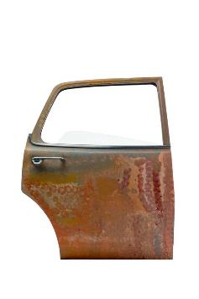
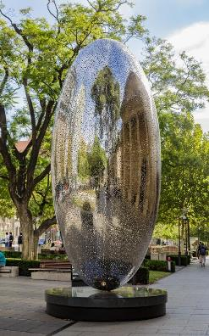
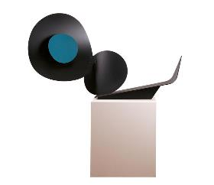
Years 5 and 6: Viewpoints, skills and processes Time to put on your curator hat!
During your visit to the Gallery select 5 artworks to present as a hypothetical exhibition. You might like to curate an exhibition based on a colour, a texture, your favourite things, pattern, women, light and shadow or humour. Photograph your selections. The possibilities are endless!
Present your hypothetical exhibition to your class and assign a soundtrack to each or to the display as a whole. Discuss your curatorial choices. See below for an example:
What is a curator? Curators oversee collections by managing the acquisition, preservation and display of objects.
Exhibition title: Tough Stuff
These works were selected because each includes a strong and durable material.
We hope we have piqued your interest - to find out more about these artworks see the next few slides.

Slide 29

Lindy Lee, Life of Stars, 2017
Born in Brisbane, artist Lindy Lee uses a variety of mediums including painting, sculpture and installation to address themes of identity and belonging. From her photocopy works of the early 1980s to her portraits of the 1990s, Lee has explored her complex family history relating to her Chinese-Australian heritage. Over the past 10 years, Lee has shifted away from figurative work and moved towards a more abstract approach, reflecting her long-standing engagement with Buddhism.
Situated at the entrance of the Art Gallery of South Australia, Lindy Lee’s six-metre sculpture The Life of Stars links the Art Gallery of South Australia and its exterior forecourt. Fabricated by Lee in China, the work displays a densely perforated surface and creates dappled light, which together suggest a universe within, while its oval form suggests the beginnings of life itself. Visible by day and night, The Life of Stars appears both to contain and radiate light. This delicate play between interior and exterior, form and emptiness is significant. The concentric circles on the surface reference Indra’s net, which is a metaphor of Mahayana Buddhism, symbolising the universe as a vast web of connections.
Installation view: Lindy Lee, The Life of Stars, 2017, Art Gallery of South Australia, Adelaide.

Slide 30
Auguste Rodin, The Three Shades
Auguste Rodin (1840-1917) is one of the masters of modern art. The French sculptor revolutionised the way we look at, and think about, the human body. Originally positioned at the very top of his major monument The Gates of Hell, this sculptural group titled The Three Shades demonstrates Rodin’s fondness for repurposing existing artworks, as well as his affinity for repetition and fragmentation. This bronze sculpture is comprised of three identical casts of an earlier statue of Adam, which was influenced by Michelangelo’s fresco The Creation of Adam in Rome’s Sistine Chapel.
Rodin was also inspired by the written work of the late-medieval poet Dante and his celebrated Inferno, wherein he describes the shades as departed souls who dance in a circle in Hades, or hell. Their necks are exaggerated, and their torsos twisted - formal manipulations that speak to the nature of their hellish predicament. Together, they exhibit a powerful force, with their bodies radiating out from the spot where their left hands meet, an effect borrowed from Dante, who wrote: ‘the three of them joined up to make a wheel’.
For more information see our the education resource Versus Rodin
Auguste Rodin, France, 1840 - 1917, The three shades, 1881-83 (G.Rudier Foundry, cast 1973), Paris, bronze, 98.0 x 92.0 x 45.0 cm; William Bowmore AO OBE Collection. Gift of the South Australian Government, assisted by the Art Gallery of South Australia Foundation 1996, Art Gallery of South Australia, Adelaide.

Slide 31

Inge King, Blue and yellow
Inge King (1915–2016) was a leading Australian sculptor. Born in Berlin, King migrated to Melbourne, Australia in 1951 after studying in London and New York, where she was influenced by other abstract artists such as Alexander Calder, Henry Moore and Mark Rothko as well as Australian artist Robert Klippel. King began making sculptural artworks from wood and stone.
Early in her career she made jewellery as a means to generate an income. However, after purchasing a welder in 1959 she taught herself how to weld and began creating artworks from steel and aluminium. Although her initial sculptures were rough and textural, King soon simplified her forms and refined her surfaces. As well as exhibiting regularly, King produced numerous public commissions in Australia, including Forward Surge (1974) at Melbourne’s Victorian Arts Centre, Sentinel (2000) on the Eastern Freeway in Melbourne and Rings of Saturn (2006) at Heide Museum of Modern Art, in Victoria.
For more information see our the education resource on Inge King
Inge King, Australia, 1915 - 2016, Blue and yellow, 1985, Melbourne, polychrome steel, aluminium, 35.0 x 60.0 x 18.0 cm; South Australian Government Grant 1997, Art Gallery of South Australia, Adelaide, © Estate of Inge King.

Slide 32
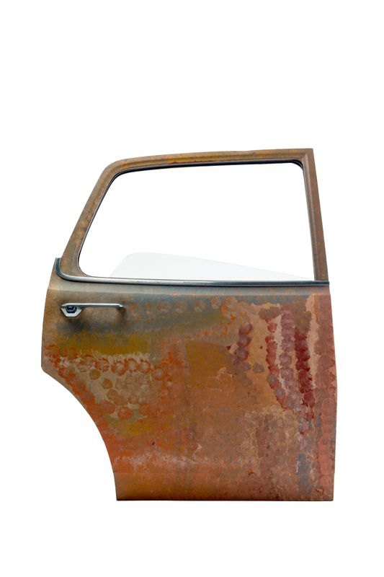
Emily Kame Kngwarreye, Untitled
Emily Kame Kngwarreye (1910–1996) was born at Alhalkere (Alalgura), on the edge of the Utopia pastoral station, about 250 kilometres northeast of Alice Springs. She lived most of her life in Alhalkere, her father’s country, which extends from Utopia, northwest through neighbouring Mount Skinner station. Alhalkere is also the name of the creation ancestor who stands as a large monolith there. Her mother’s country was Alhalpere (Aharlper), just to the east.
Along with many women from Utopia, Emily Kame Kngwarreye learnt batik, tie-dye, sewing and woodblock printing from 1977 onwards. She worked in batik for more than a decade until, well into her seventies, she painted her first work in acrylic on canvas in 1988–89. Her natural style and flair flourished in this newly found medium. Her first solo show followed soon after, in Sydney in 1990.
The subjects of her paintings include bush foods such as wild yam (kame means yam seed and is her principal Dreaming), bush potato, ntange (grass seed) and merne (food), awelye (body paint designs, ceremonies) and emu stories. Over the years her style shifted, from an early use of dotting, which increasingly veiled awelye or other designs (c.1989–91), to looser dotting (c.1992– 95), to brush strokes in minimal striped body painting designs (c.1994–95), or swirling wild yam and potato designs (c.1995–96).
Nici Cumpston and Barry Patton
For more information see our publication Aboriginal and Torres Strait Islander Art in the Classroom.
Emily Kame Kngwarreye, Anmatyerre people, Northern Territory, born 1910, Alhalkere (Alalgura) soakage, Northern Territory, died 1996, Alice Springs, Northern Territory, Untitled, 1992, Alalgura, Utopia, Northern Territory, synthetic polymer paint on metal (car door), glass, 110.0 x 84.0 cm (irreg); Gift of Hon. Diana Laidlaw MLC 1995, Art Gallery of South Australia, Adelaide, © Estate of Emily Kame Kngwarreye/Copyright Agency.

Slide 33
Robert Klippel, Metal Sculpture
Artist Robert Klippel was born in Sydney in 1920 where he lived in Potts Point overlooking Sydney Harbour. As a child he was interested in ships and made his first model ship at the age of 6. Klippel became a sailor and served in the Australian Navy during the Second World War.
After leaving the Navy Klippel studied sculpture at Sydney Technical College exploring the human form using a clay, wood and metal. He produced hundreds of sculptures, drawings and collages throughout his career. Klippel was interested in the union between organic and machine forms, drawing on the machine for its shapes, form and function. His use of hard industrial materials to communicate ideas about growth is evident in Metal Sculpture as the organic form is released from the geometric cage located at the base.
Robert Edward Klippel, Australia, 1920 - 2001, Metal sculpture, c.1974, Sydney, welded steel construction and found objects, 122.5 x 63.0 cm; South Australian Government Grant 1974, Art Gallery of South Australia, Adelaide, © Estate of Robert Edward Klippel/Copyright Agency.

Slide 34

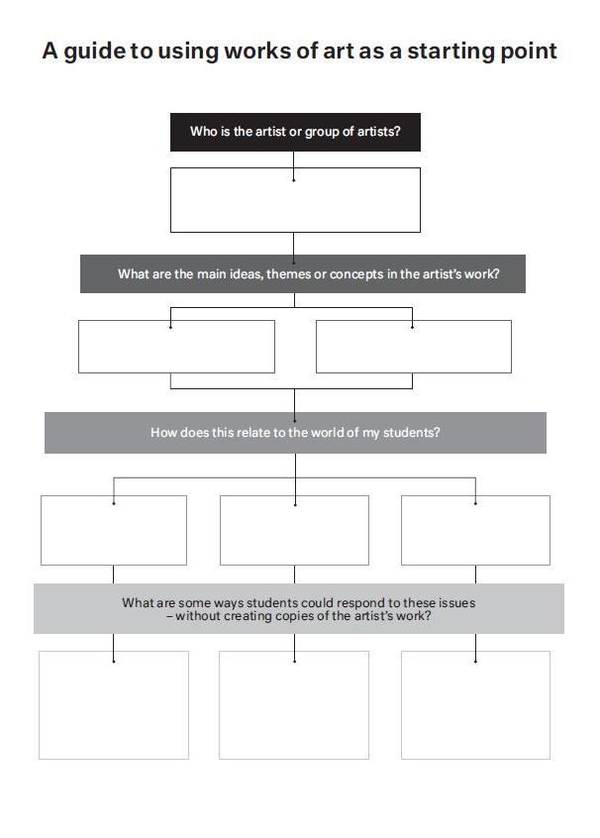
Responding to and interpreting artworks
‘A guide to using artists as a starting point’ flow chart will support you in making suitable decisions as you rationalise a unit work prompting you to check the ‘what’, ‘how’ and ‘why’ of your teaching practice.
Students creating replicas of artists’ work is not best practice, nor is it appropriate. The arts has the capacity to personalise learning where other subjects do not. Take advantage of this opportunity for your students to learn about artists and their intentions, but to respond in their own way.
Our wide range of interpretive resources provide you with a variety of ways to respond to artworks, including prompts for considering the artist’s intentions and comparing artworks from different social, cultural and historical artworks. The Gallery’s Curiosity Cards are also a great tool to have students practicing their critical thinking skills whilst responding to and interpreting artworks.
Examples of the completed flowcharts can be found on our website
Interpretive resources also available online include:
Teacher Tools
Themed resources (Mathematics, Design, Science and Contemporary Art)
Aboriginal and Torres Strait Islander Art
Australian Art
Past Exhibitions

Slide 35
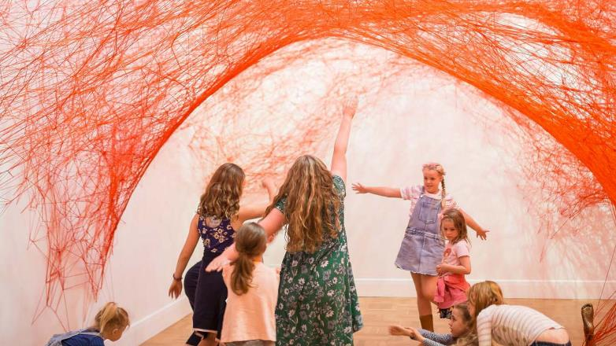
Programs for Early Years and Primary
Dancing in the Gallery Our program Dancing in the Gallery is a great way to incorporate multiple arts learning areas into a visit to the Gallery. Students will respond to artworks through the medium of dance, manipulating movement to create meaning individually and in collaboration with their peers.
Play: Sound and Colour Students will experiment with materials and explore visual conventions in this hands-on workshop. With an emphasis on process, students will work independently and collaboratively to create ephemeral compositions and soundscapes in response to a variety of artworks on display.
Writing in the Gallery Using artworks as a prompt, students will be led through a series of writing exercises designed to delve into their imagination and extend their critical thinking skills.
My Portrait My Story This learner-centred portrait workshop provides an opportunity to embrace curiosity, share ideas and make connections. Children will discover artworks, observe independently and examine self-portraiture as a form of artistic expression.
Teacher Resources
photo: Nat Rogers
AGSA online interpretive resources
AGSA for educators AGSA online collection
Sound Cloud – AGSA Account
Australian Curriculum: The Arts

